Slide 1
Indus River Valley

Slide 2
Geography of the Indian Subcontinent
Mountains:
Located in the north
3 major Ranges: Hindu Kush, Karakorum, Himalayan
Deserts and Plateaus:
Located in the South
Thar Desert, Deccan Plateau
Rivers:
Ganges, Indus, and Brahmaputra
Modern Day Countries:
Pakistan, India, Nepal, Bhutan, and Bangladesh

Slide 3
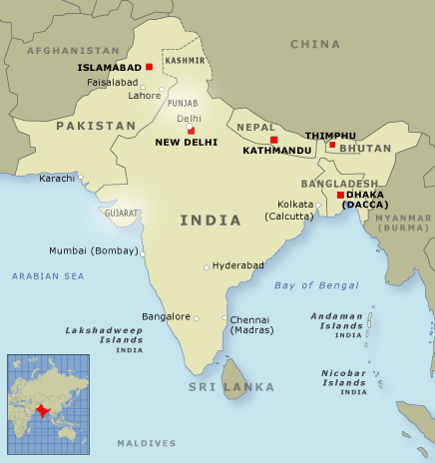
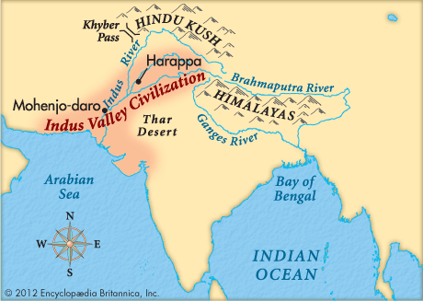

Slide 4
Seasonal Monsoons
Monsoon:
Seasonal winds that control wet and dry seasons
Causes rivers to flood and deposit rich soil in the plains area

Slide 5
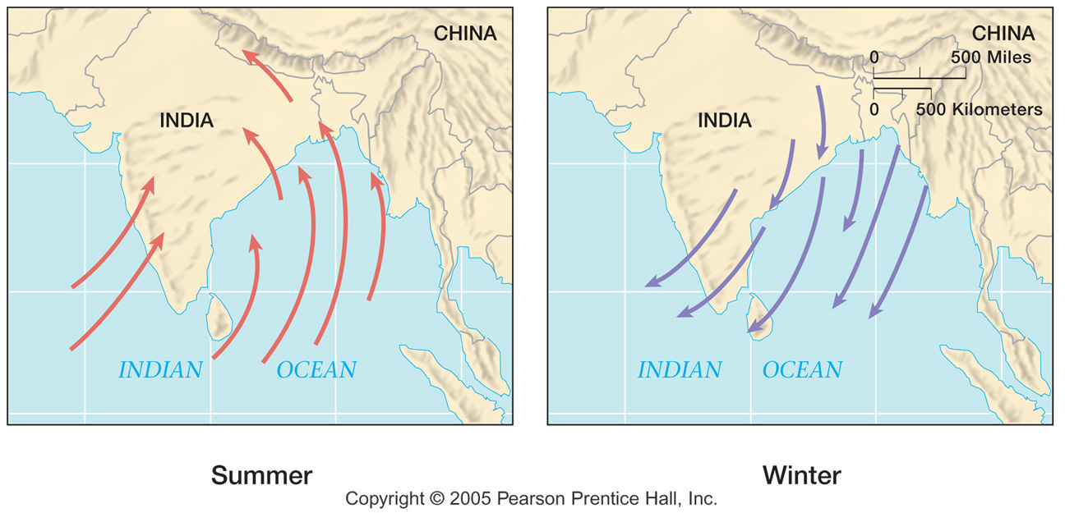
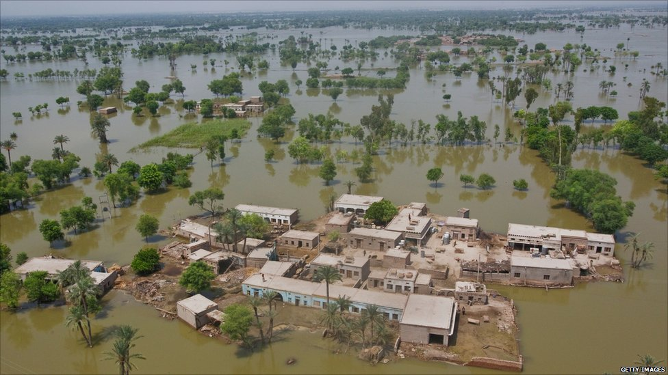

Slide 6
First Civilizations Along the Indus
Little is known about the first civilizations
Two Possible Groups first settled the area
1. From the sea to the south
2. Over land from the north via the Hindu Kush

Slide 8
Traits of the Civilization
Civilization influenced an area greater than that Mesopotamia
1,500 settlements found
Writing System:
Common throughout the civilization
Has not been deciphered
400-450 signs- too large to be an alphabet
No written documents
Trade:
Large trade network
Traded with Mesopotamians
Seal found in Ur
Social Stratification
Specialized occupations
Religion is unknown

Slide 9
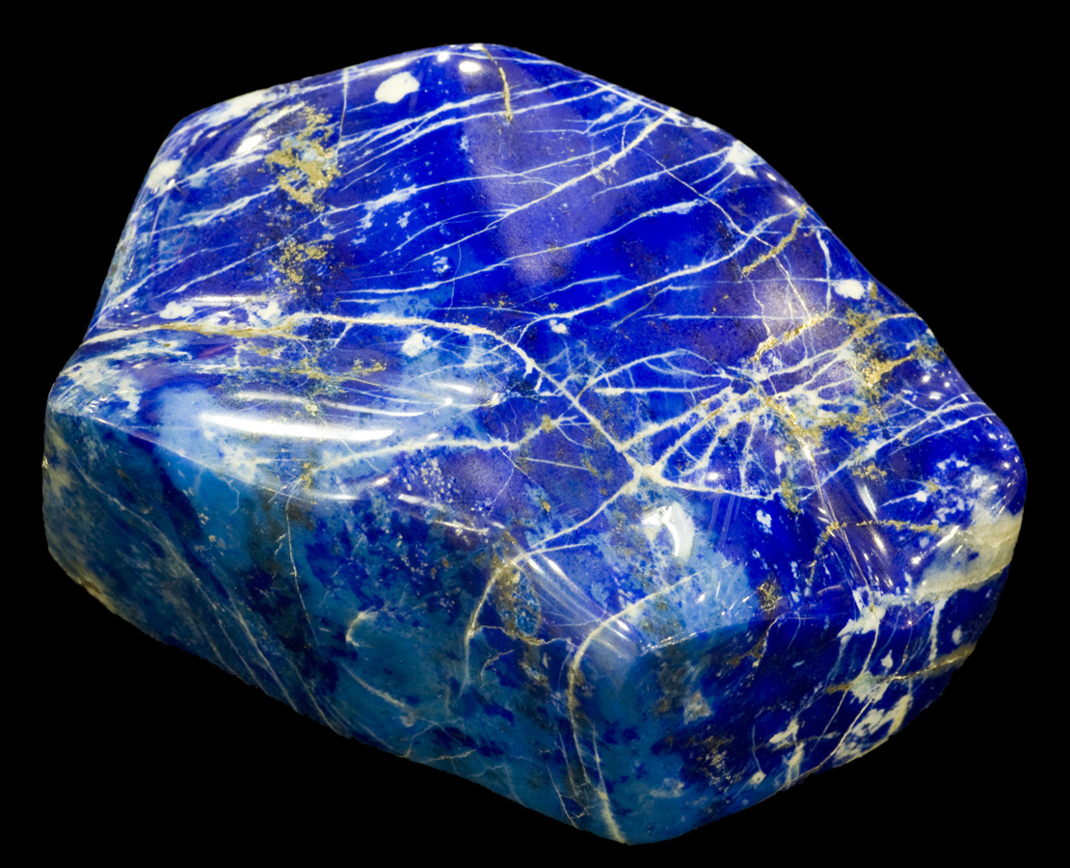
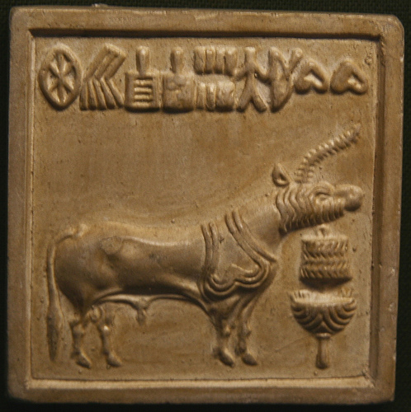

Slide 10
Major Cities
Harappa
Planned city
Streets were laid out on a grid
Sewage system
23,000 residents
Mohenjo Daro
Was at its height by 2000 BCE
40,000-80,000 residents
Planned City
Bathrooms and private wells
Sewage system
Social Stratification:
Large houses (2-3 stories)= rich
Standardized 2 room houses= poor

Slide 11
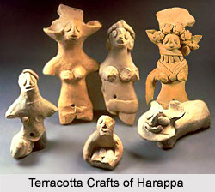
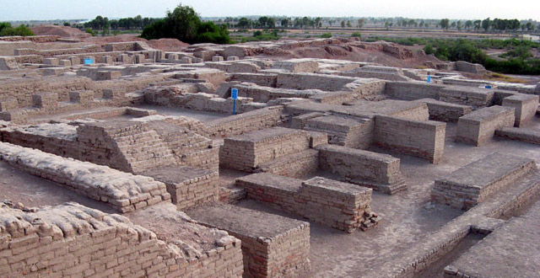
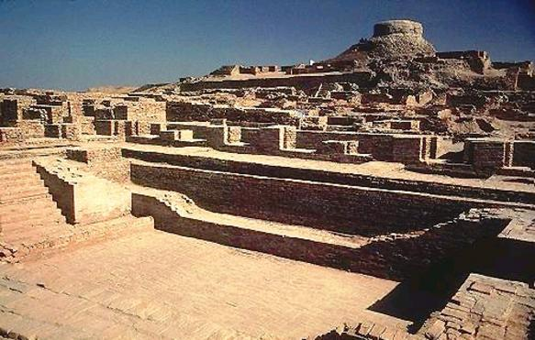
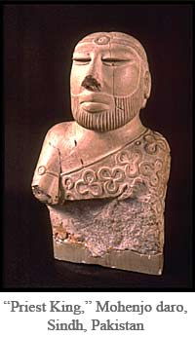

Slide 12
Decline
By 1900 BCE cities are smaller
New types of pottery appear
Writing system continues
Likely due to a shift in the river and outside influences

