Slide 1
Europe in the Middle Ages

Slide 2
Eastern Europe

Slide 3
The Byzantine Empire: Origins
Former Eastern Roman Empire
Constantine (4th Century CE)- Founder of the empire
Converted to Christianity in the early 300s
Issued edict of Milan in 313 (stops the persecution of the Christirians)
Constantinople was its capital
Greek was the official language
Traded with the east via the Silk Road
Flourished for centuries and withstood many attacks

Slide 4
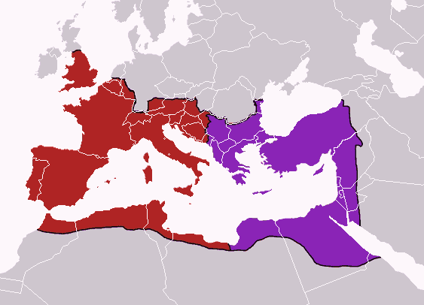

Slide 5
Byzantine Empire Under Justinian (527-565)
Justinian Emperor founder of the fourth dynasty in Byzantine history
Tried to restore Roman Empire
Hagia Sophia – Orthodox Church
Justinian’s Code
Unified law based on Roman legal principles
Faced attacks from Slavs & Persians

Slide 6
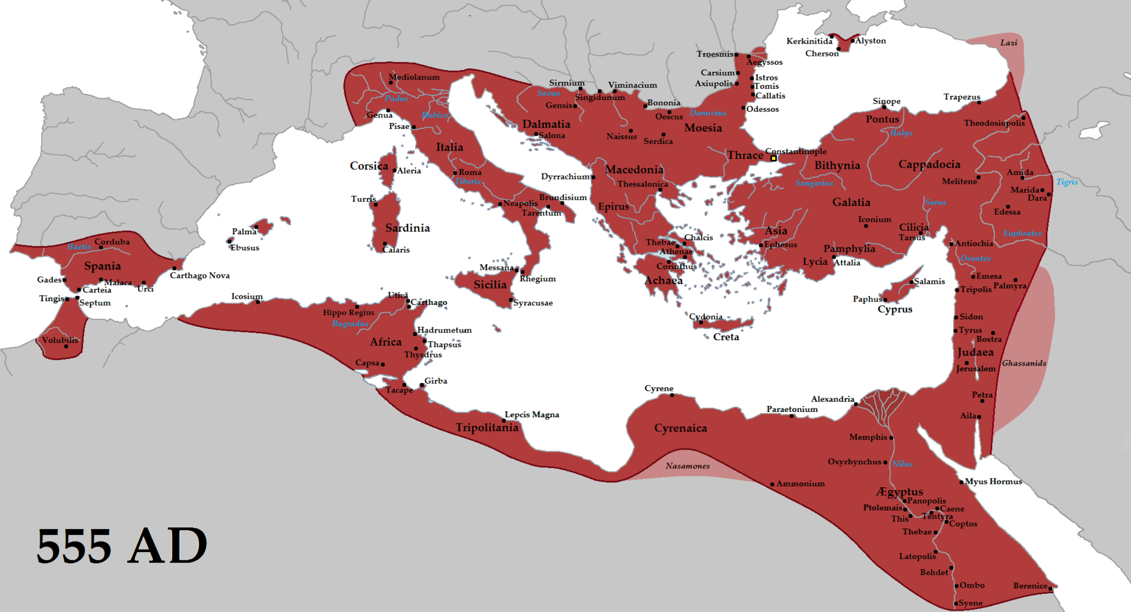
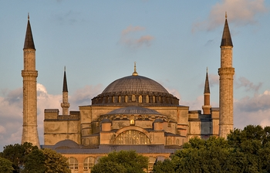
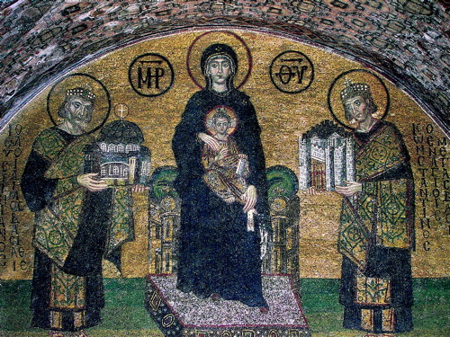
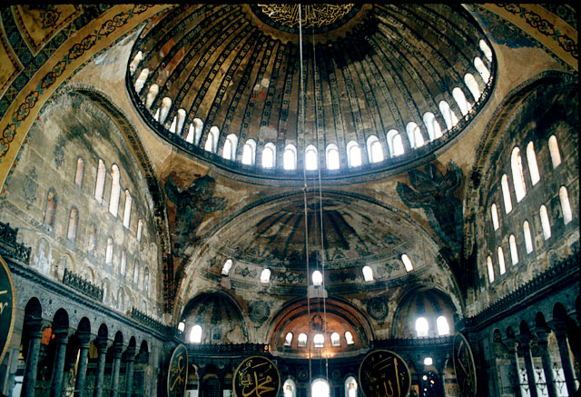
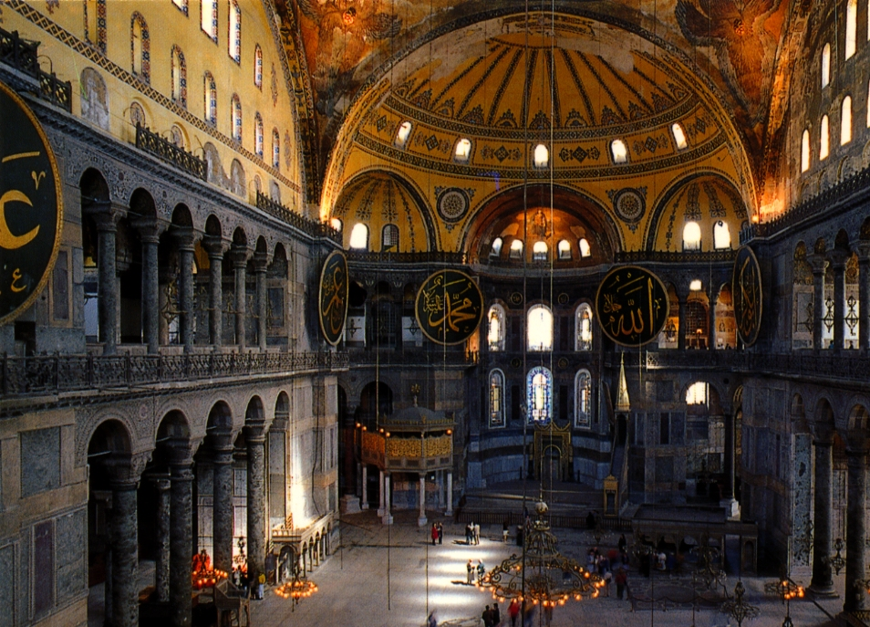

Slide 7
Byzantine Society and Politics
Role of the Emperor
Ordained by god
Head of Church
Passed religious & secular laws
Some women held throne
Theodora & Zoe
Sophisticated bureaucracy
Open to all classes
Bureaucracy controlled trade & food prices
Trade with Russia, Asia, Scandinavia, Europe, & Africa
Specialized in luxury goods
Byzantine Empire resembled China in many aspects

Slide 8
The Great Schism
Split between Eastern & Western Christianity
Disagreement over papal authority
Differences:
West = priest chaste (couldn’t have sex), spoke Latin
Eastern = priests could marry, spoke Greek
Patriarch Michael (head of the Eastern Church) and his followers were excommunicated by the Pope (Pope Leo IX)
Responded by doing the same to Roman Catholics

Slide 9
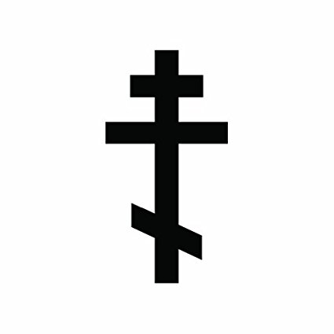
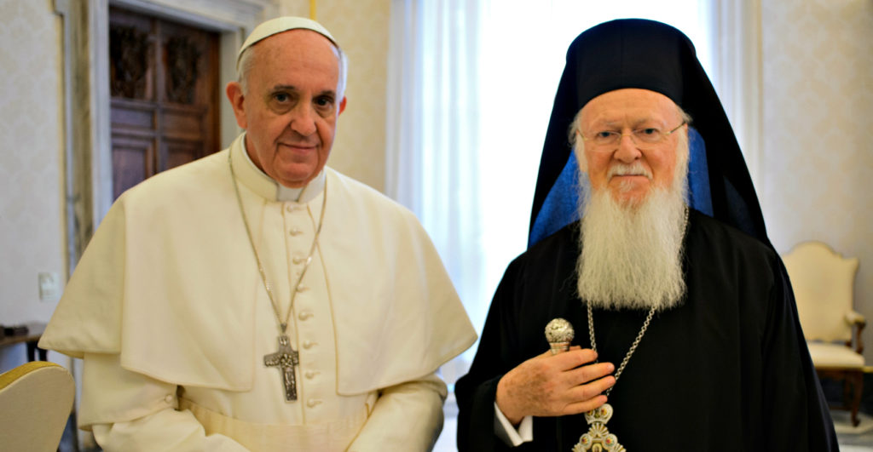
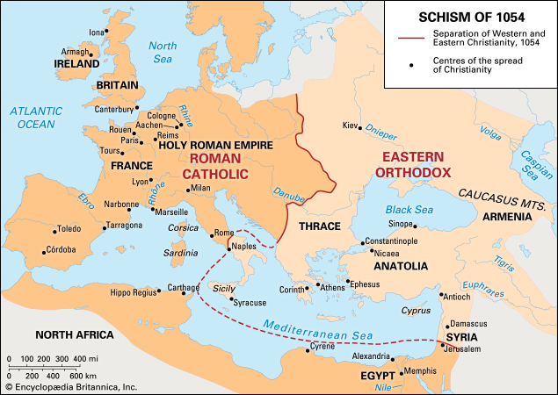

Slide 10
The Empires Decline and Fall
Withstood many attacks from the Arab (Islamic) word beginning in the 7th century
Began to decline in the 11th century
Lost Battle of Manzikert to Seljuk Turks and the empire never recovered
Take most of Byzantine Asian provinces
Turkish settlements & Slavic kingdoms
Appeal to Western Europe to bring the Crusades
Venetian crusaders conquer Constantinople
Empire falls in 1453 when they were conquered by the Ottomans

Slide 11
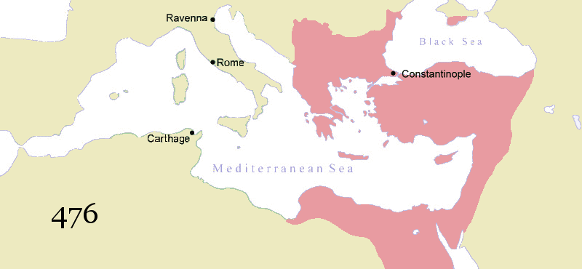

Slide 12
Western Europe

Slide 13
The Church: Political and Spiritual Power
Popes follow Roman organization
Monasticism
Benedict of Nursia
Benedictine rule- promoted Christian unity
Spiritual functions- Holiness, Network, Pilgrimage centers
Secular functions- Education, Large estates, Shelter travelers
Universities- form in the 13th century

Slide 14
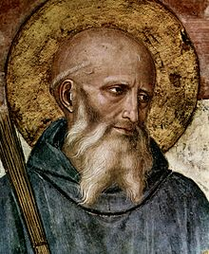

Slide 15
Charlemagne and His Successors
Frankish Carolingian dynasty
Charles Martel
732- Battle of Tours
Charles the Great (Charlemagne)
800- crowned emperor by the Pope
Copied Roman central administration
814- dies
Empire fragments
843- Treaty of Verdun
Three kingdoms
Holy Roman Empire
962-1806
Rules Germany and most of northern Italy
Most dominate state in western Europe in the middle ages

Slide 16
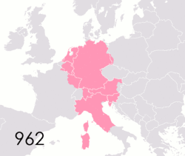
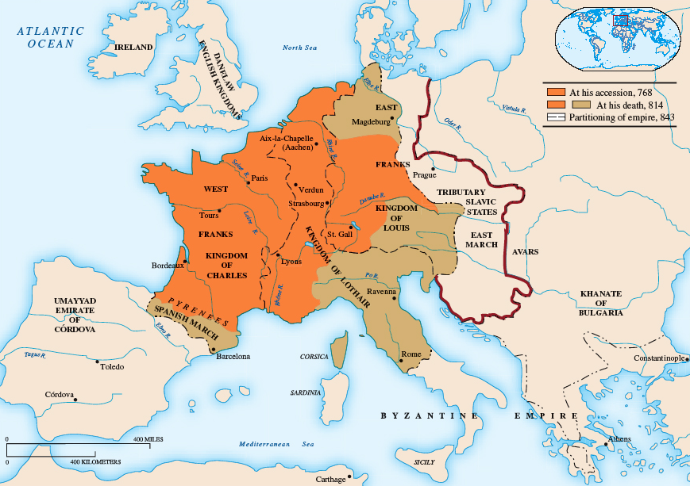
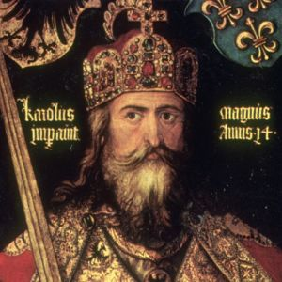
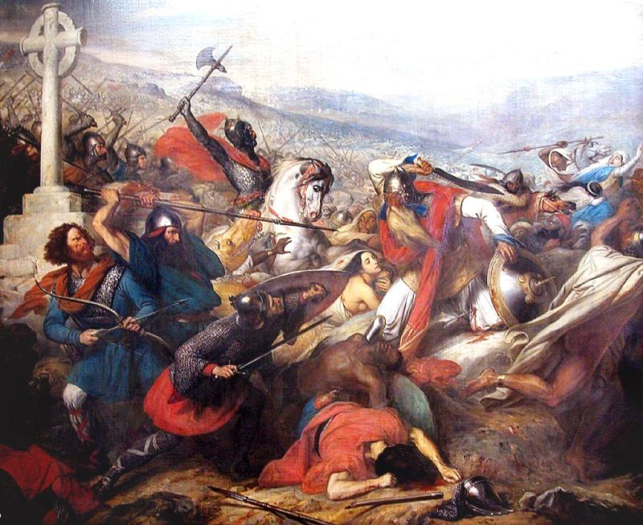

Slide 17
Feudal Monarchies and Political Advances
Personal relationship between lord and vassal was stressed
Military service for land
Some lords emerge more powerful
Develop bureaucracies, states
William the Conqueror (from Normandy)
1066- Norman conquest of England
Introduces centralized government to England
Established sheriffs and courts

Slide 18
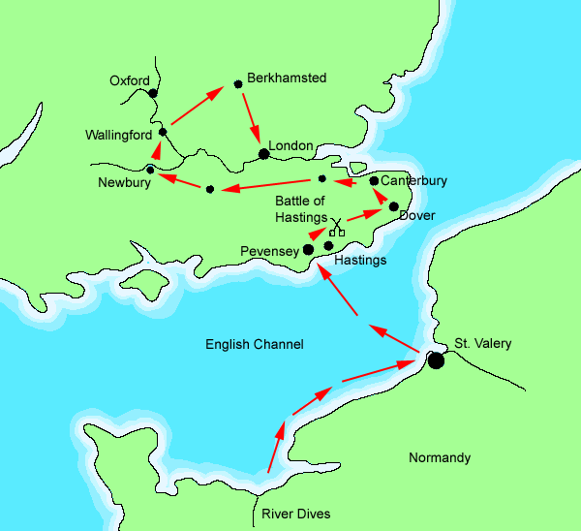
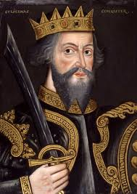

Slide 19
New Economic Vigor and Urban Development
Agriculture:
Three-field system- a third of the farm land is left un planted to regain fertility.
Towns grow
Education
Literacy expands
Cathedral schools- form in the 11th century
Universities- form in the 13th century

Slide 20
Limited Government
1215- Magna Carta (England)
King John recognizes supremacy of written law
Representative bodies
Catalonia (Spain) form 1000
England- 1265
Parliament- two houses : house of lords and house of commons
Monarchs continue to increase in power
Large conflicts
Hundred Years War
England vs France claims to the throne of France

Slide 21
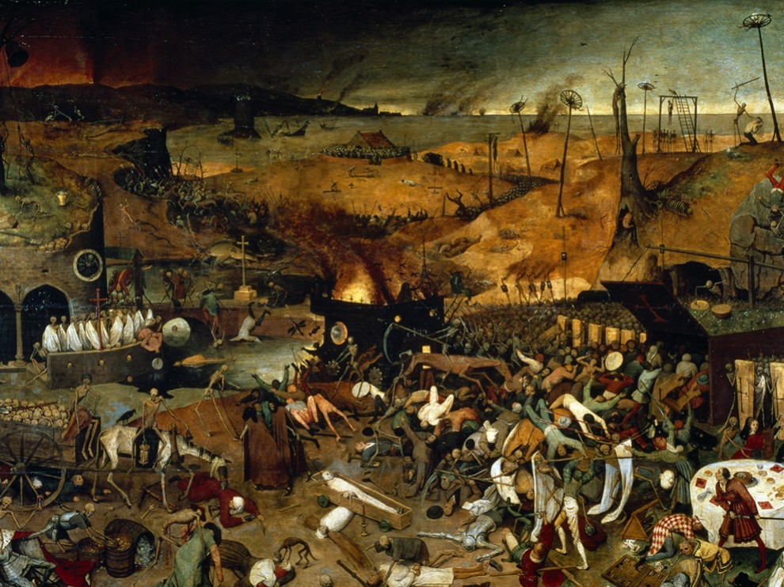

Slide 22
The Plague
Originated in Central Asia
Arrived in the Italian ports first (southern Europe)
Carried by the Oriental Rat Flea carried by rats
Has a religious, economic, and social impact on European history
Carried east and west along the Silk Road by traders and Mongol Armies
1340s- disease had struck China, India, and Persia
Many felt that the diseases was a punishment from God
Caused religious fanaticism to increase

Slide 24
3 Types
Pneumonic
Attacked the Lungs
Caused fierce coughing & sneezing fits
Chest pain, Bloody sputum
Septicemic
Rarest and Deadliest
Traveled thru bloodstream
Black spots beneath skin
Victims choked on own blood, Excruciating Pain!
Bubonic
Most Common
Egg-sized swellings (buboes)
Neck, armpits, groin (dark blisters)
Headaches, Weakness, Nausea/Vomiting
Severe Fever and Delirium

Slide 25
Results of the Plague
People persecuted heretics to try to please god.
Jews, Friars, Foreigners, Pilgrims, Beggars, Lepers
Between 75 and 200 million people died in Europe and Asia
Estimated that between 25%-60% of Europe’s total population was killed
The loss of life caused labor shortages throughout Europe
Caused the end to the feudal system in western Europe
By the 1350s the worst epidemic had run its course

