Slide 1
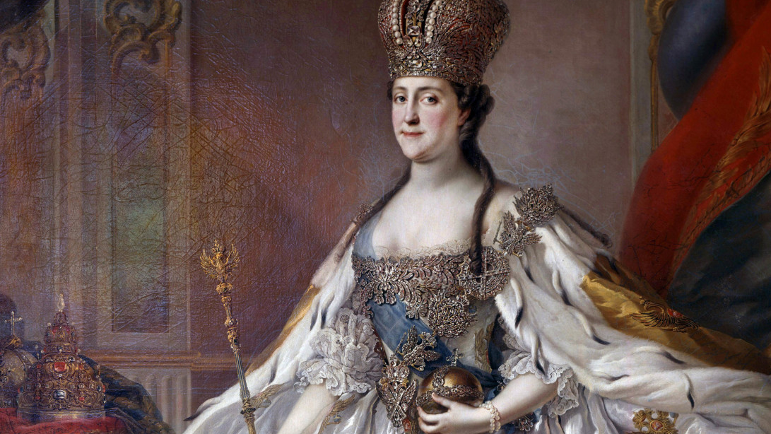
Enlightened Absolutism

Slide 2
Enlightened Absolutism (1740-1815)
In the 18th century, a number of states in eastern and central Europe experimented with enlightened absolutism
The philosophes inspired and supported the reforms of the Enlightened Despots.
They believed absolute rulers should promote the good of the people.
Yet they believed, like Thomas Hobbes earlier, that people were not capable of ruling themselves.
Reforms of the enlightened despots were modest. They provided
religious toleration
streamlined legal codes
increased access to education
reduction or elimination of torture and the death penalty

Slide 3
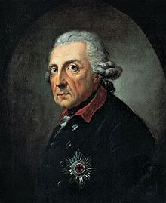
Frederick the Great (Frederick II) (r. 1740-1786)
Background
King of Prussia
One of the greatest rulers in German history
Son of Fredrick William I who gave him a strong military education
Profoundly influenced by the Enlightenment
He considered French learning to be superior.
He patronized Voltaire and invited him to live in his court in Berlin.
Musician and poet

Slide 4
Wars of Frederick the Great
The first 23 years of Frederick’s reign were dominated by warfare.
Balance of power diplomacy and war prevented him from dominating central and eastern Europe.
War of Austrian Succession (1740-48)
Cause: Frederick invaded and annexed Silesia, part of the Austrian Habsburg empire
Frederick violated Austria’s Pragmatic Sanction (1713) whereby the Great Powers recognized that Charles VII’s daughter, Maria Theresa, would inherit the entire Habsburg empire.

Slide 5
Prussia efficiently defeated Austria.
Treaty of Aix-la-Chapelle:
Prussia gained Silesia (and doubled Prussia’s population in the process).
Prussia was now recognized as the most powerful of all the German states and as one of Europe’s “Great Powers.”

Slide 6
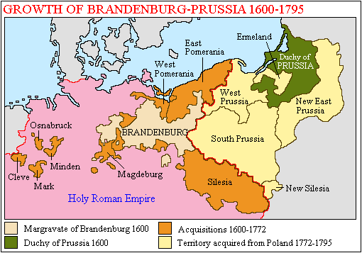

Slide 7
Seven Years’ War (1756-1763)
Cause: Maria Theresa sought to regain Silesia and gained Russia and France as allies.
Goal of Austria, Russia, and France was to conquer Prussia and divide its territories among the winners
“Diplomatic Revolution of 1756”
France and Austria, traditional enemies, were now allies
Britain, a traditional ally of Russia, supported Prussia with money

Slide 8
Bloodiest war in Europe since the Thirty Years’ War of the 17th century
It became a world war that also included England and France’s struggle for North America.
Prussia was outnumbered by its enemies 15 to 1.
Prussia suffered 180,000 dead and severe disruptions to its society.
Berlin was twice captured and partially destroyed by Russian troops.
Prussia was on the verge of a catastrophic defeat.

Slide 9
End to the War
Tsar Peter III (an admirer of Frederick)
pulled Russia out of the war in 1763
This saved Prussia from almost certain defeat.
Peter was assassinated and replaced by Catherine II as a result.
Treaty of Paris (1763)
Most important treaty of the 18th century
Prussia permanently retained Silesia.
France lost all of its North American colonies to Great Britain.
Britain gained territory in India.

Slide 10
Enlightened Reforms of Frederick
Frederick saw himself as the “first servant of the state.”
His reforms were mostly intended to increase the power of the state.
The peasantry did not really benefit from his reforms.
Allowed religious freedom (although less so for Jews).
Jews finally gained religious freedom in 1794, eight years after Frederick’s death.
Promoted education in schools and universities.
In reality, gains in primary education were very modest

Slide 11
Codified and streamlined laws.
laws throughout Prussia were simplified into aunified national code of law.
Judicial system became efficient in deciding cases quickly and impartially.
Freed serfs on crown lands in 1763.
Frederick’s motive: peasants were needed for the army.
Serfdom remained in full-force on noble estates
He improved the state bureaucracy by requiring examinations for civil servants.
Reduced censorship
He abolished capital punishment (but not in the army).
He encouraged immigration
He encouraged industrial and agricultural growth.

Slide 12
Social Structure
Serfdom on noble lands maintained
The “Junkers” (Prussian nobility) were the backbone of Prussia’s military and the state.
State did not recognize marriages between nobles and commoners.
Nobles were not allowed to sell their lands to non-nobles.
Middle-class found it extremely difficult to move up socially.
Civilian bureaucrats were not permitted to enter the nobility.
However, in the judicial system, 2/3 of judges were non-nobles

Slide 13
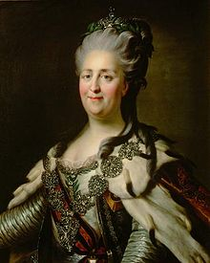
Catherine the Great (Catherine II) (r. 1762-1798)
Background
Empress of Russia
One of the greatest rulers in European history
She was perhaps the least “enlightened” of the enlightened despots.
German princess who became Queen after her husband, Peter III, was assassinated during the Seven Years’ War.
Lover of French culture (she refused to speak German or Russian); considered herself a child of the Enlightenment.

Slide 14
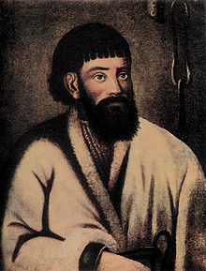
Pugachev Rebellion (1773)
Eugene Pugachev
a Cossack soldier, led a huge serf uprising.
He demanded end to serfdom, taxes and army service.
Landlords and officials were murdered all over southwestern Russia.
Pugachev was eventually captured and executed.

Slide 15
Catherine’s Reforms
Nobility
Serfdom spread to new areas (e.g. Ukraine)
1785, Catherine freed nobles from taxes and state service
Confiscated Orthodox Church lands and gave them to her favorite officials
Nobles reached their height while serfs were worse off
Western Reforms
Architects, artists, musicians and writers were invited to Russia.
Culturally, Russia gained the respect of western European countries.

Slide 16
Educational Reforms
supported the first private printing presses.
The number of books published annually in Russia increased
A school for noble girls founded
Religion
limited degree of religious toleration was allowed.
Catherine stopped gov’t policy of persecuting Old Believers
(ultra-conservative and dissident sect of the Orthodox Church).
Jews were granted civil equality.
Does not mean they are completely equal

Slide 17
Territorial Growth under Catherine
She annexed Polish territory under the 3 partitions with Prussia and Austria in 1772, 1793 and 1795.
Poland’s government of nobles was ineffective as the liberum veto required unanimous agreement for the gov’t to act.
Gained Ottoman land in the Crimea controlled by the Tartars.
Began conquest of the Caucasus region.
Expansion provided Catherine with new lands with which to give the nobility (to earn their loyalty).

Slide 18
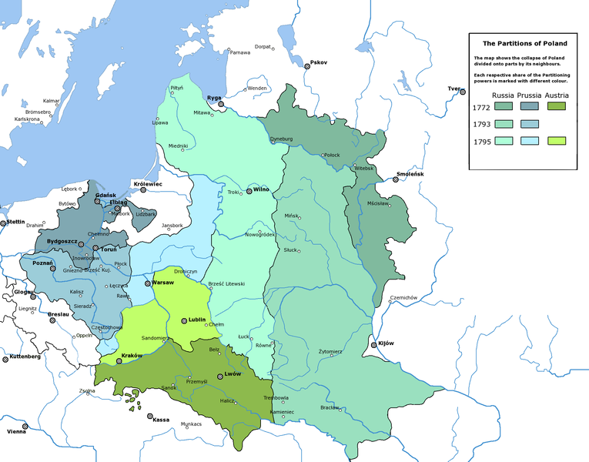

Slide 19
Austria: Maria Theresa (r. 1740-1780)
She assumed the Habsburg Empire from her father, Charles VII
Pragmatic Sanction of 1713: Issued by Leopold I and agreed to by the Great Powers that the Habsburg Empire would remain intact under his daughter’s rule
Officially, she was Archduchess of Austria and Queen of Hungary and Bohemia.
She sought to improve the condition of her people through absolute rule.
She was conservative and cautious (unlike her son, Joseph II who was a bold reformer but brought the empire to near rebellion).

Slide 20
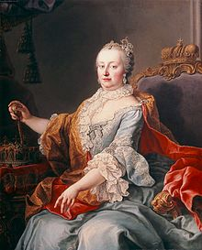

Slide 21
The War of Austrian Succession
As a female, Maria Theresa could not assume the title of Holy Roman Emperor.
This issue cast doubts among the Great Powers regarding her legitimacy as ruler of the Habsburg Empire.
Although Maria Theresa lost Silesia to Prussia, she saved her leadership of the empire.
The Hungarian nobility helped the queen to defeat the Bohemian revolt and preserve the empire.

Slide 22
Centralizing Control
She limited the power of the nobles.
Reduced power of the lords over their serfs
Some serfs were partially freed.
Feudal dues by peasants were reduced or eliminated.
Nobles were taxed.
Maria Theresa did more to help the condition of serfs than any ruler in European history up to that time (only her son, Joseph II, did more).
Response to the terrible famine and disease of the 1770s
Increased the empire’s standing army from 30,000 to over 100,000
Reduced the practice of torture in legal proceedings

Slide 23
Religion and Economics
Religion:
Brought control of the catholic Church under State control in Austria
Sought to reduce pope’s influence in Austria
Taxed the Catholic Church in Austria
She believed that the Church and the nobility were the foundations of the state.
Economics:
Promoted economic growth
Abolished guilds
Abolished internal customs duties
Improved transportation: roads, ports
Supported private enterprise
Encouraged immigration

Slide 24
Was Maria Theresa an Enlightened Ruler?
Maria Theresa is NOT considered, however, an enlightened despot
She was not a fan of the Enlightenment.
She did not go as far as others in allowing religious toleration (which her son did, along with Frederick the Great and Catherine the Great).
She did provide some toleration for Protestants.

Slide 25
Joseph II (r. 1780-1790)
He ruled with his mother, Maria Theresa, as co-regent until her death in 1780.
Perhaps the greatest of the “Enlightened Despots” in terms of reforms but in many ways was among the least effective
He was deeply influenced by the Enlightenment and its emphasis on reforms.
He was a firm believer in absolutism and he could be ruthless in achieving his goals.

Slide 26
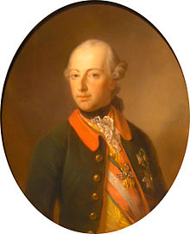

Slide 27
Major Reforms under Joseph II
Abolished serfdom and feudal dues in 1781
Ironically, opposed by many peasants since the law stated that obligations to lords would have to be paid in cash, rather than labor (serfs had little cash available)
Nobles resisted their reduced power over the peasantry
This edict was rescinded after his death by his brother, Leopold II, who needed support of the nobles.
Freedom of religion and civic rights to Protestants and Jews
Reduced the influence of the Catholic Church
Allowed freedom of the press to a significant degree
Reformed the judicial system
Abolished torture and ended the death penalty
Expanded state schools

Slide 28
Decline of the Empire under Joseph II
Austria was defeated several times in wars with the Ottoman Empire.
The Austrian Netherlands were in revolt.
Russia was threatening Austria’s interests in eastern Europe and the Balkans.
Leopold II was forced to reverse many of Joseph’s radical reforms in order to maintain effective control of the empire.

