Slide 1
Egypt

Slide 2
Geography
Borders
Situated along the Mediterranean coast in North Africa
Red Sea forms the boarder to the East
Sahara Desert to the West
Nile River
Flows North from the mountains and plateaus
From present day Burundi, Tanzania, Uganda, and Ethiopia.
Each July the river floods and deposits nutrients
Agriculture
thin strip of land provides enough fertile soil to grow crops.

Slide 3
Geography Continued
Two regions: Upper and Lower.
Upper Egypt: begins where the first cataract (or rapid) appears.
Lower Egypt: begins where the river fans out into many branches and forms the Nile Delta.

Slide 4
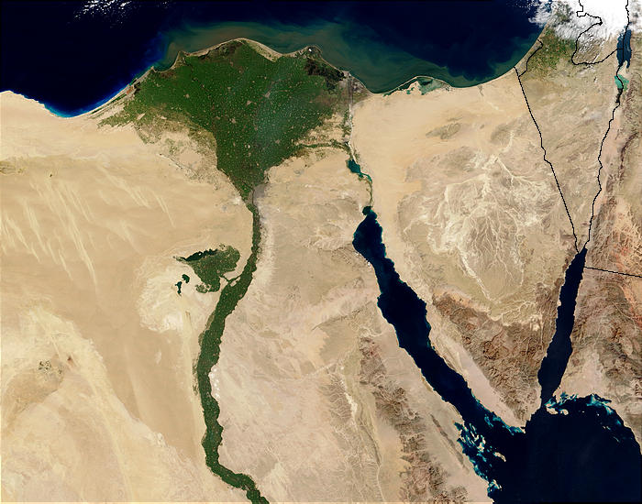
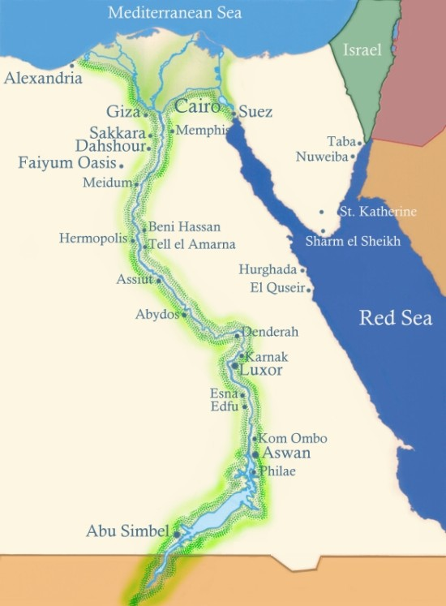
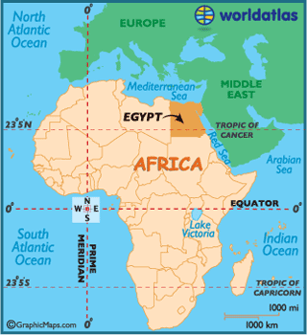

Slide 5
Traits of the Egyptians
Agriculture
Began between 4400 and 4000 BCE
Calendar=had three seasons
Each was 120 days long
Writing system:
Developed independently of the Sumerian by 3100 BCE
Wrote on papyrus instead of clay tables
Religion: Polytheistic
Social Class System:
Wealthy landowners
middle class made up of merchants
bottom were the peasants.
Calendar: 365 days
Advanced medicine

Slide 6
Government
A king= pharaoh.
The pharaohs were believed to be living gods.
In Mesopotamia kings were seen as representatives of the gods.
The Center of both Egyptian religion and politics (government).
Theocracy- government system in which he ruler has both religious and political authority.
Would eventually be invaded by the Kingdom of Kush (Nubia to the south)

Slide 7
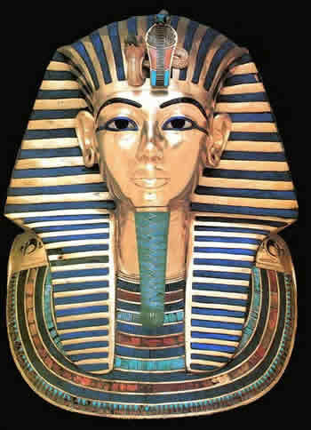
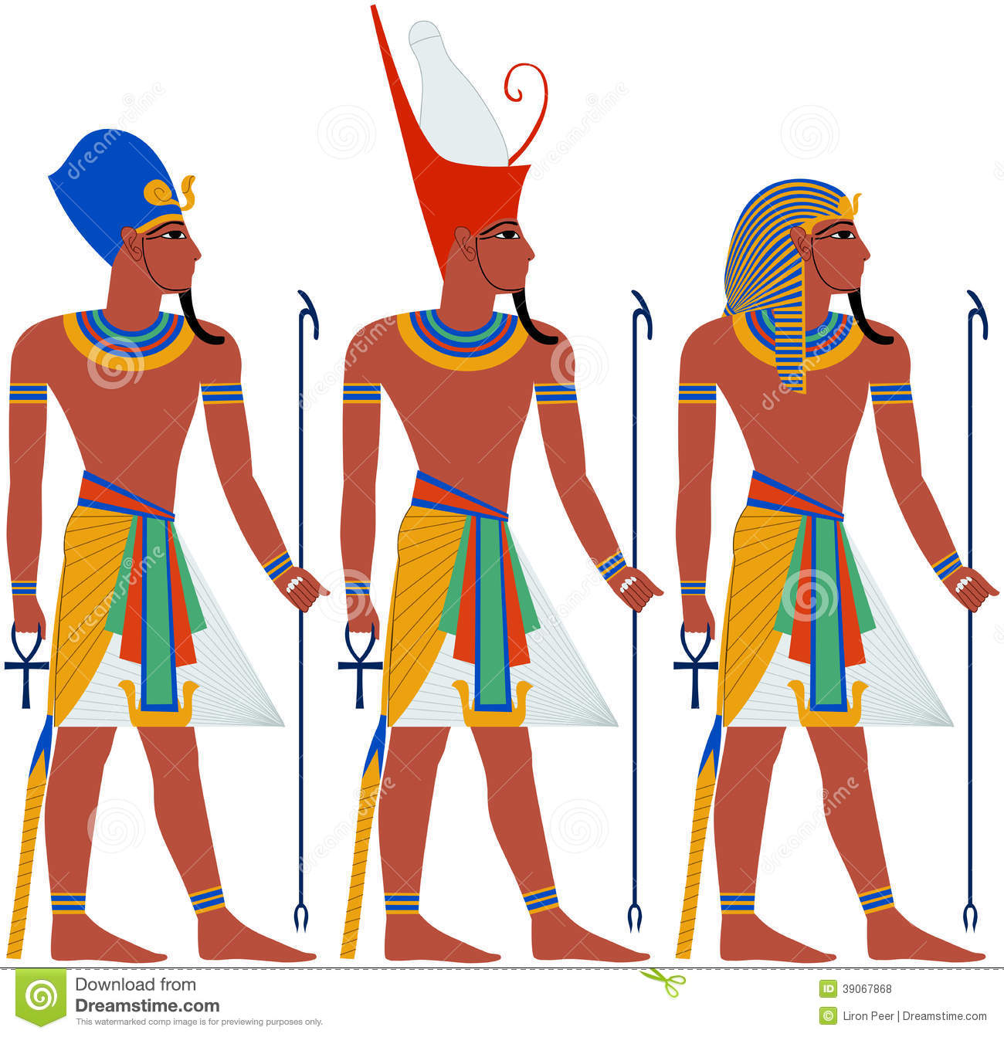

Slide 8
Unification of Egypt
Prior to unification:
two kingdoms, Upper and Lower.
Unification: 3000 BCE
King Narmer (Menes) united the two
He created is depicted as wearing both the white crown of Upper Egypt and the red crown of Lower Egypt
He created the first Egyptian dynasty.
There would be 31 total dynasties.
From 2600- 2180 B.C. was known as the Old Kingdom.

Slide 9
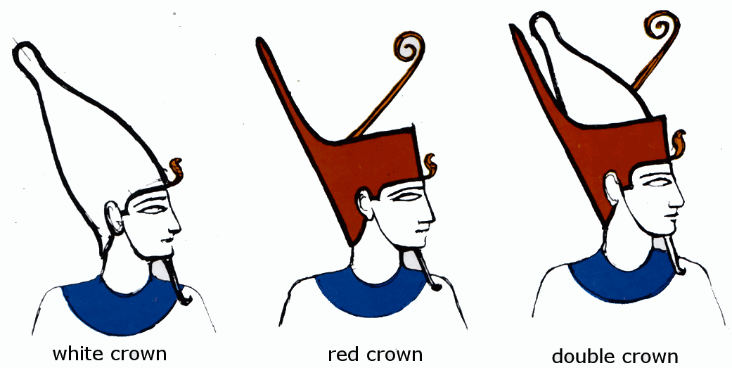

Slide 10
Pyramid Builders
Afterlife:
Pharaoh possessed an eternal life force known as ka.
Royals and Elites would have their bodies mummified
Pyramid:
Tomb for the Pharaohs.
He was accompanied by all that he would need in the afterlife.
Greatest is the Pyramid of Khufu: found in Giza
Some of the stones used to build the structure weighed from 2 ½ tons to 15 tons!
The structure covers 13 acres.

Slide 11
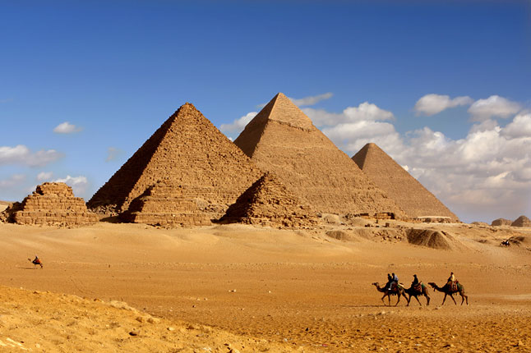
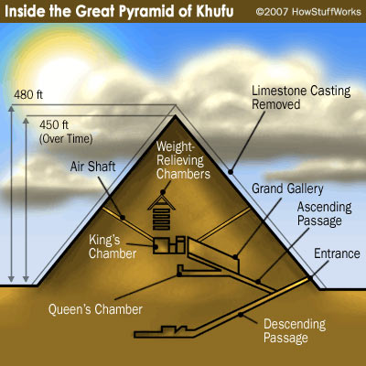
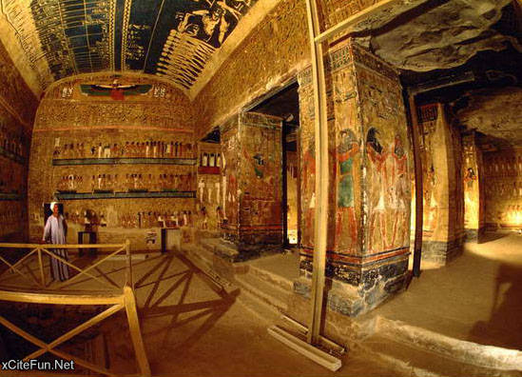
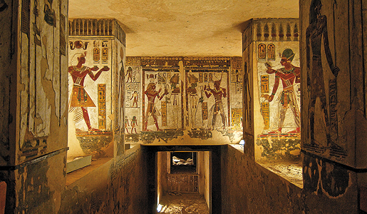
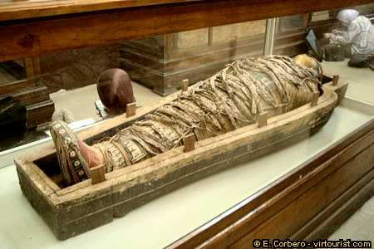

Slide 12
Religion
Key to Egyptian culture.
The Egyptians were polytheistic.
Worshiped more than 2000 different gods.
The most important were Re (sun god),
Osiris ( god of the dead),
Isis ( goddess of the ideal mother and wife).

Slide 13
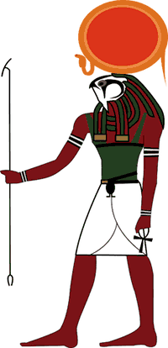
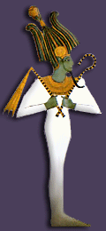

Slide 14
Hieroglyphics and the Rosetta Stone
Picture stands for the image or for the sound of a letter.
Rosetta Stone: 1799 CE
French soldiers found a black stone
Found near Rosetta
Three languages
Hieroglyphics, Hieratic, Ancient Greek.
1822 CE: a French scholar named Jean François Champollion broke the code.

Slide 15
