Slide 1
Early River Valley Civilizations
Mesopotamia

Slide 2
Bronze Age: 4,000-1,500 BCE
Bronze used to make tools and weapons
Rise of specialization of work: ex. Woodworking
Development of more complex settlements such as towns

Slide 3
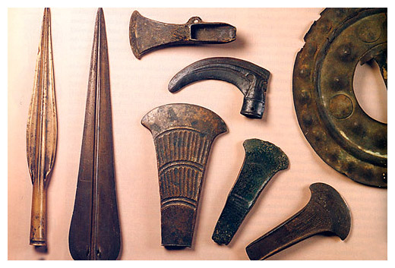
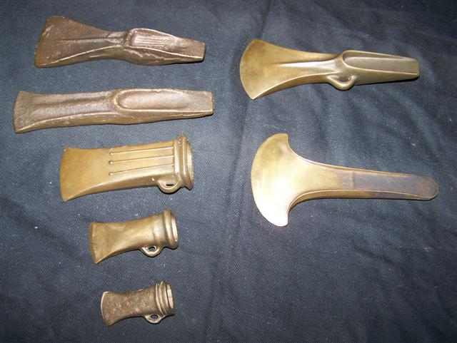

Slide 4
Beginnings of Civilization
Settlements and villages
Use slash and burn agricultural methods
Beast of burden: ex. ox
Made up of bands of herding peoples
Advantages:
Well built homes
Constant supply of water
Irrigation
Defense systems
Food surplus= increase in population

Slide 5
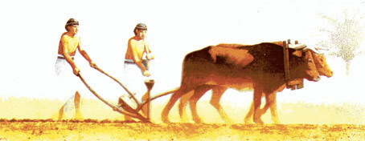
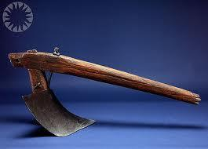
454 × 176 - goldenageproject.org.uk

Slide 6
Villages to Cities
Skilled Labor
Some people pursued other occupations
Craftsman: pottery, metal objects , and woven clothe.
New Technologies
The wheel and sail allowed traders to move goods over greater distances.
Social Structure
Division of social classes: wealthy and influential vs. poor
Priest: religious and political leaders
Inequality of the sexes
Religion changed too, to include more complex rituals.

Slide 7
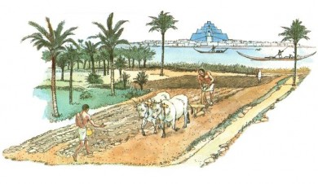
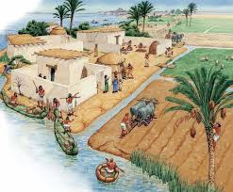

Slide 8
Çatal Hüyük: 7000 B.C.E. southern Turkey
Large complex 32 acres
mud brick & timber homes
religion – believed in “mother goddesses” & had shrines
Agriculture
Commerce & trade
Ruled other communities = politics & military
Diverse occupations by 3000 B.C.E., civilization
skilled tool makers & jewelry

Slide 9
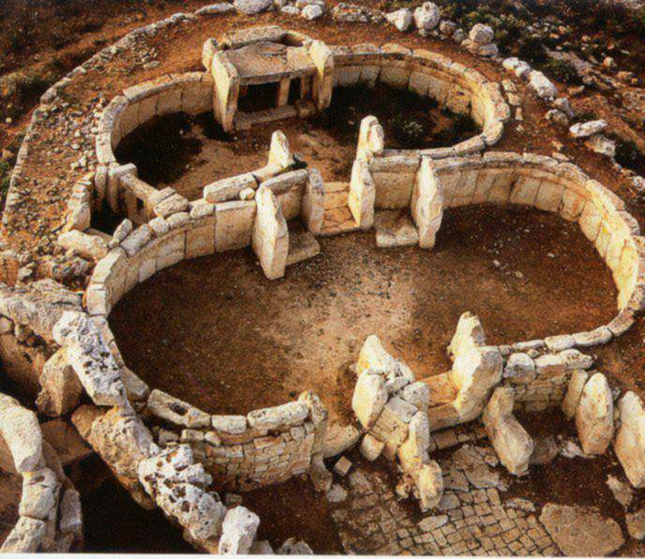

Slide 10
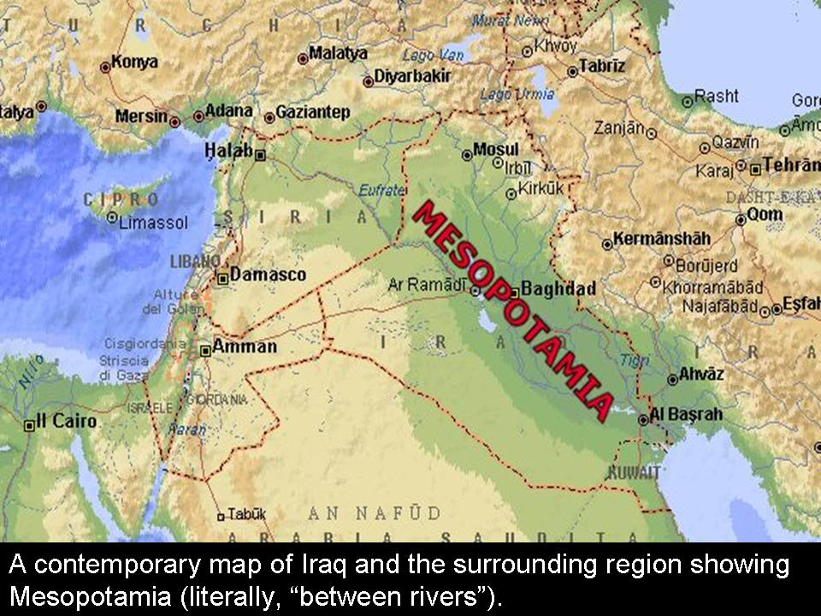
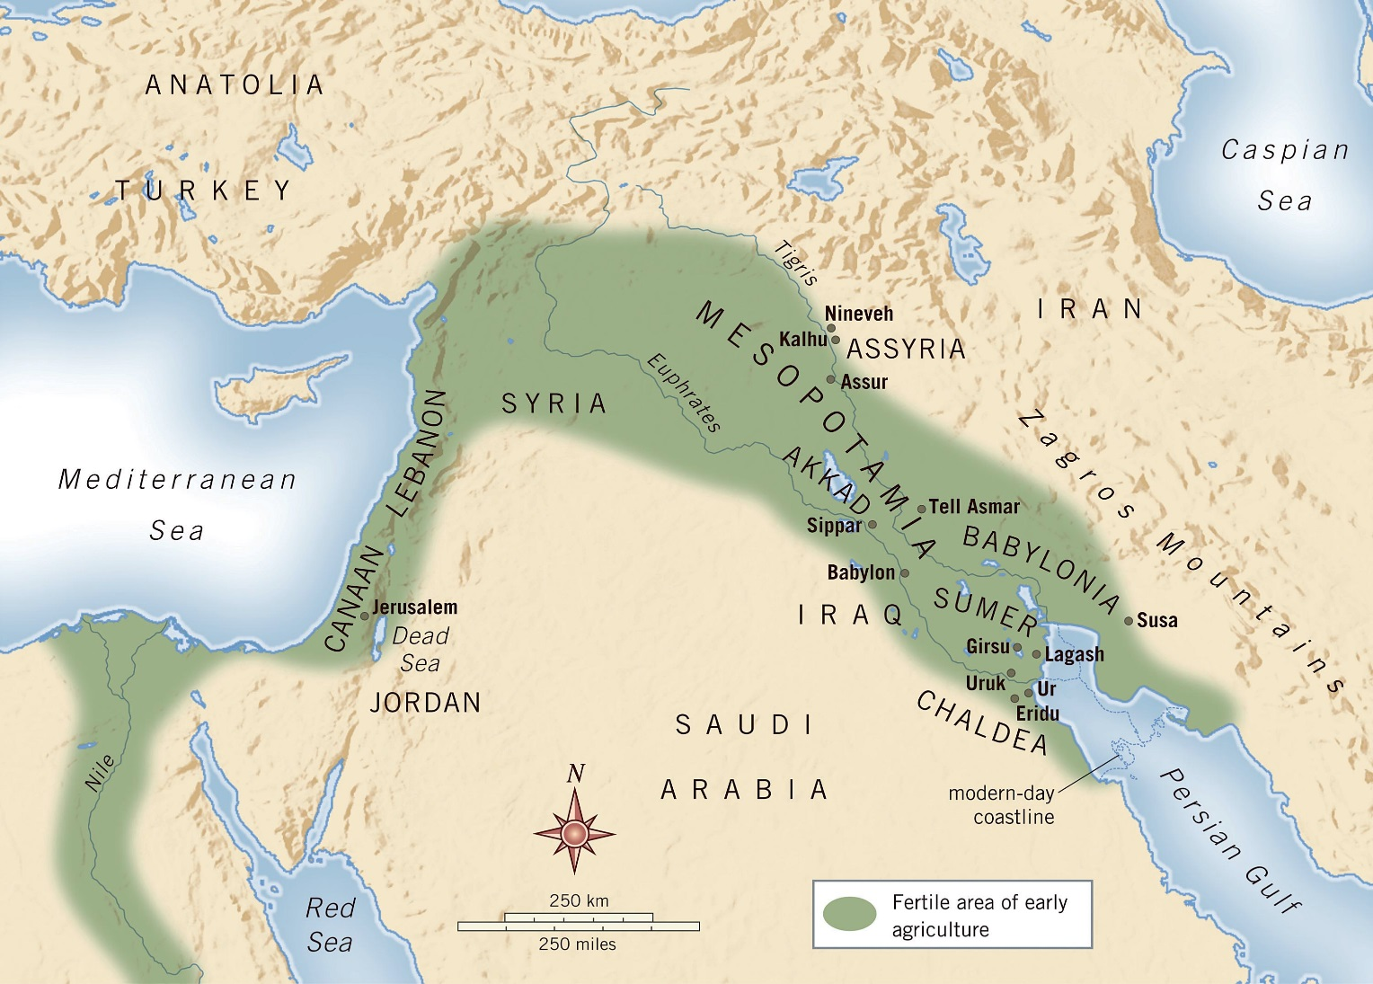
Mesopotamia: Land Between the Rivers
Located between the Tigris and Euphrates rivers
Prone to irregular violent flooding due to geography of the area
Very fertile land

Slide 11
Sumerians: from 3500 B.C.E.
Agriculture
Irrigation and fertilizer
Writing
Cuneiform and scribes
Science
Astronomy (12 month calendar)
created number system based on 10, 60, & 360
Social Organization
Free citizens and slaves
Religious rituals (ziggurats)
Polytheistic
divine punishment through floods
originated concept of hell
Political structure
city states with defined boundaries
Largest was Ur
monetary system

Slide 12
Development of Writing
Cuneiform
wedge shaped
Cuneiform allowed Sumerians to:
send messages
keep records
Particularly tax records
make contracts & treaties
very few people were literate

Slide 13
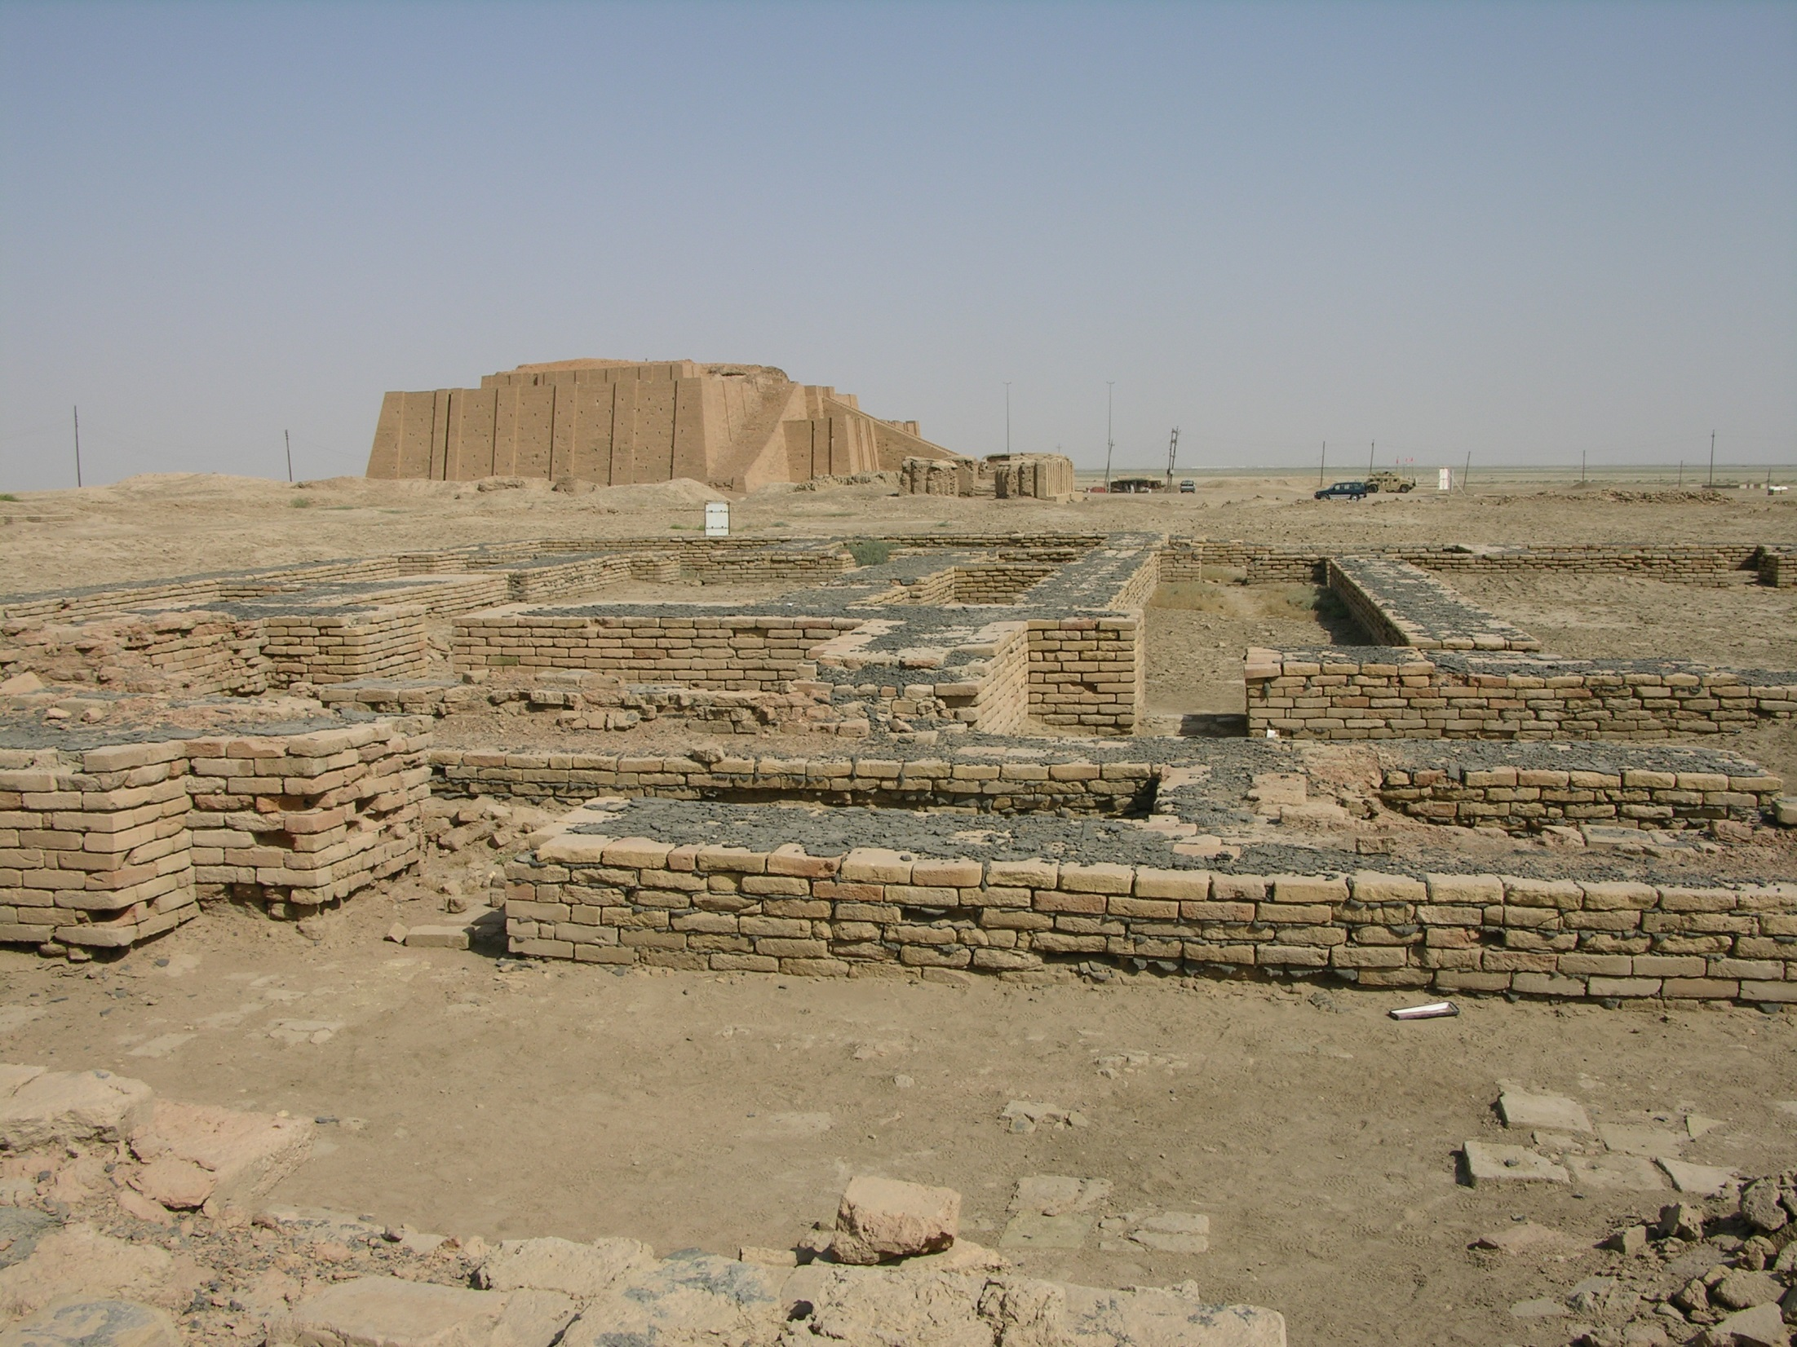
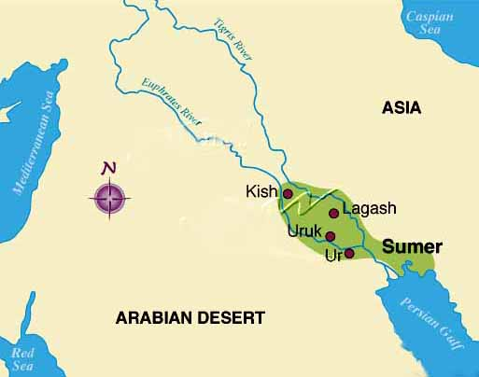
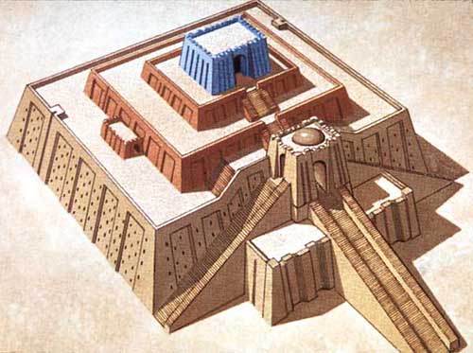

Slide 14
Later Mesopotamian Civilizations
Akkadians: 2350 BCE
Defeated the Sumerians
Established by Sargon of Akkad
Spread Sumerian culture
Amorites (Babylonian) 2000 BCE
Large empire centered in Babylon
peaked during the reign of Hammurabi (1792 B.C.- 1750 B.C.)
Indo-Europeans
from 2100 B.C.E.
Semitic (Jewish) People
Practiced monotheism

Slide 15
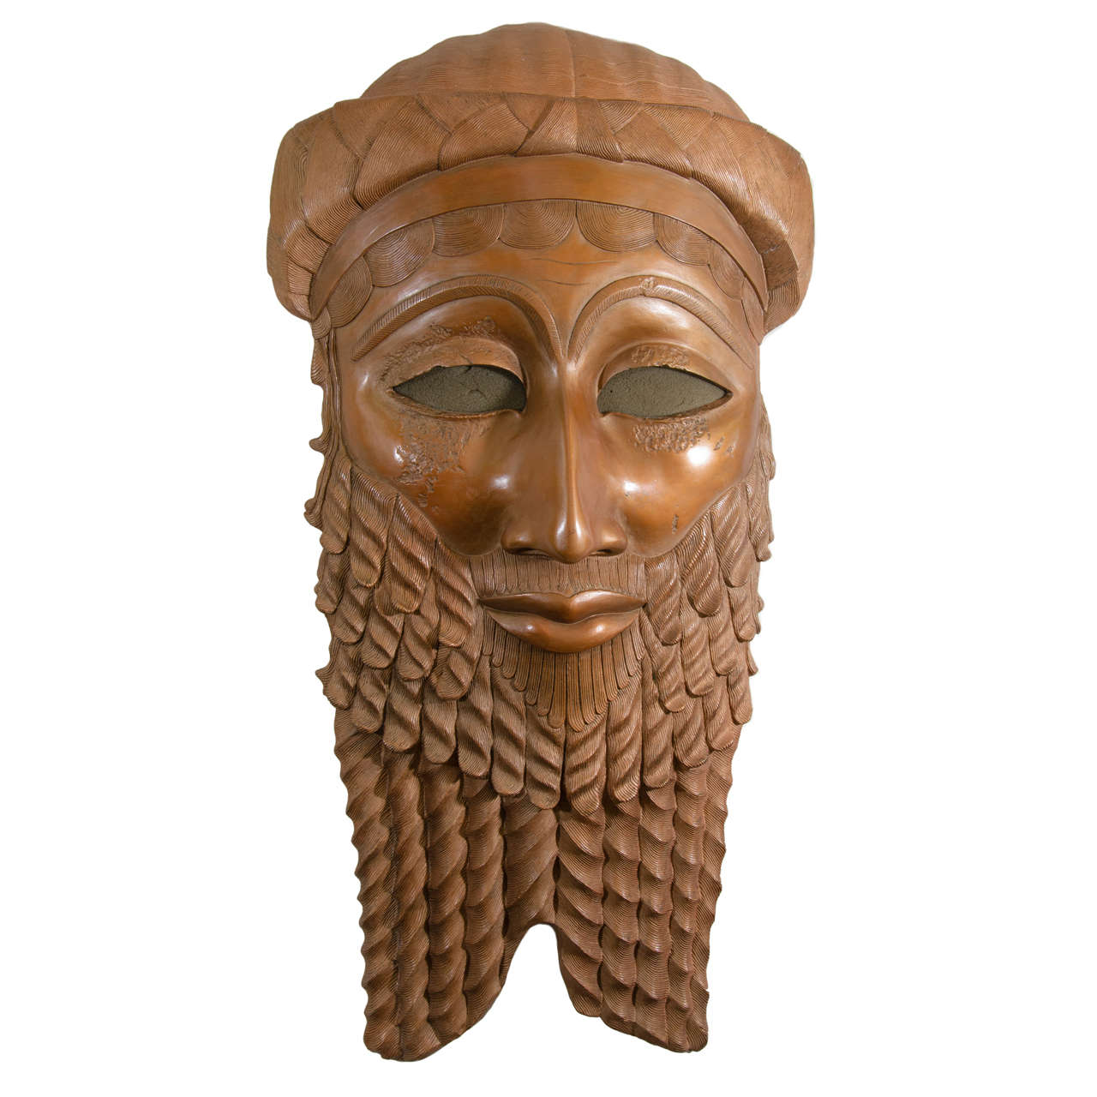
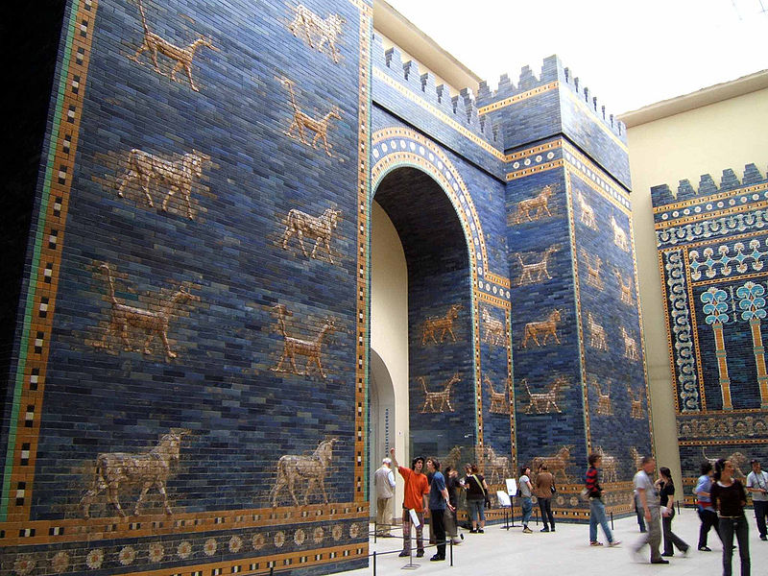
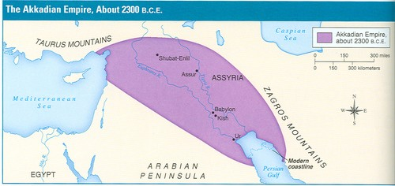
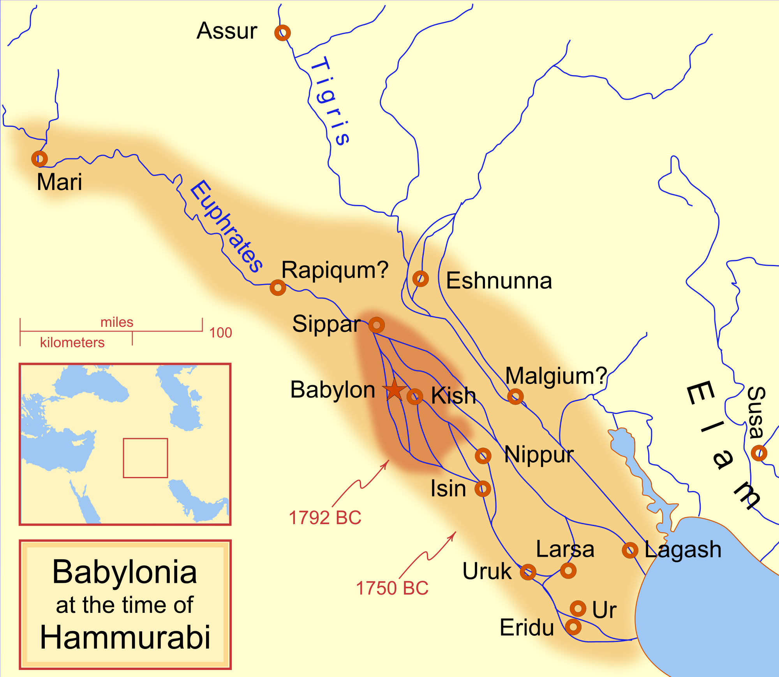
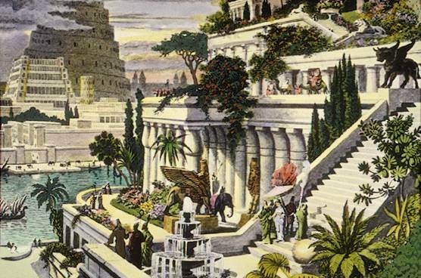
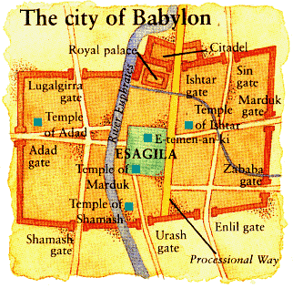

Slide 16
Hammurabi’s Code
uniform code a law
specific laws: issues ranging from family relations, business, and crime.
punishments were harsh: “an eye for an eye” policy.
code was engraved in stone and placed throughout the empire.

