Slide 1
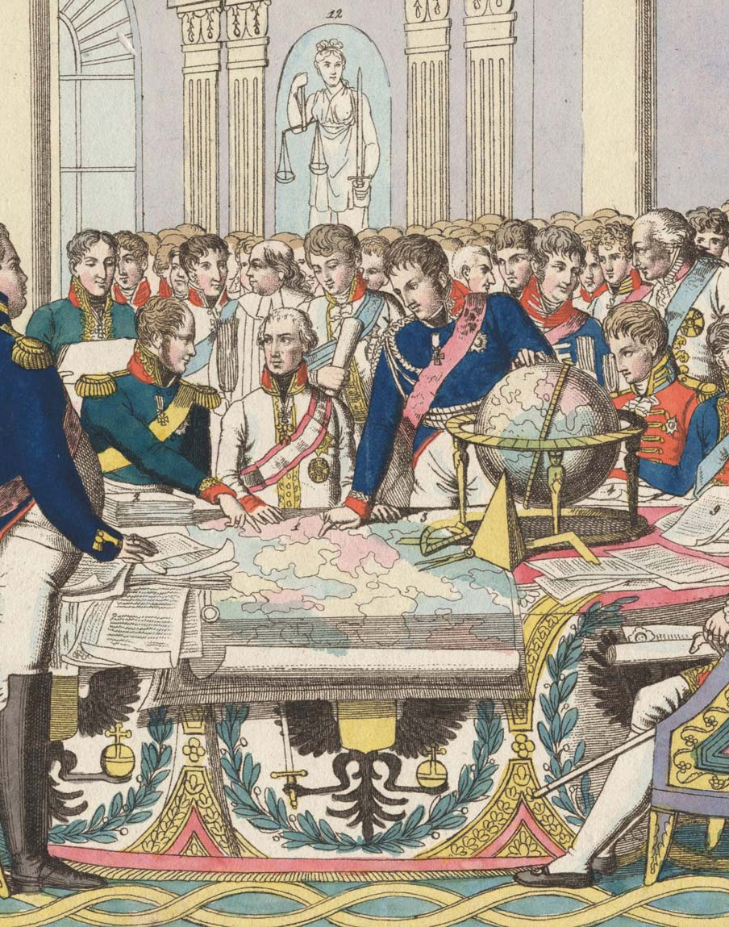
Congress of Vienna and Napoleons Return
1814-1815

Slide 2
Restoration of the Monarchy
The Bourbons were restored to the throne; Louis XVIII.
Charter of 1814: the king created a two-house legislature that represented only the upper classes.
It was the first constitution in European history issued by a monarch.
The restoration maintained most of Napoleon’s reforms such as the Code Napoleon, the Concordat with the pope, and the abolition of feudalism.

Slide 4
The “First” Treaty of Paris 1814
Treaty it signed May 30, 1814
France surrendered all territory gained since the Wars of the Revolution had begun in 1792.
Allied powers imposed no indemnity or reparations (after Louis XVIII had refused to pay).
Napoleon was exiled to the island of Elba as a sovereign with an income from France.
The Quadruple Alliance agreed to meet in Vienna to work out a general peace settlement.

Slide 5
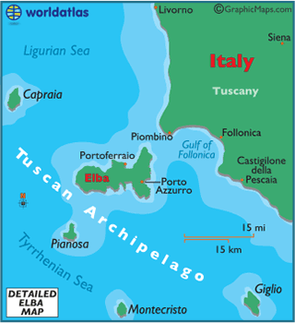

Slide 6
Congress of Vienna (Sept. 1814- June 1815)
Representatives of the major powers of Europe, including France, met to redraw territorial lines and to try and restore the social and political order of the ancien regime.
The “Big Four”
Austria
Klemens Von Metternich represented
He epitomized conservative reaction to the French Revolution and its aftermath.
He opposed ideas of liberals and reformers because of the impact such forces would have on the multinational Hapsburg Empire.
Britain
represented by Lord Castlereagh.
He sought a balance of power by surrounding France with larger and stronger states.

Slide 8
Prussia
sought to recover Prussian territory lost to Napoleon in 1807 and gain additional territory in northern Germany (e.g. Saxony).
Russia
Represented by Czar Alexander I
He demanded a “free” and “independent” Poland, with himself as its king.
France
later became involved in the deliberations.
Represented by Talleyrand, the French Foreign Minister
Congress of Vienna represents the triumph of conservatism in Europe

Slide 9
Principles of Settlement
Legitimacy
meant returning to power the ruling families deposed by more than two decades of revolutionary warfare.
Bourbons were restored in France, Spain, and Naples.
Dynasties were restored in Holland, Sardinia, Tuscany and Modena.
The Papal States were returned to the pope.
Compensation
meant territorially rewarding those states which had made considerable sacrifices to defeat Napoleon.
England received naval bases (Malta, Ceylon, Cape of Good Hope).
Austria recovered the Italian province of Lombardy and was awarded adjacent Venetia as well as Galicia (from Poland), and the Illyrian Provinces along the Adriatic.
Russia was given most of Poland, with the tsar as king, as well as Finland and Bessarabia (modern-day Moldova and western Ukraine).
Prussia was awarded the Rhineland, 3/5 of Saxony, and part of Poland.
Sweden received Norway

Slide 10
Balance of Power
It arranged the map of Europe so that never again could one state upset the international order and cause a general war.
The encirclement of France was achieved through the following:
A strengthened Netherlands
United the Austrian Netherlands (Belgium) with Holland to form the Kingdom of the United Netherlands north of France.
Prussia received Rhenish lands bordering on the eastern French frontier (left bank of the Rhine).
Switzerland received a guarantee of perpetual neutrality.
End of the Hapsburg Holy Roman Empire
Austrian influence over the German states was enhanced by creating the German Confederation (Bund) of 39 states out of the original 300, with Austria designated as President of the Diet (Assembly) of the Confederation.
It maintained Napoleon’s reorganization.
It was a loose confederation where members remained virtually sovereign.
Sardinia (Piedmont) had its former territory restored, with the addition of Genoa.
A compromise on Poland was reached—“Congress Poland” was created with Alexander I of Russia as king; it lasted 15 years.
Only Britain remained as a growing power as she began her century of world leadership from

Slide 11
Hundred Days (March 20- June 22 1815)
Napoleon capitalized on the stalled talks at Vienna and escaped Elba for France.
The Hundred Days began on March 1, 1815, when Napoleon landed in the south of France and marched with large-scale popular support, into Paris.
He seized power from Louis XVIII, who fled Paris.
Napoleon raised an army and then defeated a Prussian army in Belgium on June 16, 1815.

Slide 12
The Endgame
Battle of Waterloo- June 1815
Last battle of the Napoleonic Wars
Napoleon was defeated in Waterloo, Belgium, by England’s army led by the Duke of Wellington and Prussian forces.
Napoleon was exiled to the South Atlantic island of St. Helena, far off the coast of Africa, where he died in 1821.
The “second” Treaty of Paris (1815): the Quadruple Alliance now dealt harshly with France in subsequent negotiations.
It contained minor changes to the borders previously agreed to.
France had to pay an indemnity of 700,000,000 francs for loss of life.

Slide 13
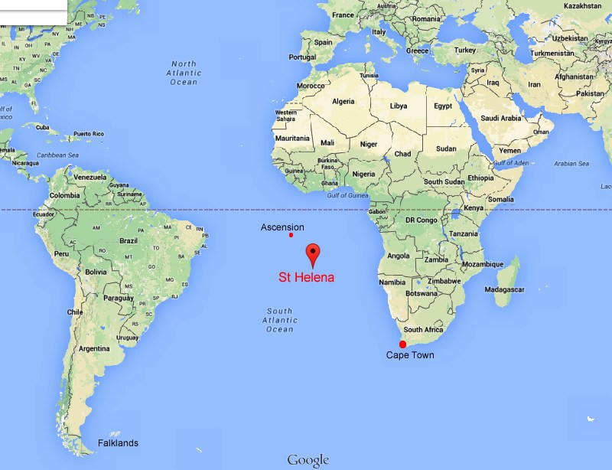

Slide 14
Evaluating Napoleons Reign
It was the first egalitarian dictatorship of modern times.
Positive Achievements
Revolutionary institutions were consolidated.
The French gov’t was thoroughly centralized.
He made a lasting settlement with the Church.
Spread positive achievements of the French Revolution to the rest of Europe
Impact on Other Countries
Serfdom was abolished in much of Germany by 1807.
Germany was reorganized into 39 states.
Prussia and Austria, for self-preservation, reformed their military and provided some reforms.

Slide 15
Liabilities
Repressed individual liberty
Subverted republicanism
Oppressed conquered peoples throughout Europe
Caused terrific suffering as a result of war

