Slide 1
Commercial Revolution and the Expansion of Colonial Claims

Slide 2
Commercial Revolution
Causes
European population growth recovered to its pre-Plague level: 70 million in 1500; 90 million in 1600; thus, more consumers existed.
The “Price revolution”: long slow upward trend in prices
States and emerging empires sought to increase their economic power.
Rise in capitalism
As colonial expansion continued through the 1700s mercantilist policies grew and wealth began to trickle down to new social classes particularly the middle class.

Slide 4
Chartered Companies and Joint-Stock Companies
Chartered Co.:
States provided monopolies in certain areas
These chartered companies became, in effect, a state within a state with large fleets of ships and military power
Example- Dutch East India Company, and the British East India Company
Joint-Stock Co.:
investors pooled resources for a common purpose
forerunner of the modern corporation
This was an early prime example of capitalism.
Stock markets emerge in Europe
As the value of stock increased so did the profit of the investor

Slide 6
Mercantilism and “Bullionism”
Developed in the 17th Century
Goal of Mercantilist policy:
Nations sought a self-sufficient economy.
Strategy:
create a favorable balance of trade where one’s country exported far more than it imported
“Bullionism”: A country should acquire as much gold and silver as possible.
A favorable balance of trade was necessary to keep a country’s supply of gold from flowing to a competing country.

Slide 7
Effects of the Commercial Revolution
Many individuals began to move back into towns and cities
The emergence of more powerful nation states occurred.
Wealth was increasingly taxed for state purposes.
The age of exploration emerged as competing nations sought to create new empires overseas

Slide 8
The bourgeoisie (middle class) grew in political and economic significance.
First evident in the Italian city-states during the Renaissance. (merchants)
Became the most powerful class in the Netherlands. (over seas trade and joint-stock companies)
In France, it grew in political power at the expense of the nobility.
The gentry exerted increasing influence in English politics.
The standard of living increased (e.g. greater varieties of foods, spices, utensils), especially among the upper and middle classes.

Slide 9
Golden Age of Spain
The empire was divided into four vice-royalties, each led by a viceroy.
It was mercantilist in philosophy from the early-16th century onward.
Colonies existed for the benefit of the mother country.
The mining of gold and silver was most important
the Crown got 1/5 of all precious metals); this accounted for 25% of the crown’s total income.
In 1545, the opening of the world’s richest silver mines at Potosí in Peru ushered in the “golden age.”
Spain shipped manufactured goods to America

Slide 10
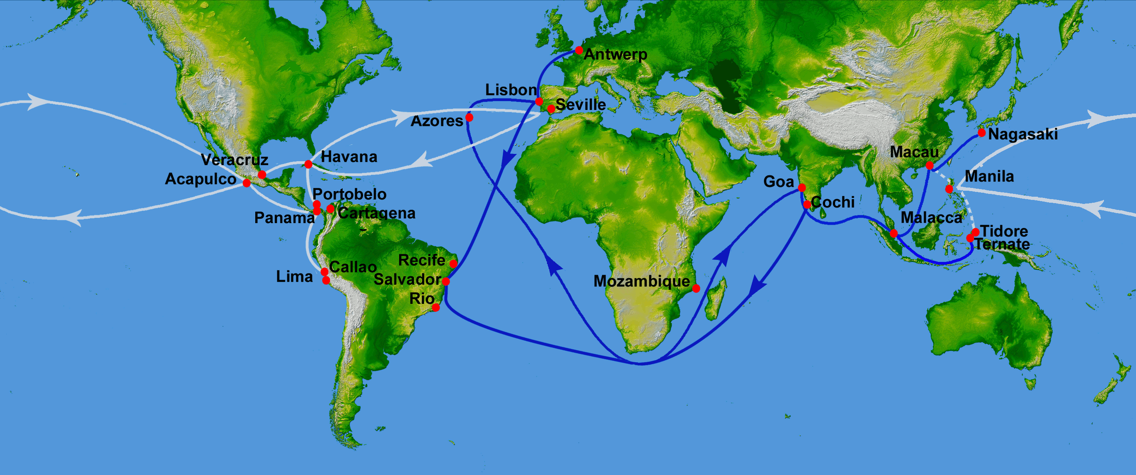

Slide 11
Dutch Claims (Netherlands)
The Dutch East India Company (VOC) was founded in 1602 and became the major force behind Dutch imperialism.
Expelled the Portuguese from Ceylon (Sri Lanka) and other Spice Islands (Indonesia).
By 1650, began challenging Spain in the New World and controlled much of the American and African trade

Slide 12
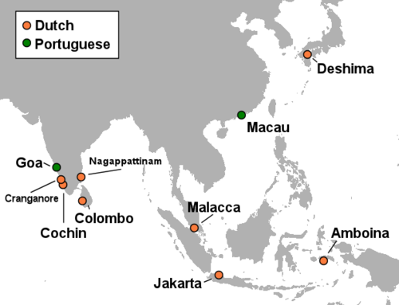

Slide 13
French Claims
Quebec, France’s first settlement in the New World, was not founded until 1608.
France eventually lay claim to over one-half of North America before being expelled in 1763.
Will also have claims in the Carribean and in South Asia.

Slide 14
English Claims
England
The first permanent settlement in North America was not founded until 1607 in Jamestown (Virginia).
Tens of thousands of Englishmen came to the eastern coast of North America in the 17th and 18th centuries
Far more English came to the New World than the French, Spanish and Portuguese combined;
By 1775 2.5 million Europeans lived in the original thirteen American colonies
India will come under the control of the British East India Company after the conclusion of the French and Indian War (Seven Years War) in 1763.

Slide 15
