Slide 1
The Columbian Exchange

Slide 2
The Effects of the Columbian Exchange
The global transfer of foods, plants, and animals
Gave rise to the system of capitalism.
This made many individuals as well as nations wealthy.
The system of mercantilism grew.
In this system the colonies act as sources of wealth that feed the mother country.
A merchant class began to develop in western Europe

Slide 3
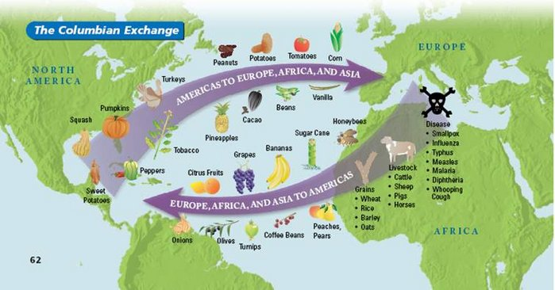

Slide 4
Spanish America
Reconquista to Conquest

Slide 5
The Caribbean Crucible
Columbus establishes Hispaniola
Puerto Rico, Cuba, Panama, & northeastern coast of S. America under Spanish control
Encomienda- plantation style farms
Used natives for work & exploitation
Gold hunting, slaving, & disease depopulated the islands
Few fortified ports
Havana, Santo Domingo, & San Juan
Disease & conquest annihilated natives of Caribbean
Leads to importation of African slaves

Slide 7
Mexico
Hernan Cortes (1519)
Attack Aztecs in 1520
Enlist defeated peoples
Cortez reaches Tenochtitlan & kills Moctezuma II (the leader of the Aztecs_
By 1521 the Aztec Empire was done
Disease contributes to the collapse

Slide 8
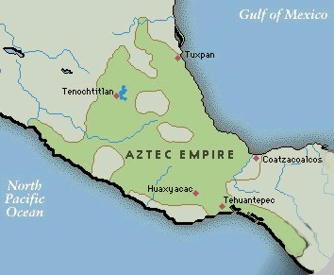
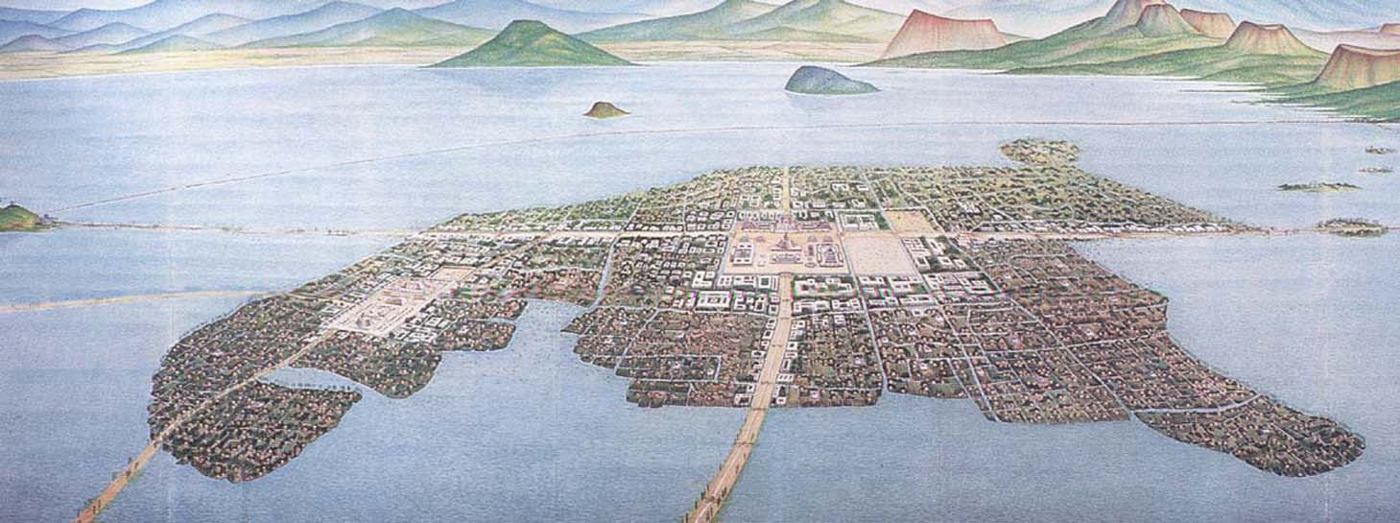
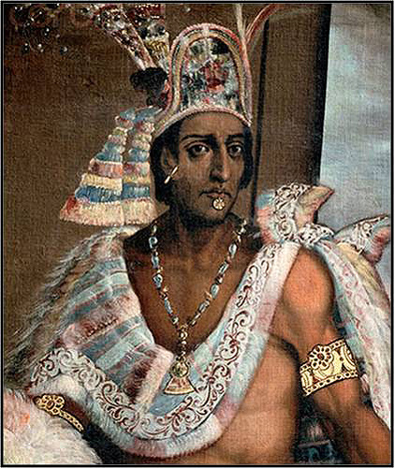

Slide 9
Peru (Inca)
Francisco Pizarro
Incas weakened by civil war
Pizarro meets Atahualpa (the Inca leader) which will lead to Atahualpa’s death
By 1540 most of Peru under Spanish control

Slide 10
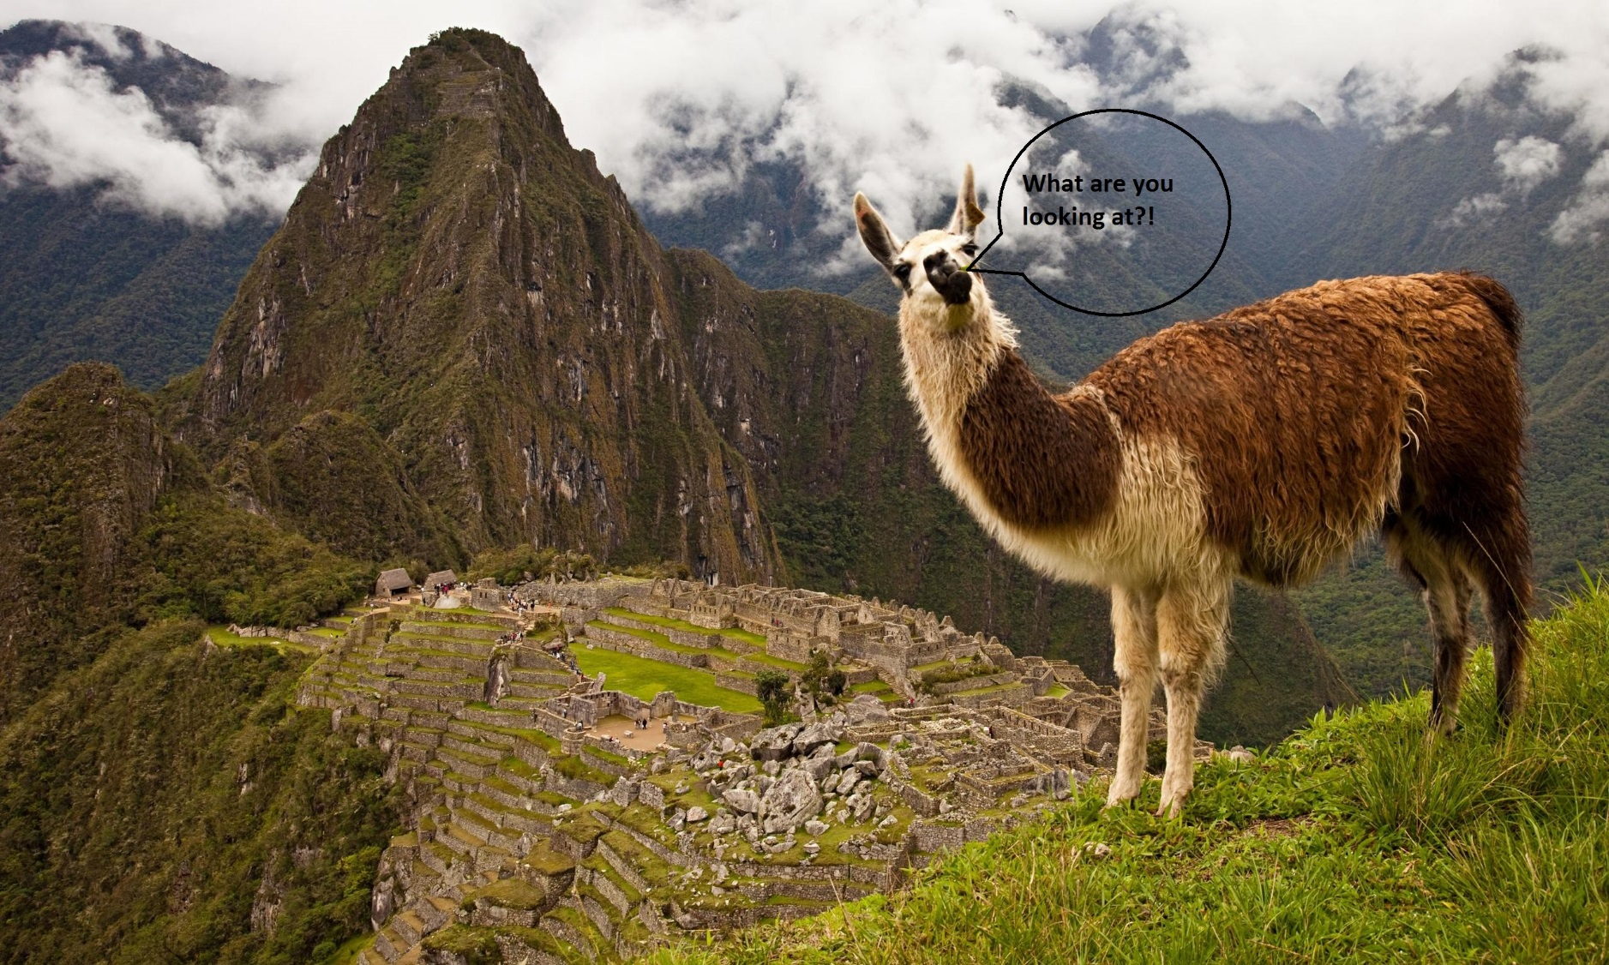
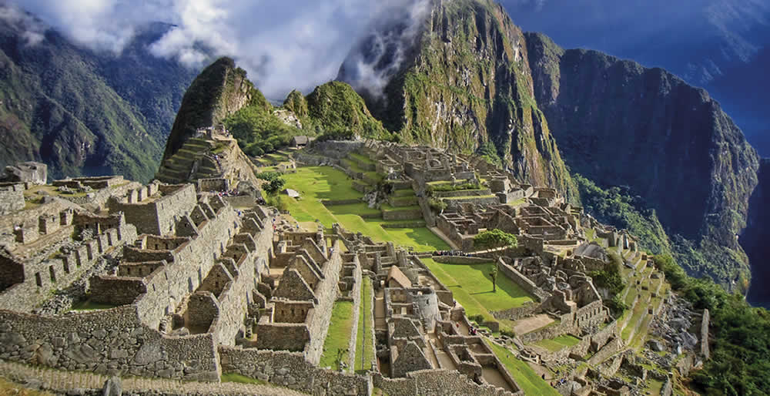
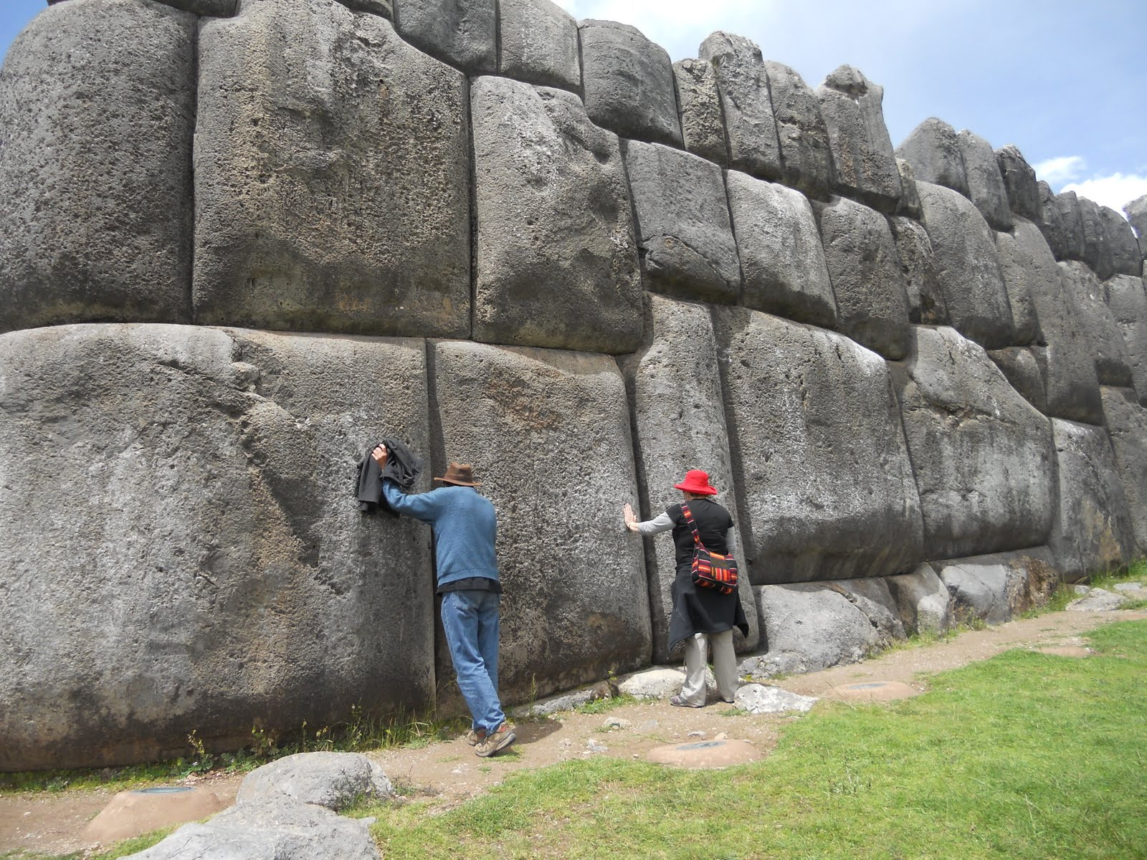
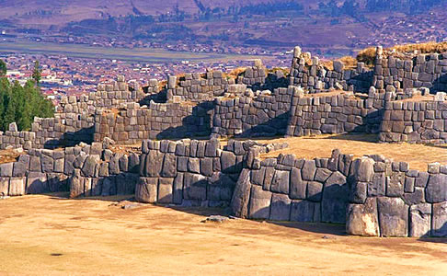
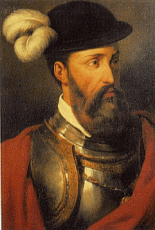
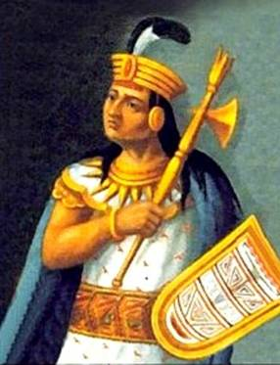

Slide 11
Exploitation of the Indians
Old Indian religions and priestly caste eliminated
Encomienda's given to individual conquerors of regions
Allowed to use Indians for work and to tax them
Destructive to Indian society
Use of Indian serfs decline in 17th century
Bartolome de Las Casas
Bureaucrat turned priest- wrote accounts of the Spanish treatment of the native populations
Advocate for justice for native groups

Slide 12
Distinct Social Classes:
Peninsulares- colonist born in Europe. Initially held the most powerful positions in colonial society
Criollos (Creoles)- colonist born in the Americas of European parents. Generally well educated and financially secure, the creoles, would eventually become colonial leaders and organizers of colonial independence movements.
Mestizos- people of Mixed European and Indian Ancestry
Mulatos (mulattos)- people of mixed European and African ancestry
Both the mestizos and mulatos occupied the lowest and social positions in Spanish colonial society.

