Slide 1
Cold War
Part 2

Slide 2
Sputnik
October 4, 1957 the Soviet Union launches Sputnik, the first man-made satellite to orbit the Earth.
In 1958, the U.S. creates the National Aeronautics and Space Administration (NASA)
Start of the “Space Race”

Slide 4
Cuba
January 1, 1959: Fidel Castro overthrow Fulgencio Batista
Castro nationalizes the sugar industry and signs trade agreements with the Soviet Union.
Cuba becomes communist
Bay of Pigs 1961
U.S.-organized invasion force of 1,400 Cuban exiles is defeated by Castro's government
Kennedy takes full responsibility for the disaster.

Slide 6
U2 Incident- 1960
May 1- American U-2 spy plane is shot down over the Soviet Union.
Pilot Gary Powers
Powers was sentenced to ten years in prison, including seven years of hard labor, following an infamous show-trial.
He served less than two years
released in 1962 in exchange for Soviet spy Rudolf Abel.

Slide 7
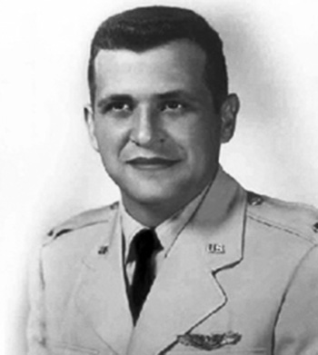

Slide 8
This is the location where Gary Powers was exchanged for Soviet Spy Rudolph Abel.

Slide 9
Berlin Wall- 1961
On August 15, communist authorities begin construction on the Berlin Wall to prevent East Germans from fleeing to West Berlin.

Slide 10
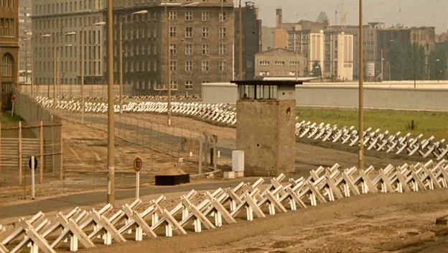
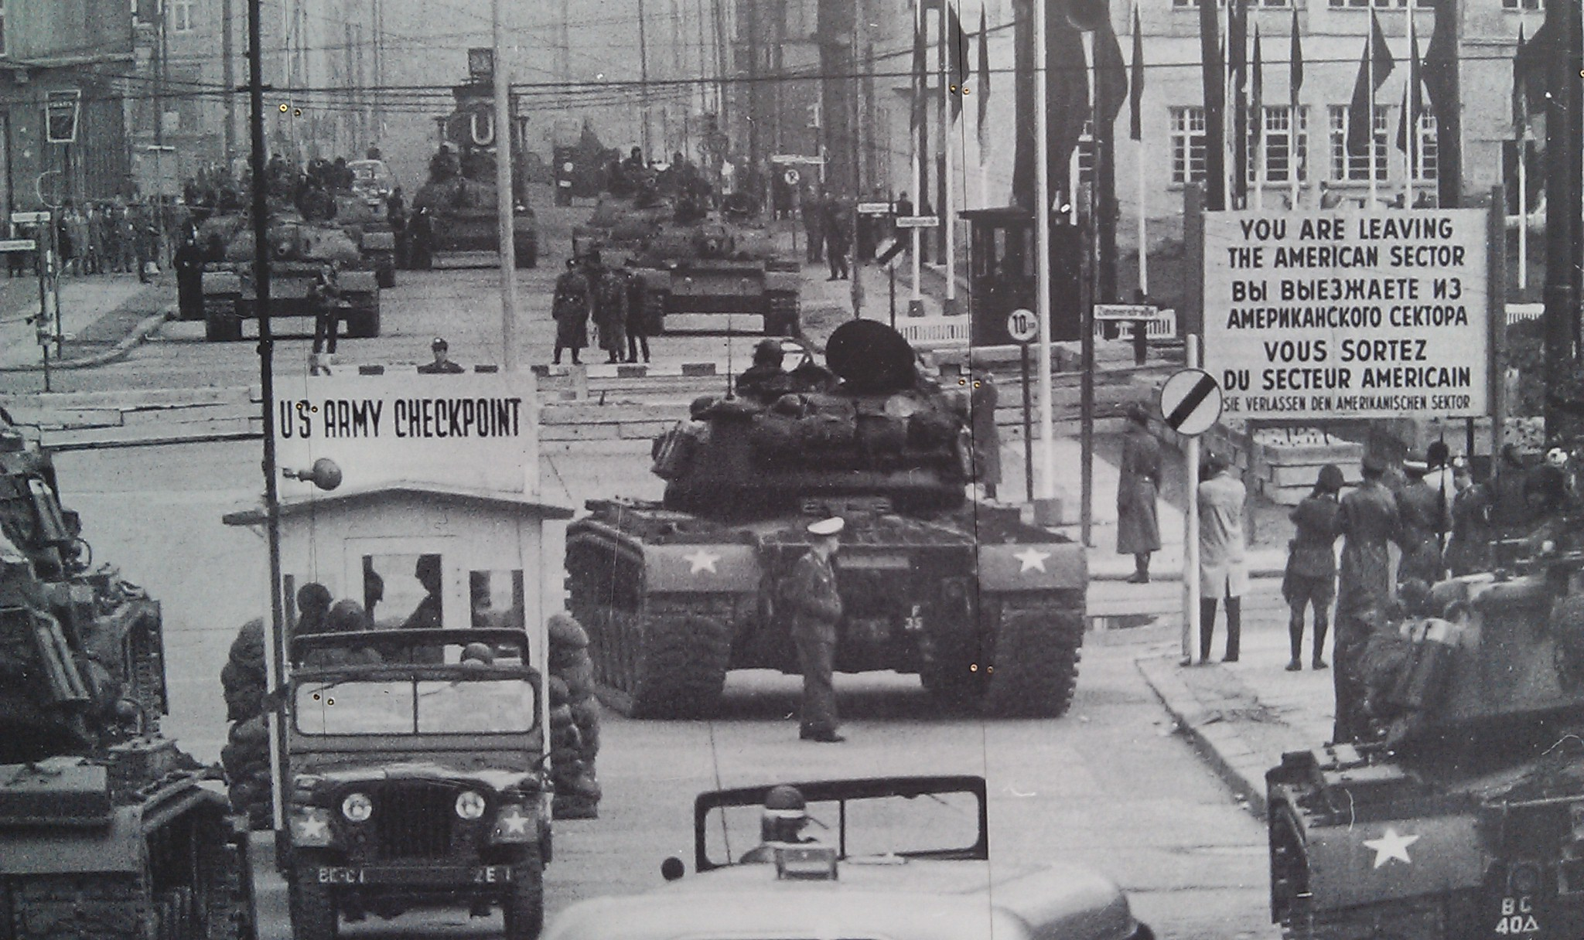

Slide 11
1962 Cuban Missile Crisis
The Soviet Union installed nuclear missiles in Cuba.
Kennedy ordered a naval blockade of Cuba on October 22 until the Soviet Union removed its missiles.
For thirteen days the world sat on the brink of nuclear war.
On October 28, the Soviets agreed to remove the missiles
In exchange the United States agreed to remove missles from Turkey a few months later.

Slide 12
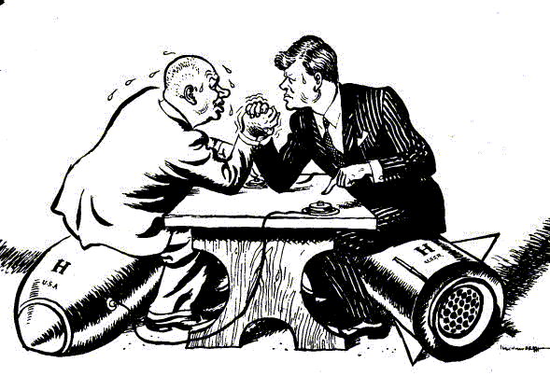
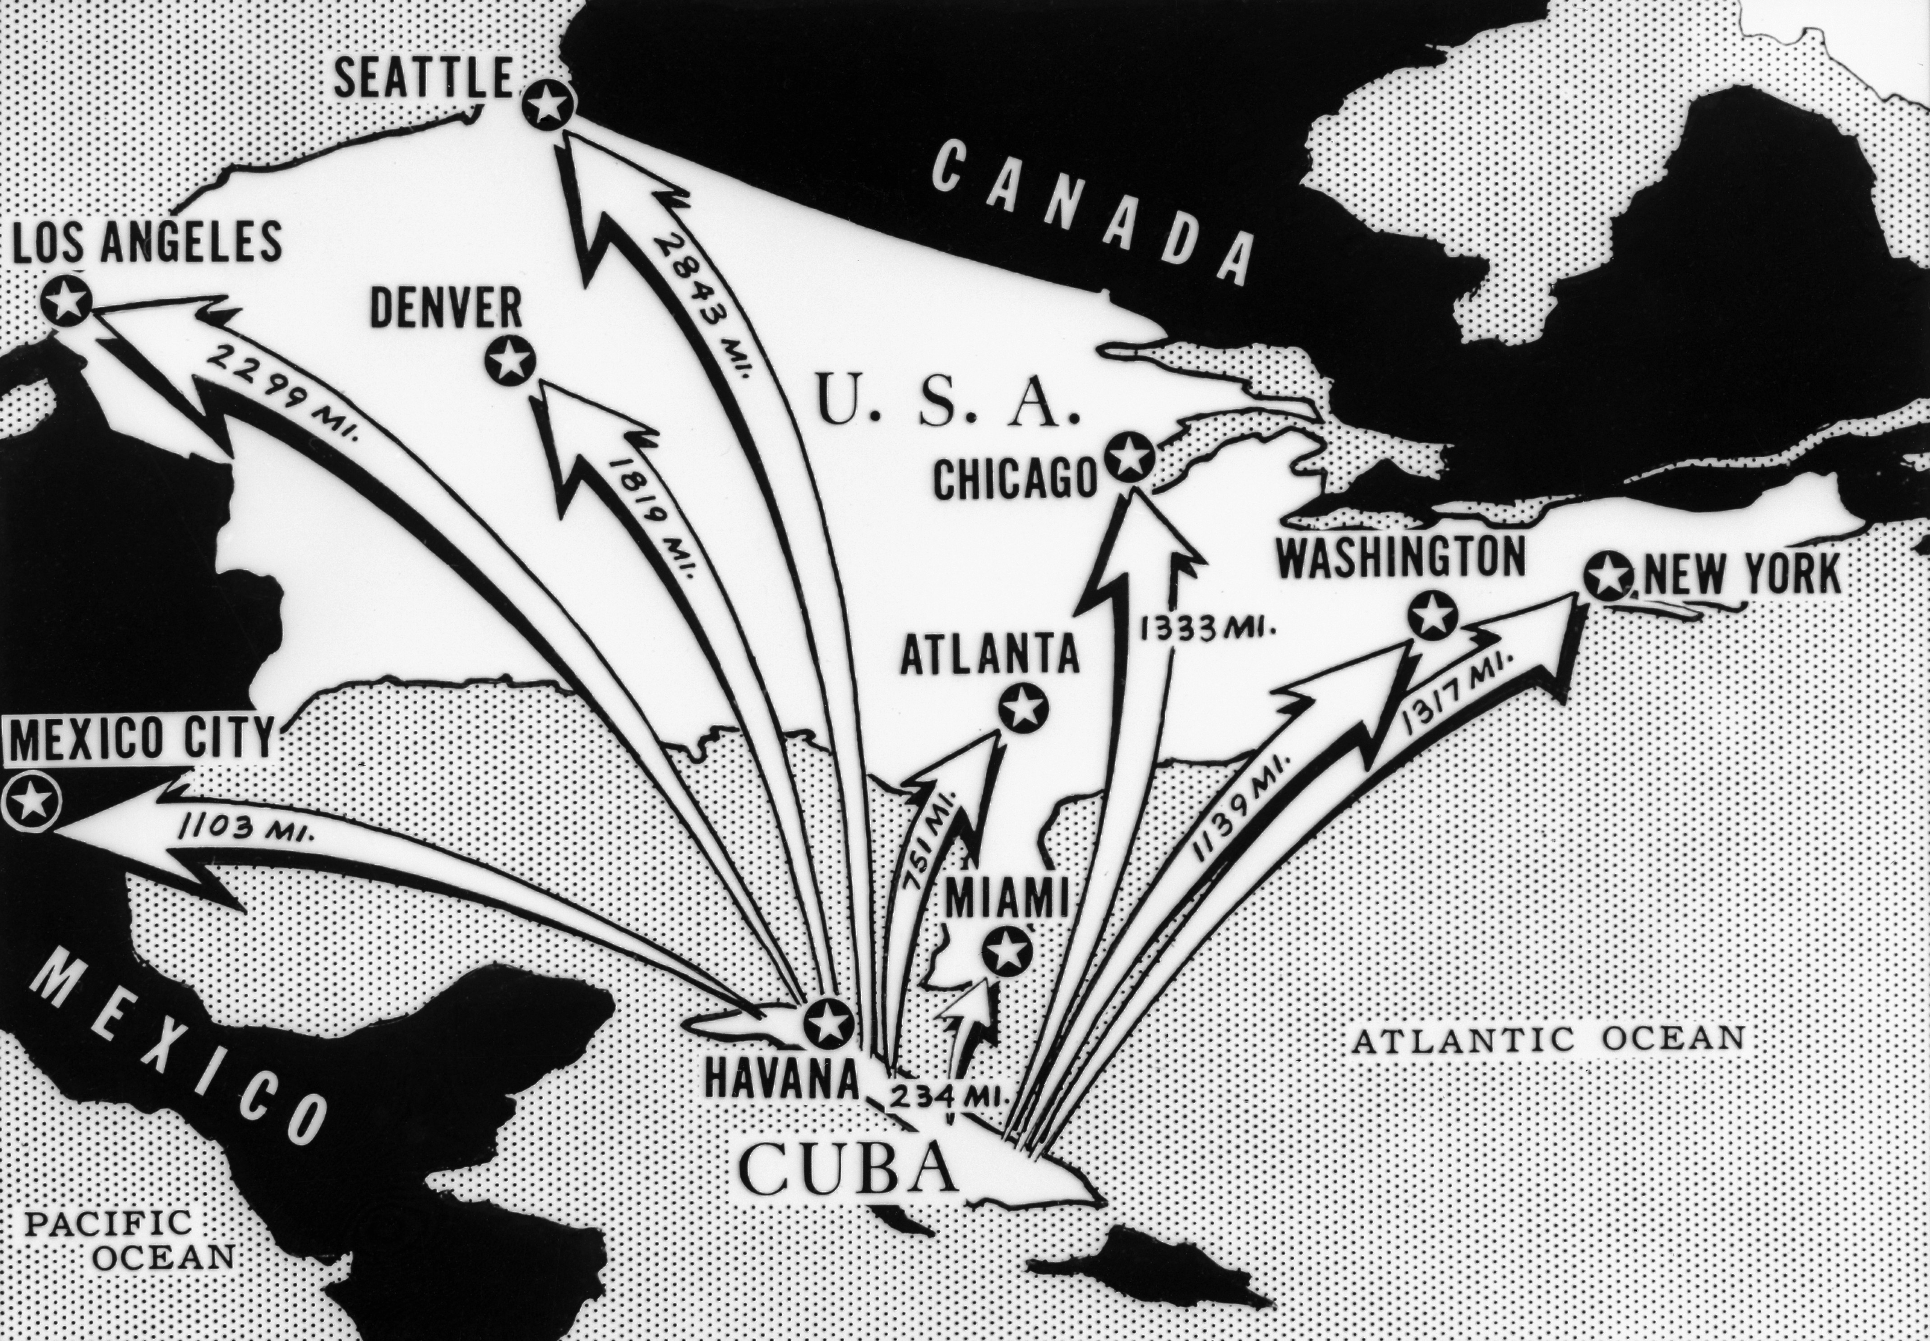

Slide 13
Vietnam
Communists defeat French colonial forces at Dien Bien Phu on May 7, 1954.
Communist leader was Ho Chi Minh
Vietnam becomes communist
July, 1954 - divide the country at the 17th parallel, creating a North and South Vietnam.
In 1964 a US gunship is attacked in the Gulf of Tonkin
US sends troops to Vietnam
Will try to defeat the communist north
US will withdraw from Vietnam in 1973
Pairs Peace Accords
Saigon falls in April 1975

Slide 14
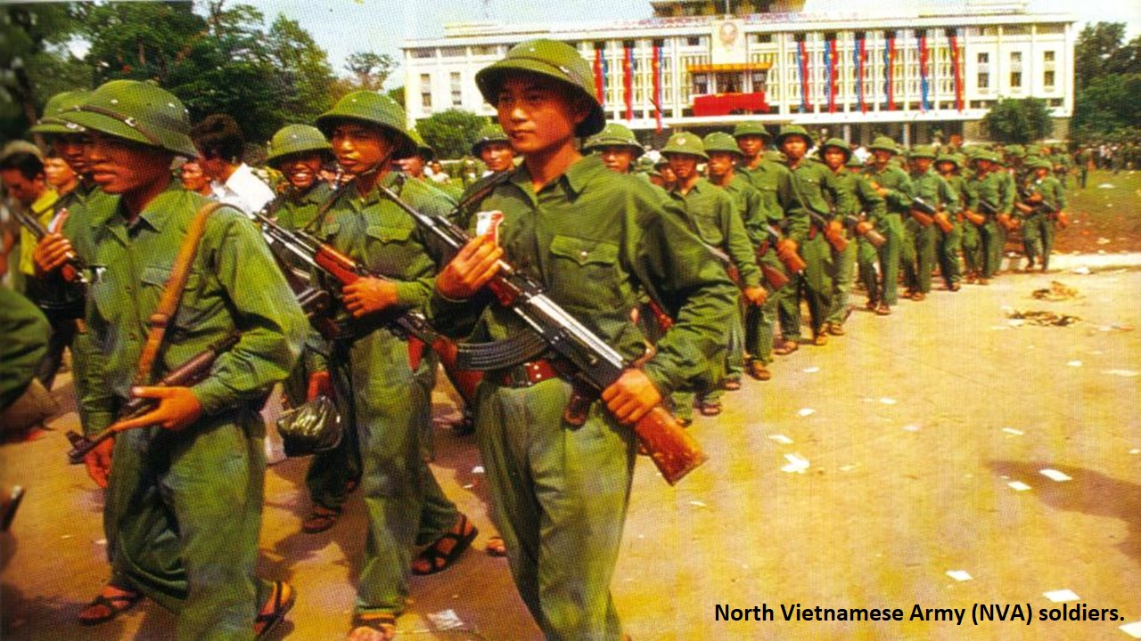
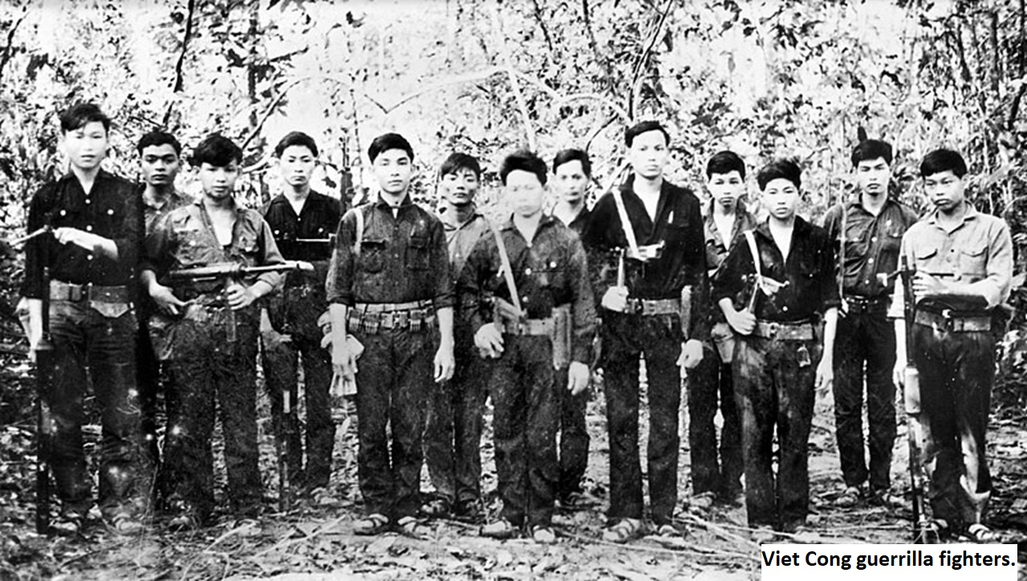

Slide 15
SALT
On November 17, 1969: Strategic Arms Limitation Talks
Signed in Moscow on May 26, 1972
placed limits on both submarine-launched and intercontinental nuclear missiles.

Slide 16
New Soviet Premier Leonid Brezhnev. In office from 1964 until 1982.

Slide 17
Cambodia
Communist Khmer Rouge takes power in Cambodia in 1975 under the leader ship of Pol Pot.
The educated and urban population forced into the countryside as part of a state experiment in agrarian communism.
Under the regime as many as 3 million died from 1975 to 1979.

Slide 18
Victims of the Khmer Rouge reeducation in agrarian communism. Many inviduals will die in reeducation camps.

Slide 19
Afghanistan
December 25, 1979 - 100,000 Soviet troops invaded Afghanistan as communist Babrak Karmal seized control of the government.
U.S.-backed Muslim guerrilla fighters waged a costly war against the Soviets for nearly a decade
Soviet troops withdraw in 1988.
Afghanistan = the Soviet “Vietnam”

Slide 20
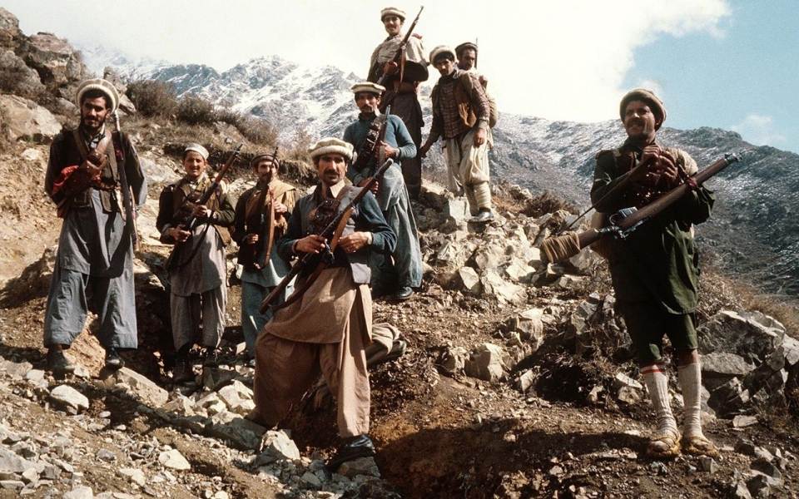
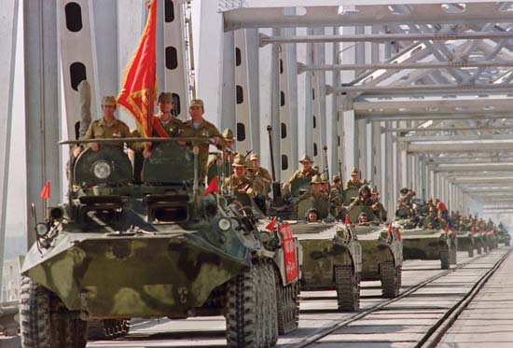

Slide 21
Gorbachev comes to Power- 1985
On March 11, Mikhail Gorbachev came to power in the Soviet Union.
Gorbachev ushered in an era of reform.
perestroika
Restructuring economic reforms
glasnost
means openness; allowed greater free expression and criticism of Soviet policies

Slide 23
Berlin Wall Falls-1989
September 10- Hungary opened its border with Austria
allows East Germans to flee to the West.
After massive public demonstrations in East Germany and Eastern Europe, the Berlin Wall fell on November 9.

Slide 24
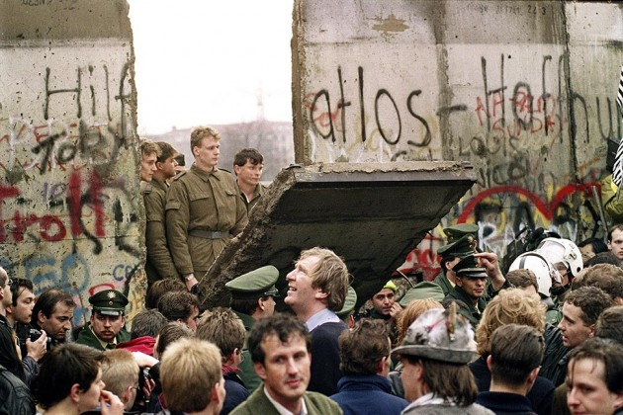
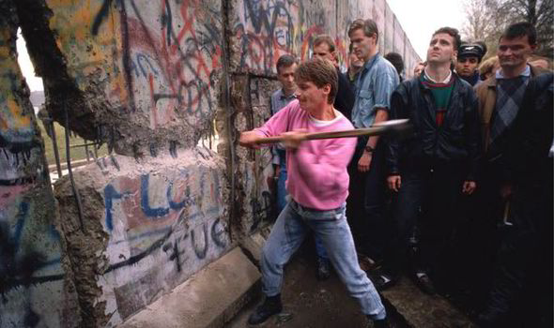

Slide 25
Reunification of Germany 1990
At a September 12 meeting in Moscow, the United States, Soviet Union, Great Britain, France and the two Germanys agreed to end Allied occupation rights in Germany.
On October 3, East and West Germany united as the Federal Republic of Germany.

