Slide 1
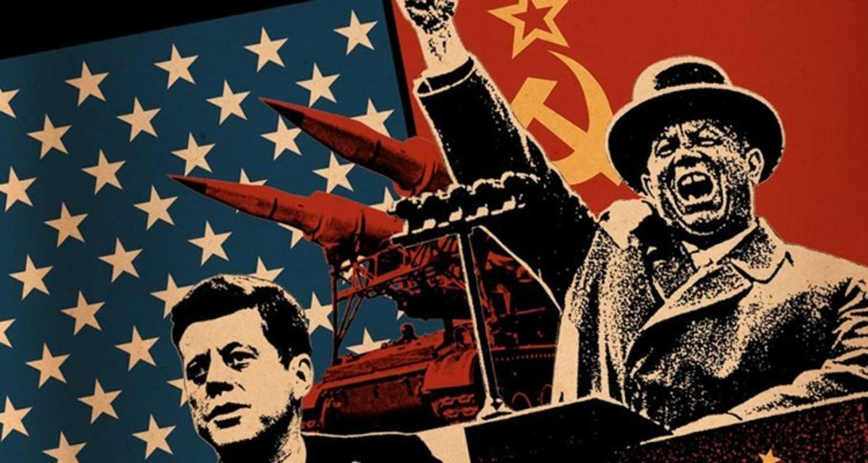
The Cold War and Decolonization
1945-1991

Slide 2
Background
The end of World War II left the United States and the Soviet Union as the two dominant world powers, and they soon became locked in a Cold war confrontation. The Cold War spread to become a global ideological conflict between democracy and communism and finally erupted into hot wars in Korea and Vietnam.
After the end of the European war it became apparent that the U.S. and the Soviet Union had opposing goals for post-war Europe.
This was aggravated by the naturally antagonistic relationship between Communism and Capitalism.

Slide 3
Goals
US Goals
Soviet Goals
Encourage Democratic Capitalism in other countries to prevent the rise of communism
Gain access to raw materials and markets to maintain US economy
Rebuild European governments and create new markets for US goods
A reunited, stable, democratic, and economically strong Germany allied with the west
Encourage Communism in other countries to spread the world wide workers’ revolution
Rebuild its war ravaged economy using Eastern Europe’s industrial equipment and raw material
Control Eastern Europe to protect Soviet boarders
A weak, divided Germany unable to wage war in the future

Slide 4
Roots of the Cold War
Stalin was intent at creating spheres of influence
Broke his pledge made at Yalta Conference in February of 1945
Yalta:
Divide Germany temporarily into zones of occupation
Require Germany to pay limited reparations to the Soviets
An occupation plan for the rest of Eastern Europe based primarily on which of the allied armies held that territory
Free elections for post-Nazi Poland
Eastern European nations became satellites
Poland, Romania, Bulgaria, Hungary, Czechoslovakia, Alabamia, and Eastern Germany

Slide 5
Partition of War-torn Areas
Churchills famous Iron Curtain speech
Germany divided into 4 zones
Berlin also
Korea & Vietnam:
north = communism
south = democracy
The division and creation so the “iron curtain” gave rise to ideological differences
West= Democratic and East= Communist

Slide 6
Shaping the Post War World
International Monetary Fund (IMF)
Bretton Woods Conference: stabilized the currency of post war era (U.S. dollar strongest currency)
United Nations
“Big Three” at Yalta established the basis for the UN
San Francisco Conference (April 1945) – created the UN as a “peacekeeping” organization

Slide 7
The German Question
Nuremburg Trials (1945-1946)
Allied nations determined the fate of top Nazi leaders accused of war crimes
Potsdam Conference – President Truman demanded democratic elections in Eastern European nations occupied by the Soviet Union
Partition of Germany
Soviets dominate their eastern zone
West Germany becomes independent in 1949
Federal Republic of Germany (FRG)
Konrad Adenauer- 1st Chancellor
East Germany established in 1949
German Democratic Republic (GDR) = pro Soviet, communist government

Slide 8
US Policy of Containment
Two Plans
Truman Doctrine (1947)
Contain the spread of communism to areas already occupied by the Soviet Union
Aid for Turkey and Greece ($400 million) to prevent them from becoming communist nations
first act of containment: dawn of the Cold War
Marshall Plan (1947)
George C. Marshall offers joint plan for recovery - Soviets walk out
U.S. Congress wary until coup d’etat in Czechoslovakia (Feb. 1948)
Plan: $12.5 billion over 4 years in 16 countries = strengthened US and West European relations

Slide 9
Berlin Airlift/ Blockade (1948)
Soviets cut off Allied section of E. Berlin from W. Germany
U.S. organized massive airlift for nearly a year.
Soviets lifted blockade in May 1949
Major failure on the Soviet part and embarrassment

Slide 10
Dueling Treaty Organizations
North Atlantic Treaty Organization (NATO) – April, 1949
Members: US, Canada, and most of Western Europe
Collective security to protect against a Soviet invasion from Eastern Europe
Warsaw Pact (1955)
Soviet response to NATO
Members: USSR and satellite nations

Slide 11
Game Changers of 1949
In September of 1949 the Soviet union successfully detonated its first atom bomb
US and the west no longer has a technological advantage
Communist China (Red China)
U.S. supported Jiang Jieshi (Chang Kai-shek) and the nationalist
Mao Zedong (Mao Tse-tung) led communist victory
Nationalists fled to Formosa (Taiwan)
Loss of China seen as major defeat for U.S.

Slide 12
The Korean War (1950-1953)
June 25, North Korean invasion backed by Soviets
UN Security Council votes military aid to South Korea
Douglas MacArthur appointed UN commander
UN Forces successfully push the North Koreans back into the north and almost into China
Chinese forces invade to defeat the UN in October of 1950
MacArthur is fired by Truman for undermining his authority
War ends in 1953 – Korea divided North and South at the 38th parallel

Slide 13
Technological Advancement
Hydrogen Bomb
U.S. –1952
Soviets -- 1953
President Eisenhower: “massive retaliation” was the US military strategy in the nuclear age
Leads to concept of MAD (Mutually Assured Destruction)

Slide 14
“Peaceful Coexistence”
Stalin’s death in 1953 results in easing of tensions
Succeeded by Nikita Khrushchev
Soviet withdrawal from Austria, 1955
Geneva Summit -1955
designed to be peace talks but discussed many issues
Suez Canal Crisis, 1956
Nasser nationalized the Suez Canal
British, French and Israeli invasion of Egypt
U.S. and Soviets back Nasser and force the invading nations out of Egypt
Khrushchev visits the U.S.

Slide 15
Hungarian Revolution (1956)
23 October to November 10, 1956
Began as a student protest against the Soviet style government
The protest turned violent and led to the collapse of the Hungarian government
New leaders made their intention known to withdraw from the Soviet led Warsaw Pact and hold free elections
Soviet leaders initially were okay with this but changed their minds
On November 4th the Soviet army invaded and took control an reestablished a pro Soviet government
All opposition was completely wiped out by 1957

Slide 16
Space Race
Sputnik- 1957
Space Race is triggered with Soviet successful space program
US lags behind for years ut creates NASA in order to catchup and surpass the Soviets
Inter-Continental Ballistic Missiles (ICBMs) – become the new threat of nuclear warfare

Slide 17
Berlin Wall
Khrushchev issues ultimatum on Berlin, 1958 – orders US and westerners out of West Berlin
Khrushchev orders the building of the Berlin Wall in 1960
Limits travel between Communist east and Democratic west
The wall will remain in place until 1989

Slide 18
U-2 Incident
In 1960 an American U-2 spay plan was shot down over Soviet territory.
The pilot, Francis Gary Powers, was found guilty of espionage and sentenced to 10 years hard labor
Exchanged for soviet spay Rudolph Abel in 1962
Incident raised tension between east and west

Slide 19
Decolonization
The postwar era saw a total collapse of the colonial empires
Causes
Modern nationalism and belief in self-determination
Decline of European prestige
Independence movements arose in Asia and Africa
Some movements were peaceful nature others were violent

Slide 20
India
India played a key role in decolonization
Indian National Congress
Nehru led Congress party in push for independence
Muslim League – Jinnah
Mohandas Gandhi: passive resistance
India supports Britain in WWII in return for guarantees of independence
Clement Atlee & Labour party pushed for independence
Lord Mountbatten appointed to oversee process
India divided into two nations
India – Hindu
Pakistan – Muslim

Slide 21
Other Asian Nations
Sri Lanka, Burma, Philippines, Indonesia
Vietnam
Ho Chi Minh
Originally pro western but turns communist when reject for the west
Dien Bien Phu (1954)
Complete French military defeat
Leads to French withdraw from Southeast Asia
Division of Vietnam into north and south
U.S. eventually failed to save South Vietnam from communism
US withdraws in 1973
Domino Theory in action

Slide 22
Arab Nationalism
Israel and Palestine
Balfour declaration, 1917
United Nations: creation of Israel in 1948 from Palestine territory
Struggle between Israelis and Palestinians continues to the present
Egypt
Arab defeat in 1948 triggered nationalist revolution in 1952
Gamal Abdel Nasser (1918-1970)
Nationalized Suez Canal in 1956
Algeria gains independence from France in 1962

Slide 23
Sub-Saharan Africa
Decolonization went smoother than in North Africa
British Commonwealth of Nations
Strong economic ties remained
De Gaulle’s grants independence to French west-African colonies in 1959
Cultural imperialism continued
Result of decolonization in Sub-Saharan Africa - Neocolonialism

Slide 24
Soviet Eastern Europe
Stalin’s Final Years
Characterized by repression
Stalinism exported to Eastern Bloc Nations
Czechoslovakia
Yugoslavia: Josep Tito successfully resisted Soviet domination
Stalin cracked down further in Eastern Europe
De-Stalinization
Power struggle after Stalin's death
Liberalization
Vowed to over take the west economically

Slide 25
Economic Reforms in the 1960s
East bloc economies lagged behind the West = exposed weakness of heavy handed central planning
Socialist leaders implemented some decentralization and limited market policies
Mixed results:
Hungary: New Economic Mechanism - broke up state monopolies, allowed private retail stores & agriculture = most successful
East Germany: New Economic System (1963) – limited privatization = moderate success (reversed in late 1960’s)
Communist planning commissions – recognized that the emphasis on heavy industry could lead to popular discontent – redirected resources to the consumer sector
Shortages of consumer goods led to growing discontent

Slide 26
Cultural Reforms of the 1960s
Soviet Union: Aleksandr Solzhenitsyn & Boris Pasternak – allowed to publish critical works of fiction
Bitterfeld Movement: conference of writers, officials, and workers in East Germany
Regime encouraged intellectuals to take a more critical view of life in the East Bloc so long as they did not directly oppose communism itself.
Ie. Christa Wolf: Divided Heaven (1963) lovers divided between west & east Berlin
Dissidents were harassed & forced to emigrate to the west
Samizdat “self published” underground literature critical of communism emerged in the Soviet Union and the East Bloc

Slide 27
Cuba
Fidel Castro
Est. a community regime in 1959
President John F. Kennedy
Bay of Pigs Invasion 1961- Failed attempt to remove Castro from power
Cuban Missile Crisis- Oct. 1962
U.S. issues “quarantine” on Cuba
Agreement
Soviets would remove missiles from Cuba
U.S. promised to never invade Cuba
U.S. agreed to remove missiles from Turkey
Nuclear Test Ban Treaty, 1963

Slide 28
Return to Conservative hard-liner power in the Soviet Union
Khrushchev removed in Oct. 1964
Conservative resurgence
Unsuccessful Cold War policies
Slow shift to consumer goods
Failed agricultural policies: most important reason
Leonid Brezhnev (1906-1982)
Stagnation and limited re-Stalinization
Massive arms buildup
More committed to “peaceful coexistence” than Khrushchev

Slide 29
Eastern Bloc Nations Sought Political Liberty
Czechoslovakia (1968 – Prague Spring): reform elements in the Czechoslovak Communist Party gained a majority and voted out the long-time Stalinist leader for Alexander Dubcek.
“socialism with a human face “ believed that they could reconcile genuine socialism with personal freedom and internal party democracy , relaxed state censorship, replaced rigid bureaucratic planning with local decision making by trade unions, managers, and consumers.
Hard line communist feared liberal reforms / democratic socialism
Poland, East Germany strong support for intervention along with Soviet Union = occupation by 500 thousand troops in August – no resistance (arrested leaders surrendered to Soviet demands)
Brezhnev Doctrine: Soviet Union and its allies had the right to intervene in any socialist country whenever they saw the need.
Showed that only the threat of the Soviet military was holding the East Bloc together

Slide 30
Soviet Invasion of Afghanistan
December 25, 1979 - 100,000 Soviet troops invaded Afghanistan as communist Babrak Karmal seized control of the government.
U.S.-backed Muslim guerrilla fighters waged a costly war against the Soviets for nearly a decade
Soviet troops withdraw in 1988.
Afghanistan = the Soviet “Vietnam”

Slide 31
Easing of Tension
Gorbachev comes to Power- 1985
On March 11, Mikhail Gorbachev came to power in the Soviet Union.
Gorbachev ushered in an era of reform.
perestroika
Restructuring economic reforms
glasnost
means openness; allowed greater free expression and criticism of Soviet policies
Berlin Wall Falls-1989
September 10- Hungary opened its border with Austria
allows East Germans to flee to the West.
After massive public demonstrations in East Germany and Eastern Europe, the Berlin Wall fell on November 9.

Slide 32
Soviet Collapse and End of the Cold War
Reunification of Germany 1990
At a September 12 meeting in Moscow, the United States, Soviet Union, Great Britain, France and the two Germanys agreed to end Allied occupation rights in Germany.
On October 3, East and West Germany united as the Federal Republic of Germany.
In December of 1991 the Soviet union collapsed
Member states declared their intention to become independent
With only one member nation remaining the Soviet flag flew over Moscow for the last time on December 25, 1991.

