Slide 1
Classical India

Slide 2
Aryans (Indo-Europeans)
Vedic Age (1500–1000 B.C.E.)
Sanskrit
First literary language of new society
Brought by Aryans
Vedas
Sanskrit for “knowledge”
Sacred books
Rig-Veda – 1028 hymns dedicated to Aryan gods

Slide 3
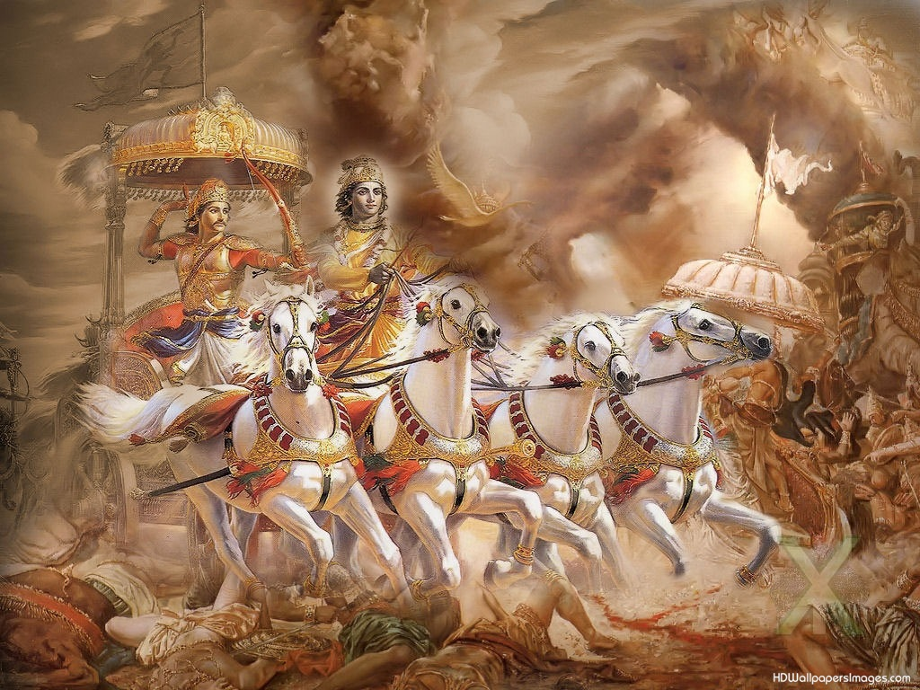
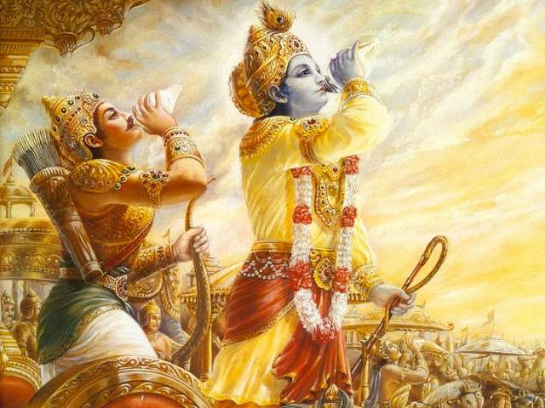

Slide 4
Caste System
Varnas – Aryan social classes based on skin color
Aryans viewed indigenous people as inferior
Castes were hereditary
Marriage between castes forbidden (no social mobility)
In order to break the cycle one must achieve moksha

Slide 5
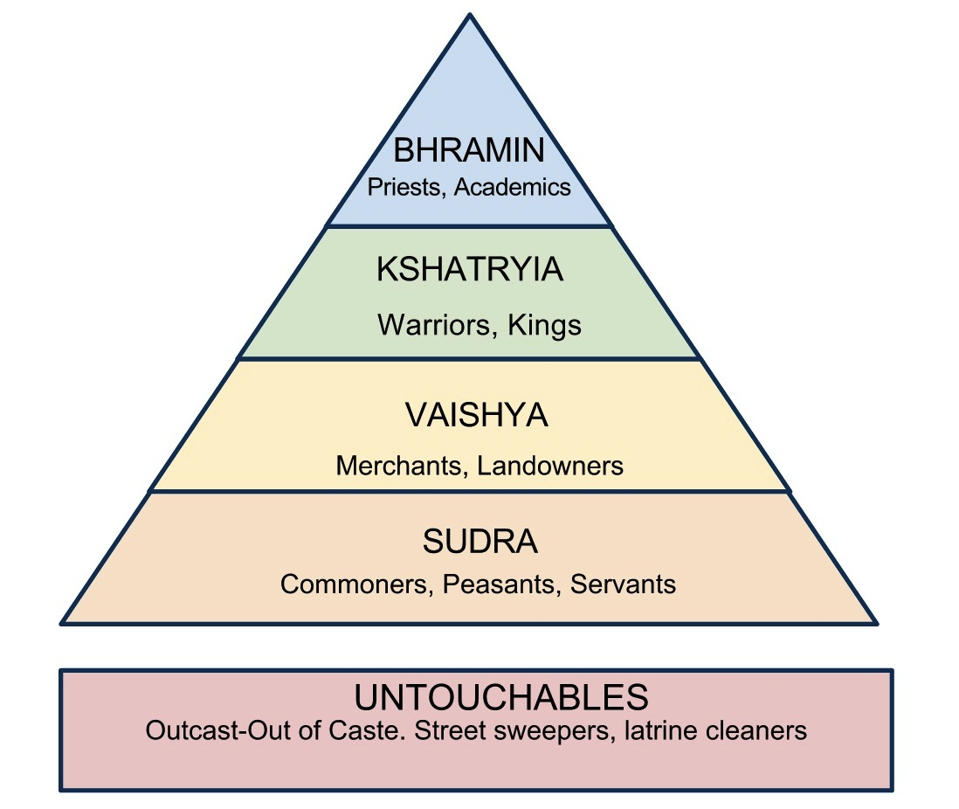

Slide 6
Mauryan Empire
A. Alexander the Great (327 B.C.E.)
Gave Indians contact with Hellenistic (Greek) culture
Hellenism: blending of Greek culture with others
Established Bactria
B.
Chandragupta Maurya
Mauryan Dynasty’s best known leader
Unified subcontinent
Autocratic – relied on the rulers personal and military power

Slide 7
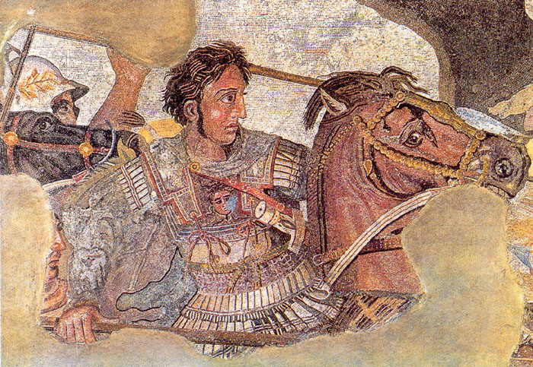
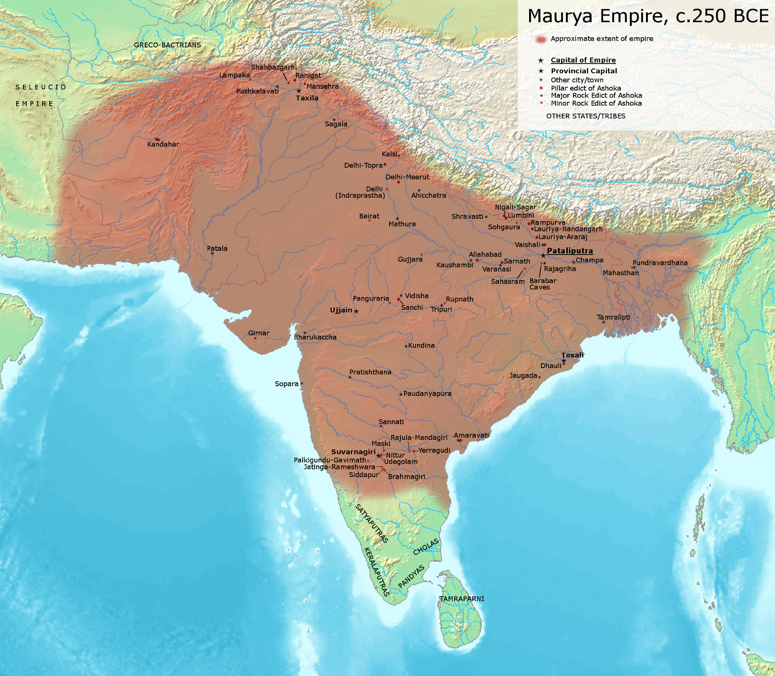
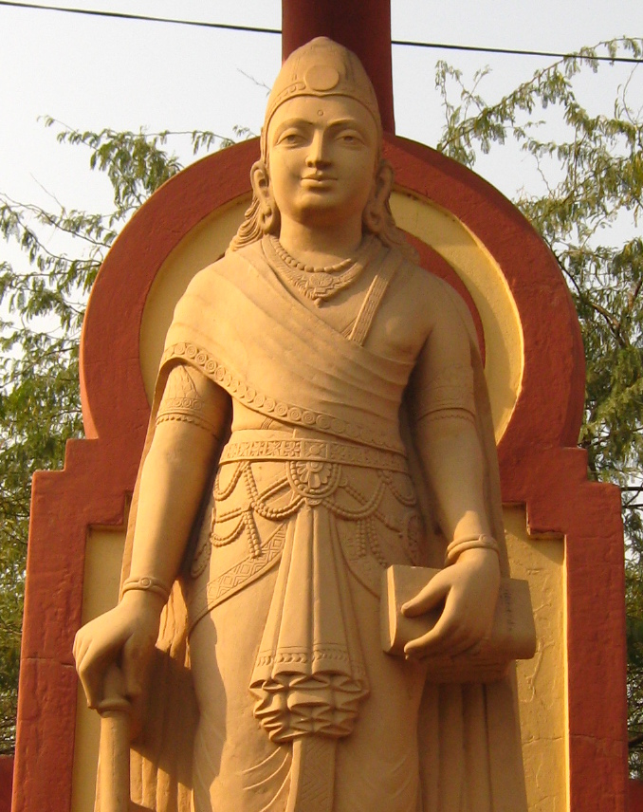

Slide 8
Ashoka (269–232 B.C.E.)
conversion to Buddhism
Believed in dharma
Sent Buddhist missionaries into the Middle East
D. Kushans
Invaded India
King Kanishka converted to Buddhism
This hurt the religion because it was associated with foreign rule

Slide 10
Gupta Empire
Claimed divine right
Implemented
Taxes
Uniform law codes

Slide 11
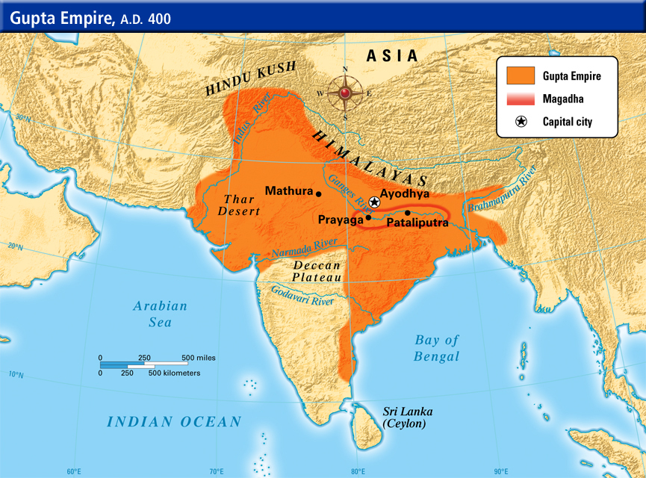

Slide 12
Religion
Hinduism was and is a unifying force
not monolithic – allowed religious diversity
No single founder or central holy figure
Karma – worldly pleasured affects reincarnation
Dharma – religious path

Slide 13
Core Beliefs
Reincarnation
Cremation
No eating beef
Divinities
Brahma – the creator
Shiva – the destroyer
Vishnu – the preserver

Slide 14
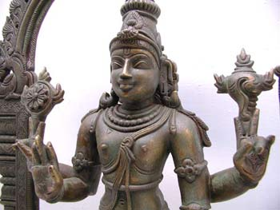
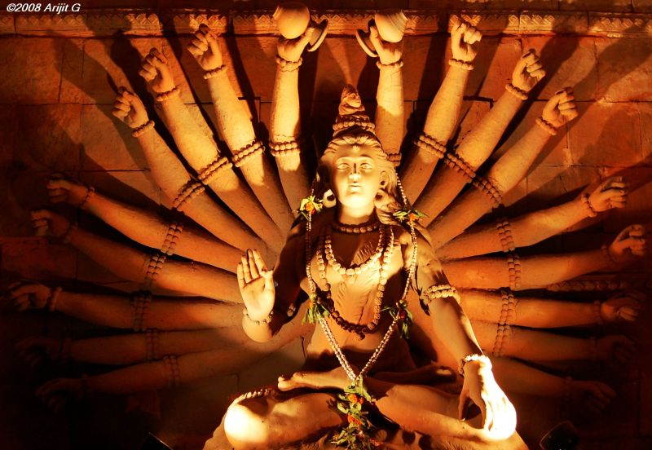
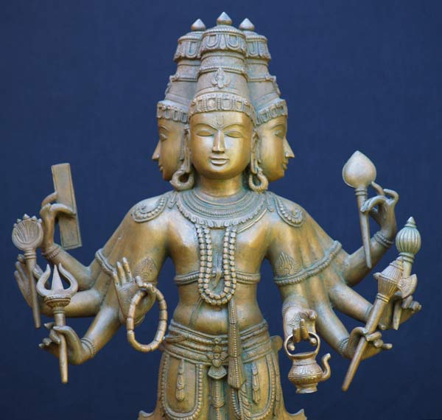

Slide 15
Buddhism
Gautama Buddha (ca 563–483 B.C.E.)
Buddha = enlightened one
rejected caste system
Nirvana
Monks & monasteries
Spread to China, Korea, Japan, & Sri Lanka

Slide 16
Economy and Society
Agriculture
Manufacturing
Textiles (cloth)
Iron making
Internal & maritime (sea) trade with Middle East, East Asia, China, & Roman Empire
Tamils – Indian traders
Indian Ocean Trade help spread both Hinduism and Buddhism

Slide 17
