Slide 1
Classical China
Late Zhou, Qin, and Han Dynasties

Slide 2
Confucianism: Kung Fuzi (ca. 551–478 B.C.E.)
Confucianism taught:
respect for superiors (fathers and husbands)
Obedience
leaders must show moderation in spending & lifestyle
rank in society/politics based on intelligence, merit
Dominate values were secular rather than religious
Analects - Confucian doctrine

Slide 3
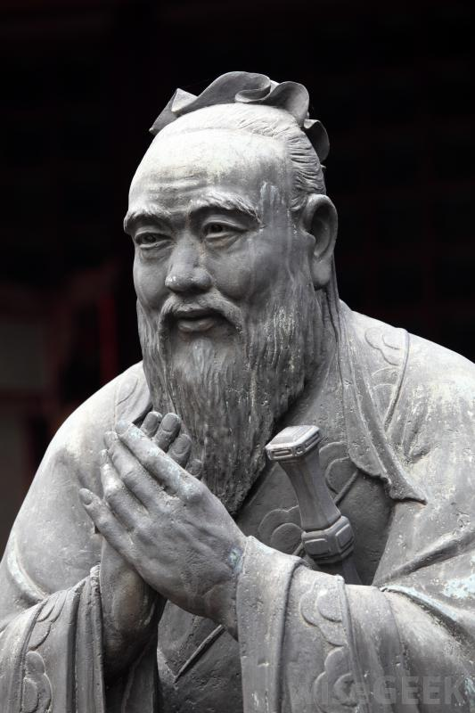

Slide 4
Warring States Period
Lasted from 475-221BCE
The region controlled by the Zhou Dynasty was divided into 8 states
Qin, Chu, Qi, Yan, Han, Wei, Yue, Zhao
Each state had a king
Fight amongst each other for power
By 230 BCE the Qin began to conquer the other states. In 221 BCE the Qi were the last to be conqured

Slide 5
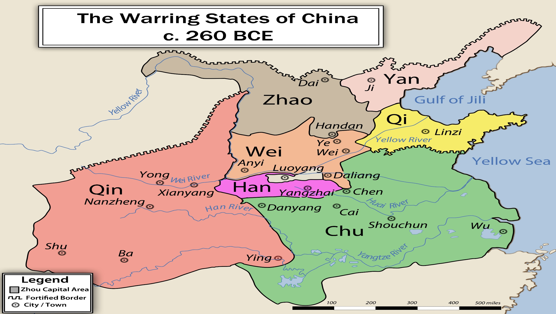

Slide 6
Qin Dynasty (221–207 B.C.E.)
Emperor Shi Huangdi
Tyrant ruler
Began building the Great Wall - 3000 miles
Legacy of the Qin Dynasty
census
standardized coinage, weights, measures
common writing system
Harsh legal system

Slide 7
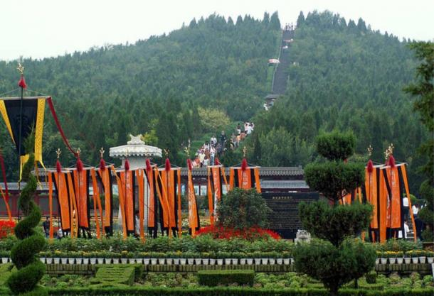
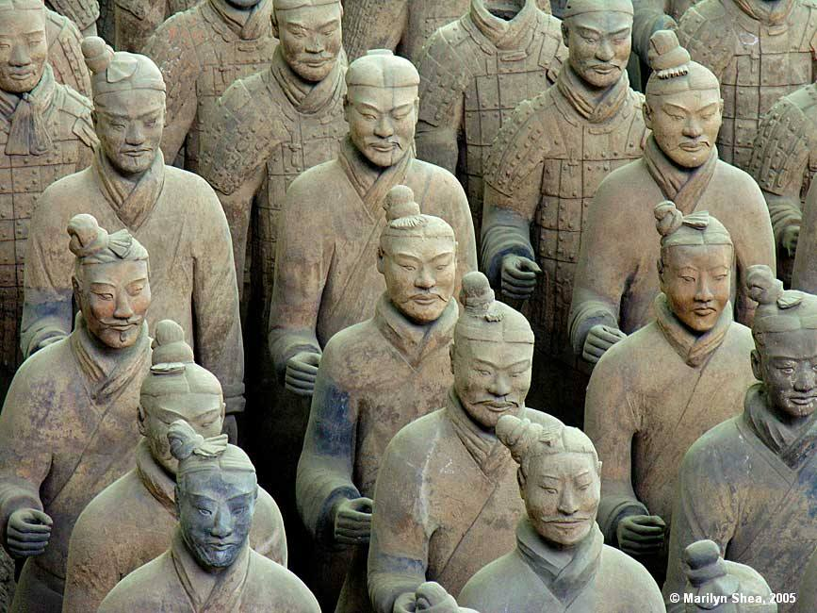
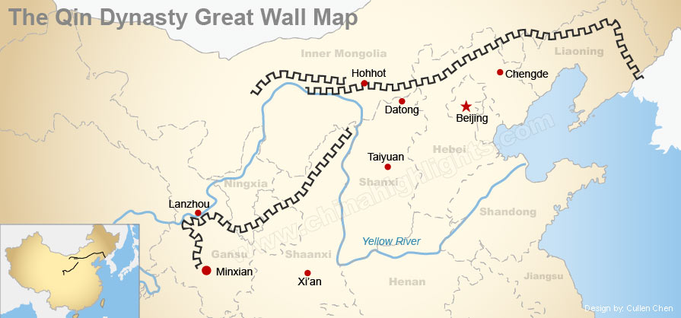
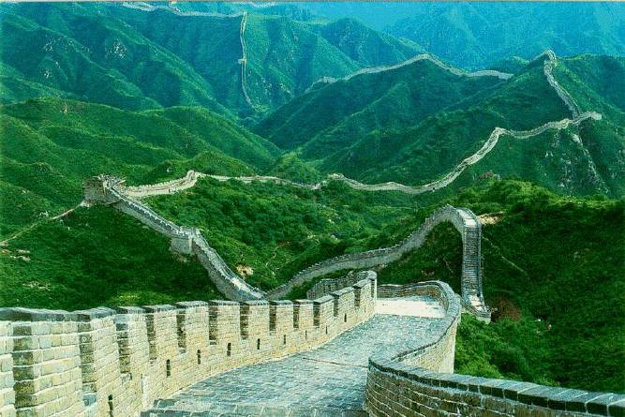
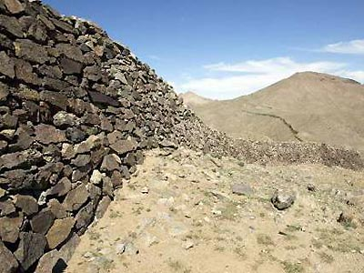
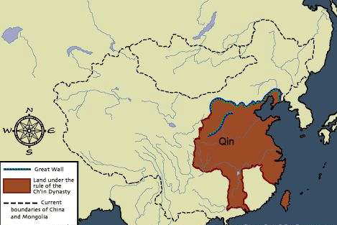
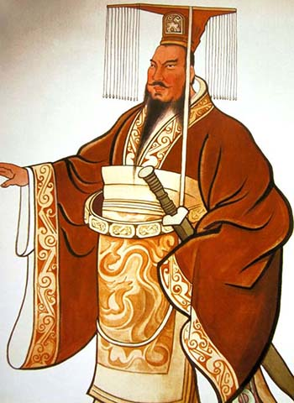

Slide 8
Han Dynasty (202 B.C.E.–220 C.E.)
Founded by Liu Bang (born as a commoner)
Han Dynasty conquers territory in Korea, Indochina, central Asia
contact with India, Parthian Empire
Founded the most enduring bureaucracy
Used Civil service exams
Emperor Wu (140–87 B.C.E.)
supported Confucianism (established the Imperial Academy)
Most famous Han ruler
Had shrines built to promote worship

Slide 9
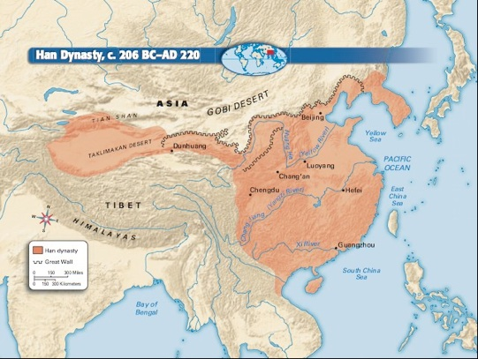

Slide 10
Legalism
Established by the Qin
Han Dynasties continues the practice
Alternative to Confucianism
Pragmatic (practical or realistic in manner)
Districts were ruled by the military under the Qin
Promotion is based on merit and education not on an hereditary title
Individuals read classical text including the Analects during the Han Dynasty
Governmental Structure:
Emperor
Prime Minister
Governor
Magistrate (local official)

Slide 11
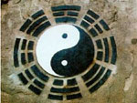
Daoism
Laozi (5th century B.C.E. Zhou dynasty)
Founder of Daoism
Means “the way of nature”
more religious than legalism
Appealed to the upper class
Believes in the force of nature
Ying & Yang
Uses ethical codes
Priests

Slide 12
Society
Agricultural based
Male dominated society (Patriarchy)
Only the wealthy upper class was literate
Slavery- house slaves were common
Inherited social status
Father was a noble you were a noble
Three main social groups
Mandarins - Landowning aristocracy, educated bureaucrats
Laboring Masses – peasants and artisans
“Mean” people – unskilled laborers, lowest status

Slide 13
Economics
Trade
Silk Road
luxury items – sold to upper class
Silks
Jewelry
Leather
furniture
Copper coins
Facilitated trade with merchants
Trade in Silk & Luxury products
India, Middle East, & Mediterranean societies traded with China for desired Chinese silk
Mostly nomadic merchants traded & traveled

Slide 14
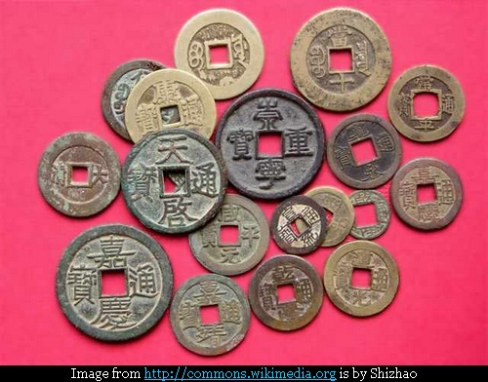
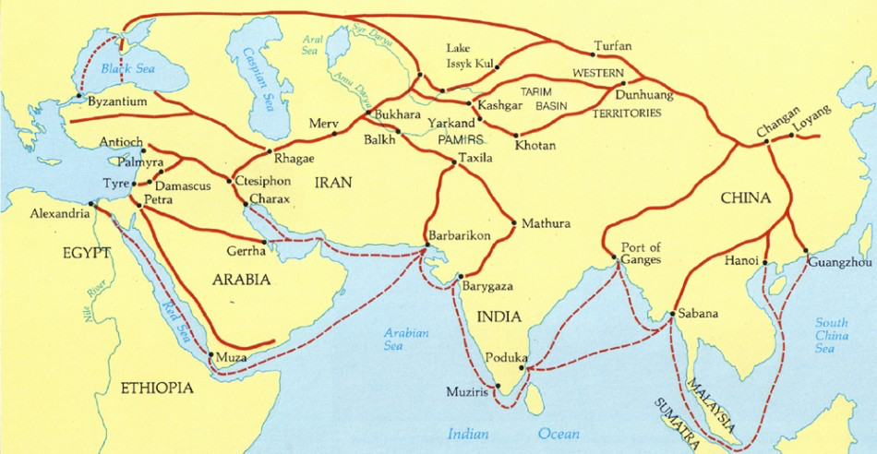

Slide 15
Innovative Legacy
Ox-drawn plows
Iron mining
Pulleys & winding gear to pull minerals to the surface
Iron tools & lamps
Water-powered mills
Creation of paper

Slide 16
