Slide 1
Civilization in Eastern Europe: Byzantium & Orthodox Europe
The Byzantine Empire

Slide 2
The Byzantine Empire Origins
Former Eastern Roman Empire
Constantine (4th century CE)
Constantinople became the capital
Greek official language
Commerce- traded with the east via the silk road
Flourished for centuries & weathered many attacks

Slide 4
The Byzantine Empire Justinian’s
Justinian Emperor after Constantine
Tried to restore Roman Empire
Belisarius (General of the Roman army)
Hagia Sophia – Orthodox Church
Justinian’s Code
Unified law based on Roman legal principles
Faced attacks from Slavs & Persians

Slide 5
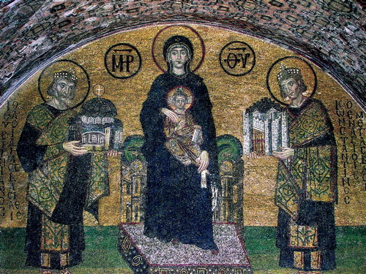
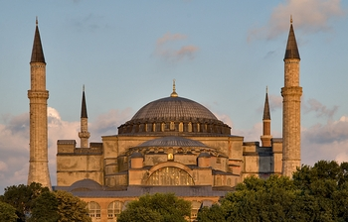
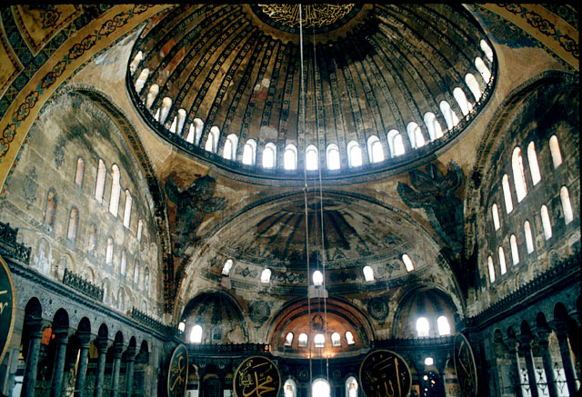
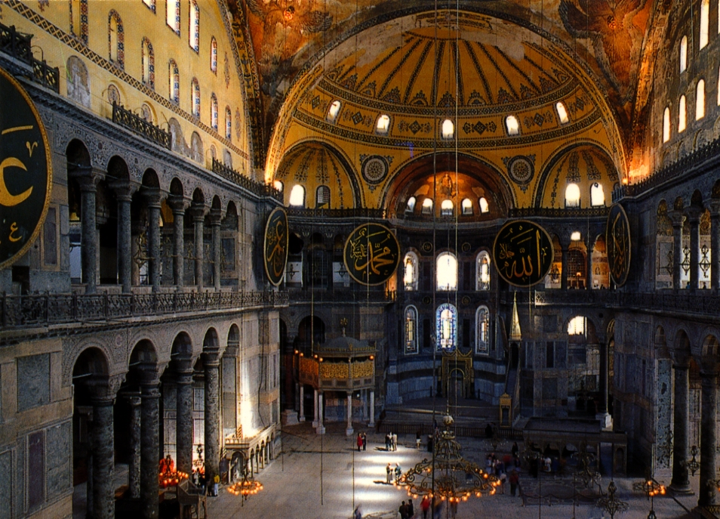

Slide 6
Arab Pressure & the Empire’s Defenses
7th Century Arab Muslims constantly attack Byzantine
Burdened economy
Peasants taxed heavily
Aristocratic estates grew in power
Center of Empire Shifts East
Bulgaria – Slavic Kingdom
Defeated by Basil II 11th Century
Byzantine was possibly considered the most powerful empire at the time

Slide 7
Byzantine Society & Politics
Emperor
Ordained by god
Head of Church
Passed religious & secular laws
Some women held throne
Theodora & Zoe
Sophisticated bureaucracy
Open to all classes
Provincial governors

Slide 9
Byzantine Society & Politics continued
Bureaucracy controlled trade & food prices
Trade with Russia, Asia, Scandinavia, Europe, & Africa
Specialized in luxury goods
Byzantine Empire resembled China in many aspects

Slide 10
The Great Schism
Split between Eastern & Western Christianity
Disagreement over papal authority
Differences:
West = priest chaste (couldn’t have sex)
Eastern = priests could marry
Patriarch Michael (head of the Eastern Church) and his followers were excommunicated by the Pope (Pope Leo IX)
Responded by doing the same to Roman Catholics

Slide 11
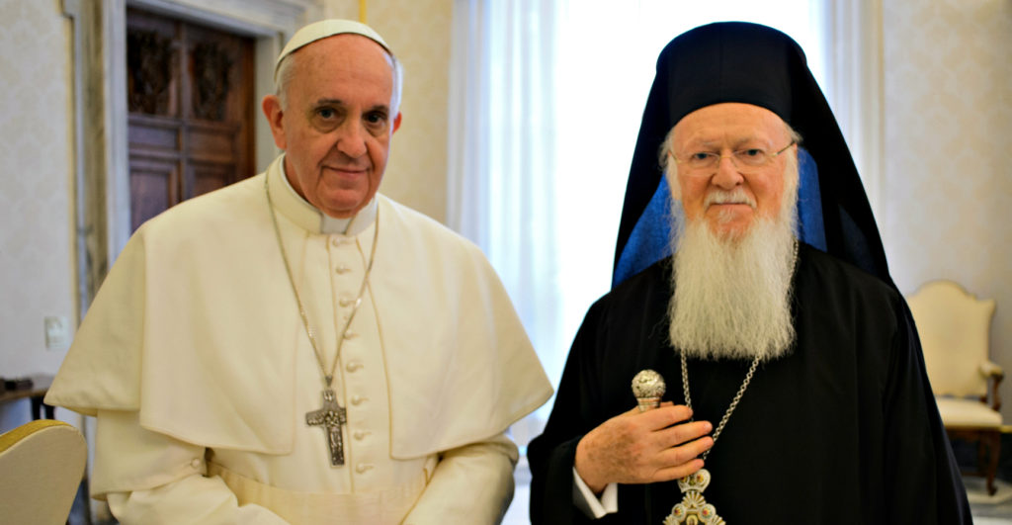

Slide 12
The Empire’s Decline and Fall
Began to decline in the 11th century
Lost Battle of Manzikert to Seljuk Turks and the empire never recovered
Take most of Byzantine Asian provinces
Turkish settlements & Slavic kingdoms
Appeal to Western Europe to bring the Crusades
Venetian crusaders conquer Constantinople
Empire falls in 1453 when they were conquered by the Ottomans

Slide 14
The Spread of Civilization in Eastern Europe
Influence through conquests, conversions, & trade
Cyril and Methodius sent to Czech and Slovak republics
Created a written script for the Slavic language
Cyrillic

Slide 16
The Spread of Civilization in Eastern Europe
The east central Borderlands
Competition between Catholics & Orthodox Greeks
Catholic Influenced the Czechs, Hungary, & Poland
Regional monarchies prevail
Jews from Middle East & W. Europe migrating to Poland

