Slide 1
China in the Middle Ages
Song Dynasty

Slide 2
Brief background : Early Chinese Dynasties
Shang Dynasty (1766-1045 BCE)
Agrarian society (rice and millet cultivation)
ancestor worship
Zhou Dynasty (1045-256 BCE)
Longest ruling dynasty
Developed concept of Mandate of Heaven
Idea that a dynasty holds power from a divine source
Developed Mandarin language
Confucianism and Daoism developed
Last few centuries known as the Waring States Period

Slide 3
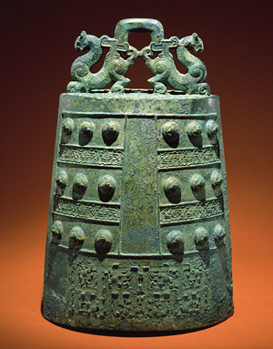
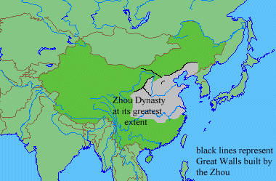
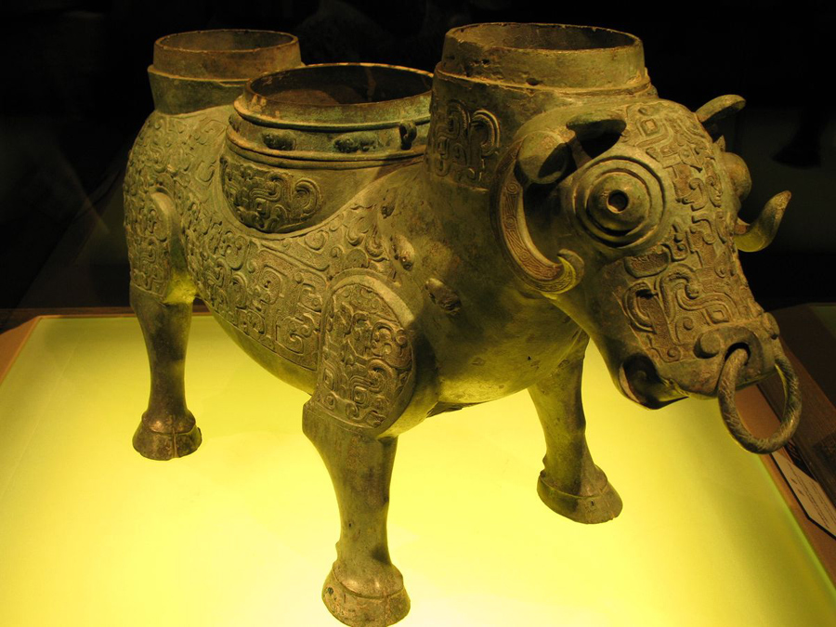
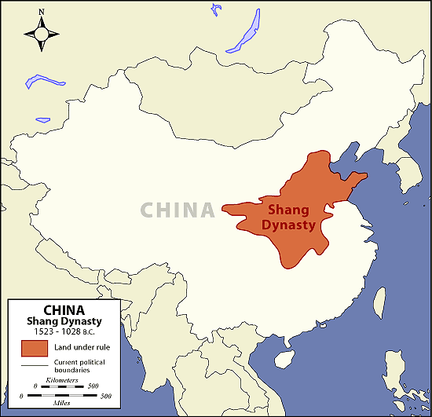
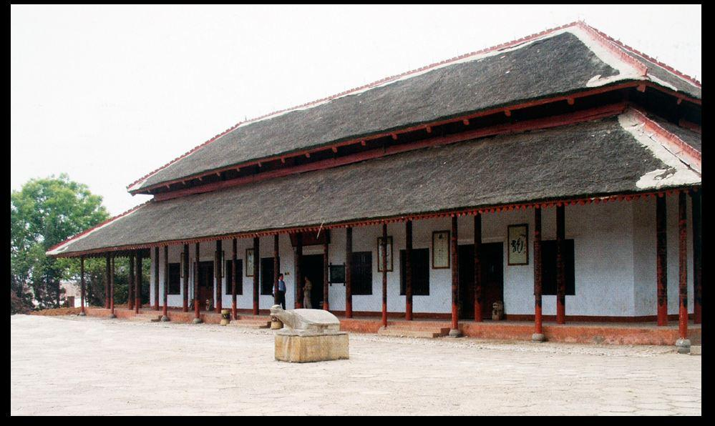
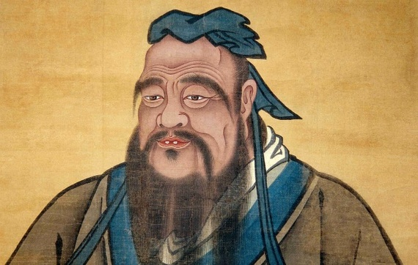
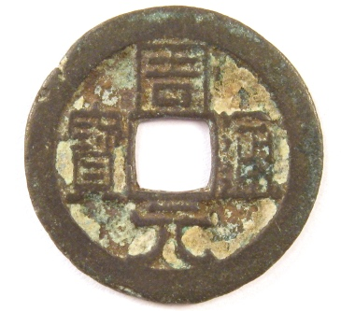

Slide 4
Brief Background: Classical Chinese Dynasties
Qin Dynasty (221–207 BCE)
Founded by Shi Huangdi
First imperial dynasty
Began the construction of the Great Wall
Census, standardized coinage, weights, measures
Developed harsh legal system known as legalism
Han Dynasty (202 BCE–220 CE)
Founded by a commoner (Lui Bang)
Expands Chinese territory (Korea, Indochina, and central Asia)
Adapted Qin legalism (made it less strict)
Invented paper

Slide 5
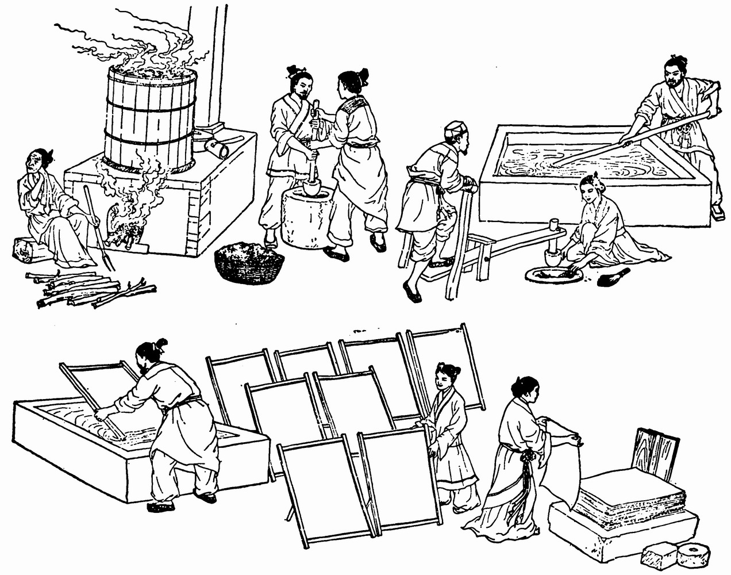
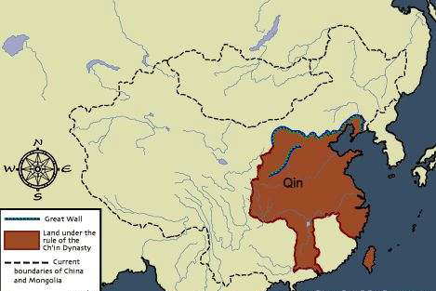
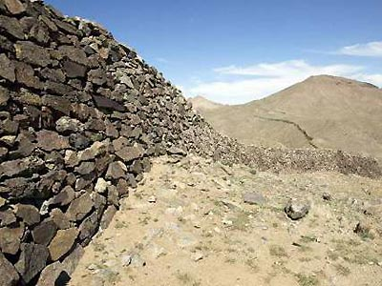
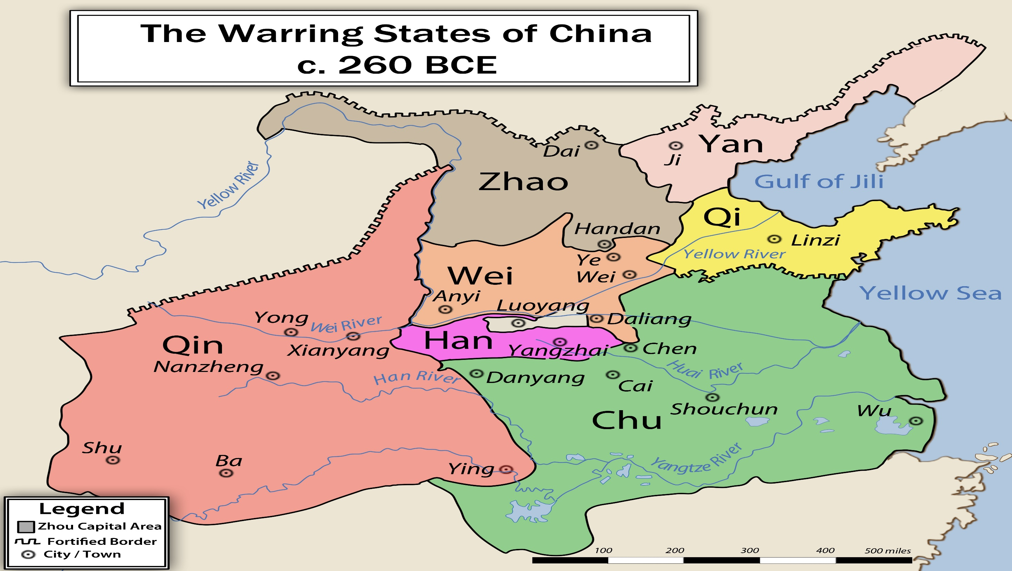
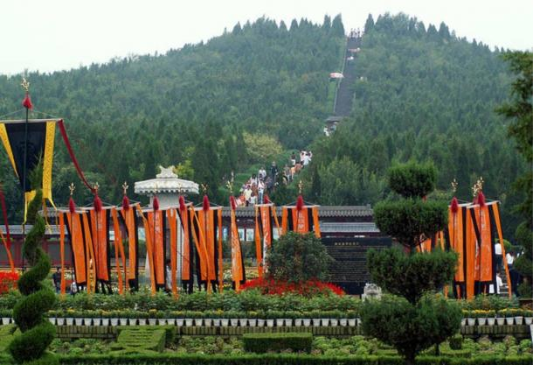
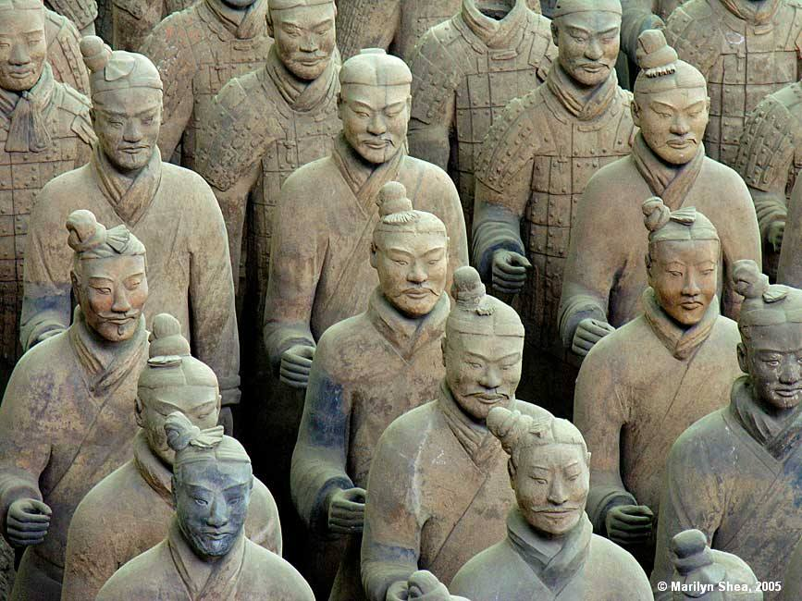
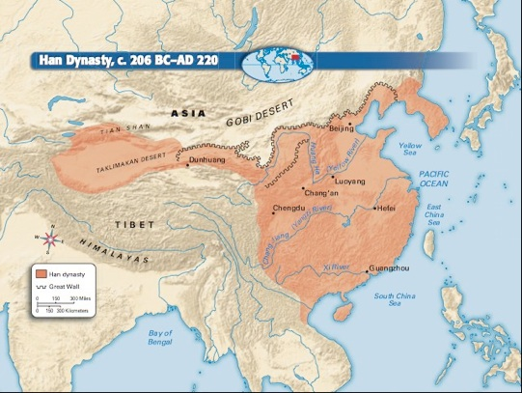

Slide 6
Brief Background: Chinese Dynasties of the Early Middle Ages
Sui Dynasty (589-618)
Founded by Wendi
Built new Capital at Loyang
Built the Grand Canal
Lowered taxes and increased food reserves
Scholar-gentry continued
Tang Dynasty (618-907)
Relative long period of peace
Capital of Chang’an was the most populous city in the world
Increased trade along the Silk Road
An Lushan Rebellion destabilized the empire in the mid 700s

Slide 7
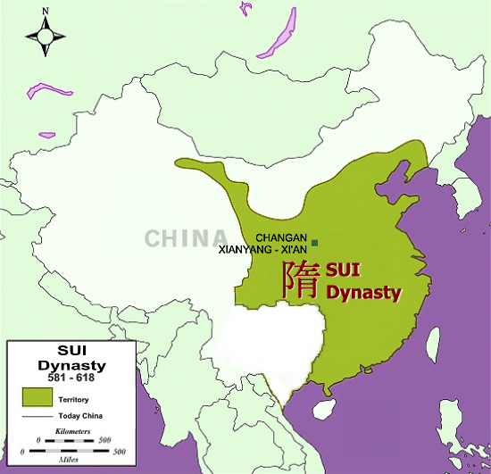
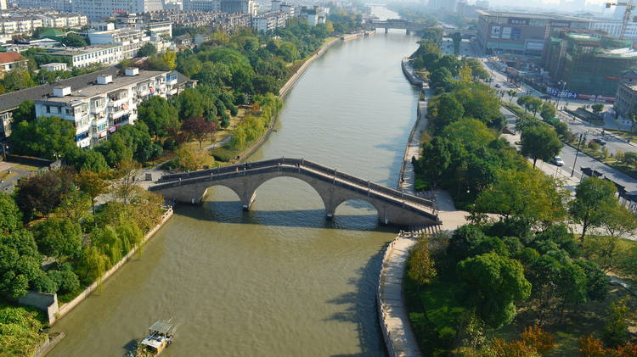
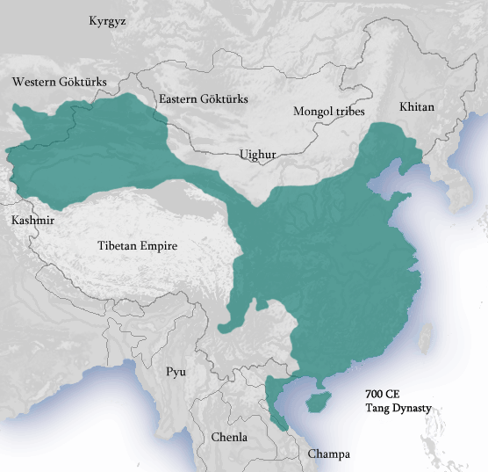
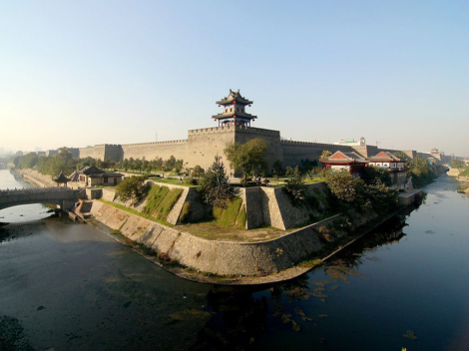

Slide 8
Common Characteristics of Ealry Chinese Dynasties
Patriarchal
Dominated by Confucian teachings
Filial Piety
Relied on trade between city states and later the Silk Road
Often was the largest empire on earth
Buddhism became rival to the traditional Confucian thought
China’s wealth was often sought by foreign powers, particularly Europeans

Slide 9
The Founding of the Song Dynasty
Last Tang Emperor resigns in 907
Zhao Kuangyin (Taizu)
Founded Song Dynasty in 960
Scholarly gentry emphasized
Song dynasty ruled for 300 years
Liao Dynasty founded by Khitan peoples (nomad)
Song had to pay tribute to Liao
The Khitan were sinified by Chinese and found Song culture superior
Nomadic peoples defeat the Song in the 13th century

Slide 10
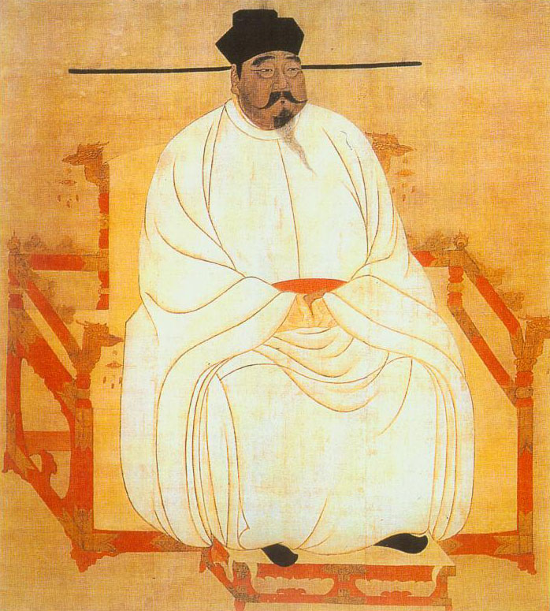

Slide 11
Song Politics: Partial Restoration
Military subordinate to scholarly gentry (shows civilian control)
Only civil officials allowed to govern to remove military influence
Military commanders rotated to prevent a build up of power
Civil service exam system still given (began during the Han dynasty)

Slide 12
The Revival of Confucian Thought
Libraries established
Study of classical texts still important
Neo-Confucians
stressed personal morality
Zhu Xi
Stressed philosophy in everyday life
Hostility to foreign philosophy such as Buddhism grew
Gender, class, and age distinction reinforced upholding patriarchal society
Thought historical experience was best

Slide 14
Roots of Decline: Attempts at reform
Khitan independence encourages other nomads
Tangut (originally from Tibet)
Xi Xia
Song pay tribute for protection of northern boarder
Wang Anshi
Confucian scholar and Chief minister
Reformer & Legalist
Supported Agricultural expansion
Taxed landlords and scholarly gentry

Slide 16
Reaction & Disaster: The Flight South
Wang Anshi dies 1085
Reforms reversed by his successor and the economy deteriorates
Jurchens (nomadic peoples) defeat Lao (Khitans)
Jin kingdom established 1115
Invaded the Song
Song flee south
Hangzhou becomes new capital
Southern Song Dynasty period lasts over a century is very prosperous

Slide 17
