Slide 1
China in the Middle Ages
Sui, Tang, and Song Dynasties

Slide 2
Sui Dynasty
Wendi (nobleman) reunited traditional core areas of Chinese civilization
Establishes Sui dynasty by defeating the Chen kingdom in 589
Reforms
Lowered taxes, increased food reserves, monitored food prices, and oversaw the construction of the
Grand Canal- connected the empire and allowed for quick transportation

Slide 3
Wendi’s son, Yandi, took control of the empire after his fathers death.
During the song dynasty a new social group was established.
Scholar-gentry reestablished (fancy word for educated government officials)
Yandi is assassinated in 618 (ends Sui dynasty)

Slide 4
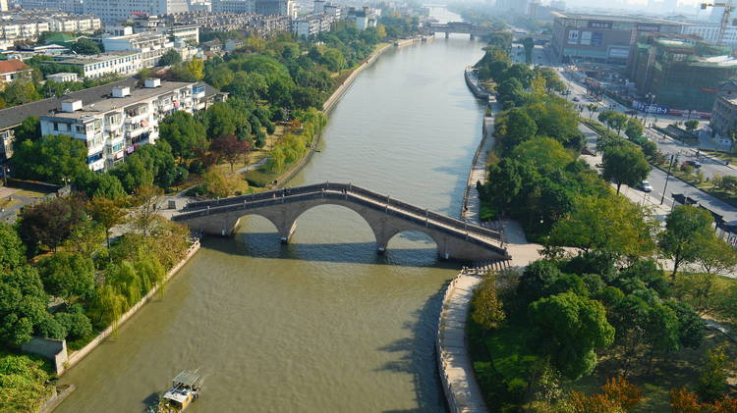
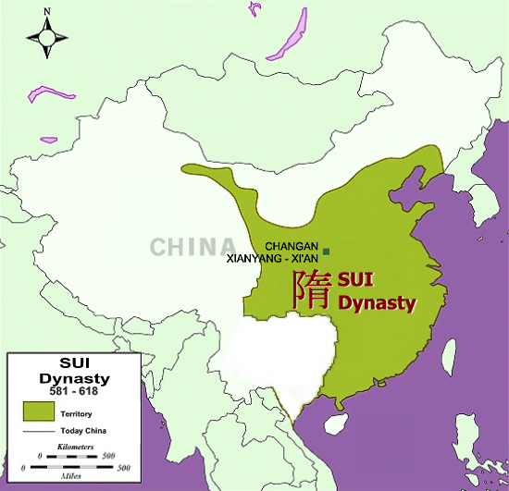
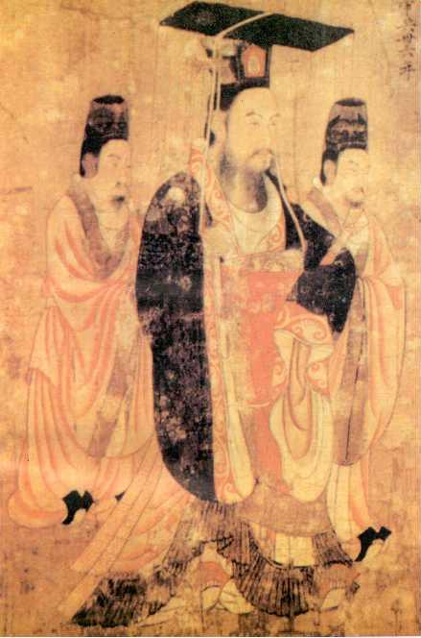

Slide 5
Tang Dynasty
Li Yuan, the Duke of Tang, took throne
Extends empire to Afghanistan, Tibet, Vietnam, Korea…
Repaired and continued to build the Great Wall

Slide 6
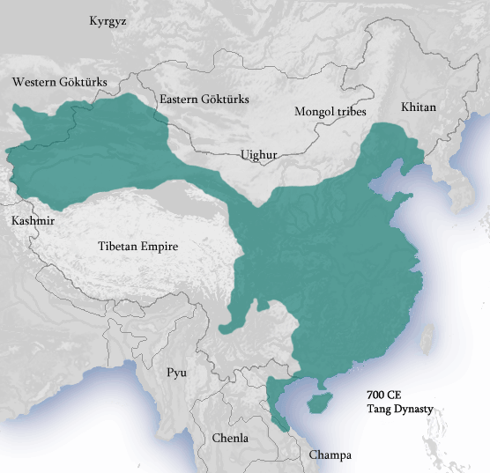
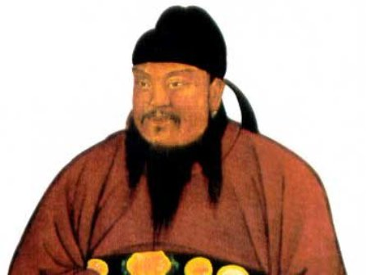

Slide 7
Politics, Society, and Culture
Aristocracy weakened by scholarly gentries
Confucian ideology revised
Changan – new capital
Ministry of Rites – exams given to students on philosophical or legal classics, and Chinese history
Confucianism and Buddhism rivals
Supported by Empress Wu
Tried to make Buddhism state religion
Attacked by Confucian and Daoist rivals
Emperor Wu: made Confucianism the official ideology of the state

Slide 8
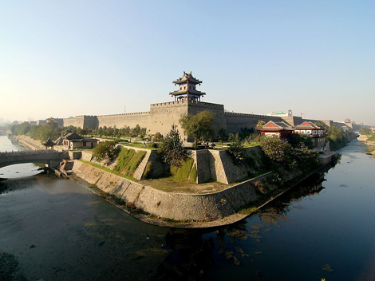

Slide 9
Song Dynasty
Zhao Kuangyin (Taizu)
Founded Song Dynasty in 960
Song dynasty ruled for 300 years but is splited into two periods
Norther and Southern Song Periods
Military subordinate to scholarly gentry (shows civilian control)
The nomadic Liao kingdom demanded that the Song pay tribute

Slide 10
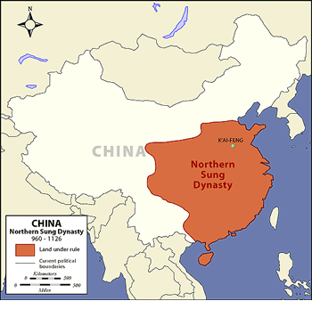
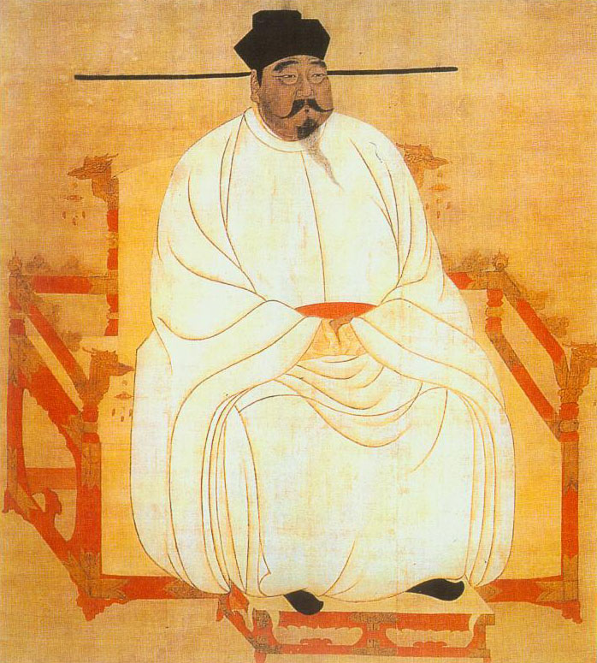

Slide 11
Decline of the Song
The Xi Xia- a nomadic group from the north that the Song had to pay tribute to
Jin Kingdom- large kindom that conqured the Xi Xia and invaded China forcing the Song to flee to the south.
The Song capital moves to Hangzhou
The Southern Song period has a long lasting legacy
Paper money
Compass
Gunpowder

Slide 12
