Slide 1
Causes of World War II
(1930-1939)

Slide 2
Economic and political causes of World War II
Aggression by totalitarian powers (Germany, Italy, Japan)
Nationalism
Failures of the Treaty of Versailles
Weakness of the League of Nations
Appeasement
Tendencies towards isolationism and pacifism in Europe and the United States

Slide 3
Aggression in Asia
China
Nationalists/Guomindang
Chiang Kai-shek
Japan
Militarization
Invade China
Manchuria in 1931
Becomes Manchukuo
Invades Korea
Emperor Hirohito
Hideki Tojo- General of Imperial Japanese Army and Prime Minister

Slide 5
Rise of National Socialism
After WWI: small group of nationalists formed the National Socialist (Nazi) Party
Attacked democracy
Promised to save Germany from Communism
Advocated extreme nationalism
Wanted dictatorship

Slide 6
Factors Explaining the Nazi Rise to Power
Lack of Democratic Tradition
German heritage = autocracy, not democracy
Appeal to Nationalism
Many Germans unable to accept defeat in WWI
Economic Distress
Germany had to pay reparations of $35 billion after WWI to France and Great Britain
Nazis promised to save the economy
Fear of Communism
Germans feared a Communist revolution due to bad economy
Nazis promised to save Germany from Communism

Slide 7
Rise of Adolf Hitler
Leader of Nazi Party
Austrian
Failed artist
Decorated WWI veteran
Brilliant organizer and speaker
Used propaganda and mass rallies to gain support and persuade people

Slide 9
The Beer Hall Putsch
In Munich in 1923
Nazi attempt at a revolution
Try to take over the city of Munich= fails
Hitler went to jail for about a year

Slide 10
Mein Kampf
Book written by Hitler while in jail
“Mein Kampf” = “My Struggle”
Outlined Hitler’s plans for Germany
Blamed the Jews & Communists for Germany’s defeat in WWI
Said Germans were a “master race” that should rule the world
Said Germans needed “Lebensraum” = living space
Explained his plan for the extermination of the Jewish race

Slide 11
Nazis Gain Power
Nazis gained support as economy kept getting worse in Germany
1932 election = Nazis got 37% of the popular vote
Made them the largest party in the Reichstag
1933 = Hitler appointed Chancellor by President Hindenburg
June 1934- Night of the Long Knives- purge of party members that were opposed to Hitler
November 9-10th 1938- Kristallnacht- night of the broken glass. Nazi party members attack Jewish owned businesses.

Slide 12
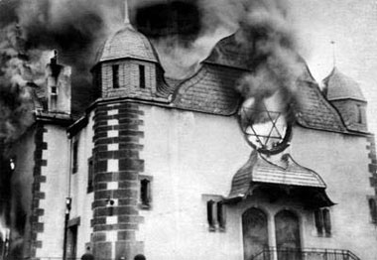
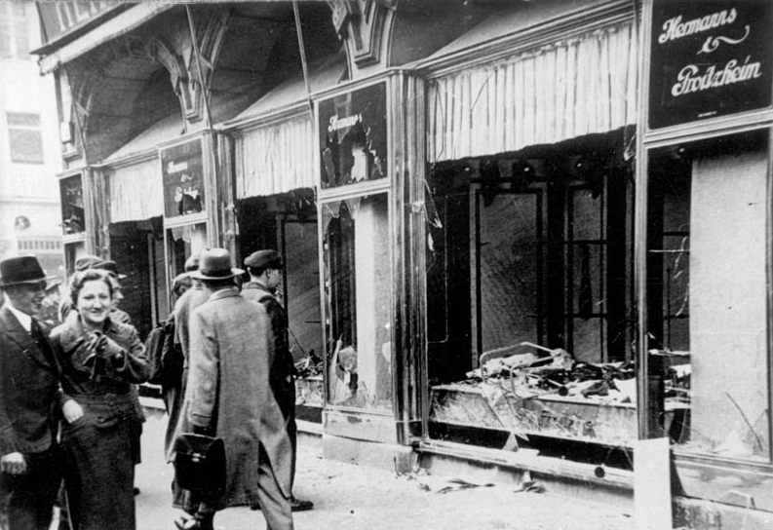

Slide 13
Spanish Civil War 1936-1939
Began on July 1936
Conservative forces in the Spanish military call for an end to the left winged republican government
Led by Francisco Franco
Both Germany and Italy back Franco by sending arms (planes, tanks, guns)
In March 1939 Republican forces surrendered Madrid to Franco. Ends the civil war
Franco will hold power in Spain until 1975
Spain will refuse to enter WWII on the side of the Axis. (does not enter the war at all)

Slide 14
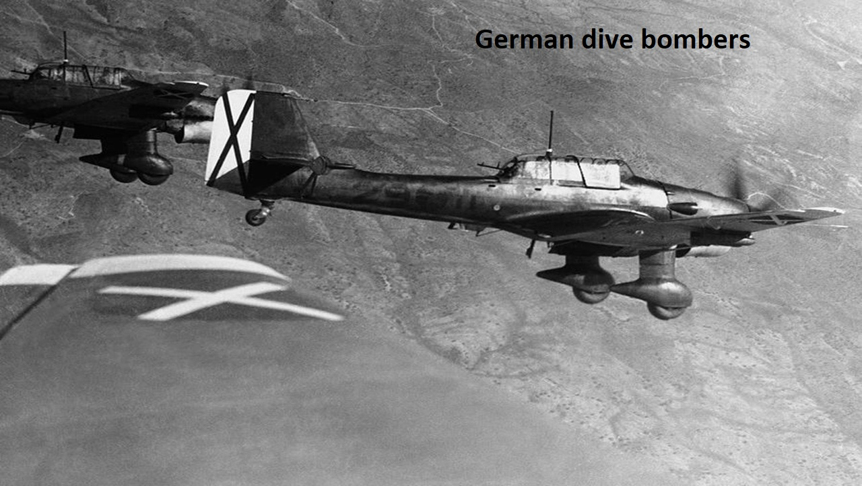
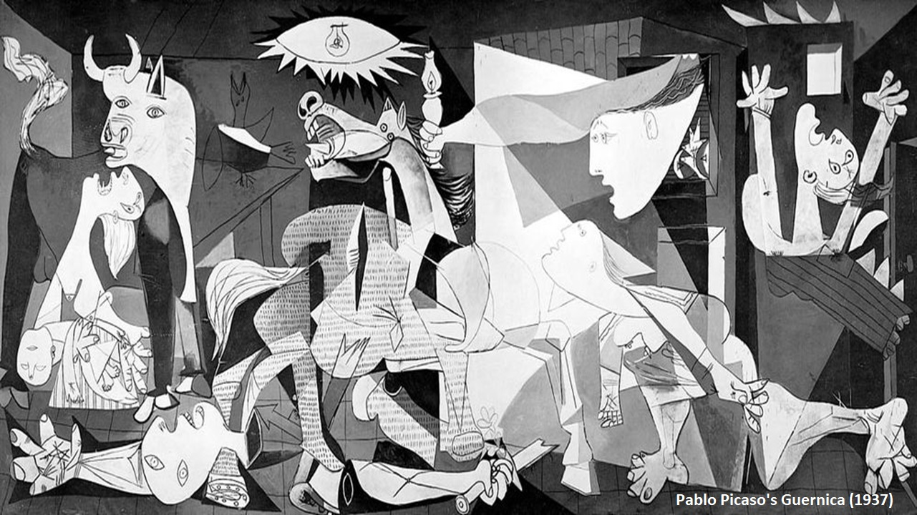

Slide 15
Unchecked Aggression in Europe
Rhineland
Occupied in 1936
No international response
Anschutz (annexation of Austria) in 1938
Sudeten Land in 1938-1939
Claimed that Germany needed lebensraum (living space)
Region was predominantly German
Munich Agreement- British and French agree with German assurance of no more expansion
Invasion of Poland in 1939
Germany Invades Poland on September 1, 1939

Slide 16



