Slide 1
British Politics and Society of the Victorian and Edwardian Ages
1850-1910
Notes:
Are your classroom colors different than what you see in this template? That’s OK! Click on Design -> Variants (the down arrow) -> Pick the color scheme that works for you!
Feel free to change any “You will…” and “I will…” statements to ensure they align with your classroom procedures and rules!

Slide 2
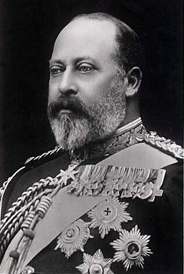
Reigned 1837-1901
Reigned 1901-1910

Slide 3
Political Parties
The period between 1850 and 1865 saw the realignment of political parties
The Tory Party was transformed into the Conservative Party under Benjamin Disraeli (1804-1881)
Whig Party transformed into the Liberal Party under William Gladstone

Slide 4
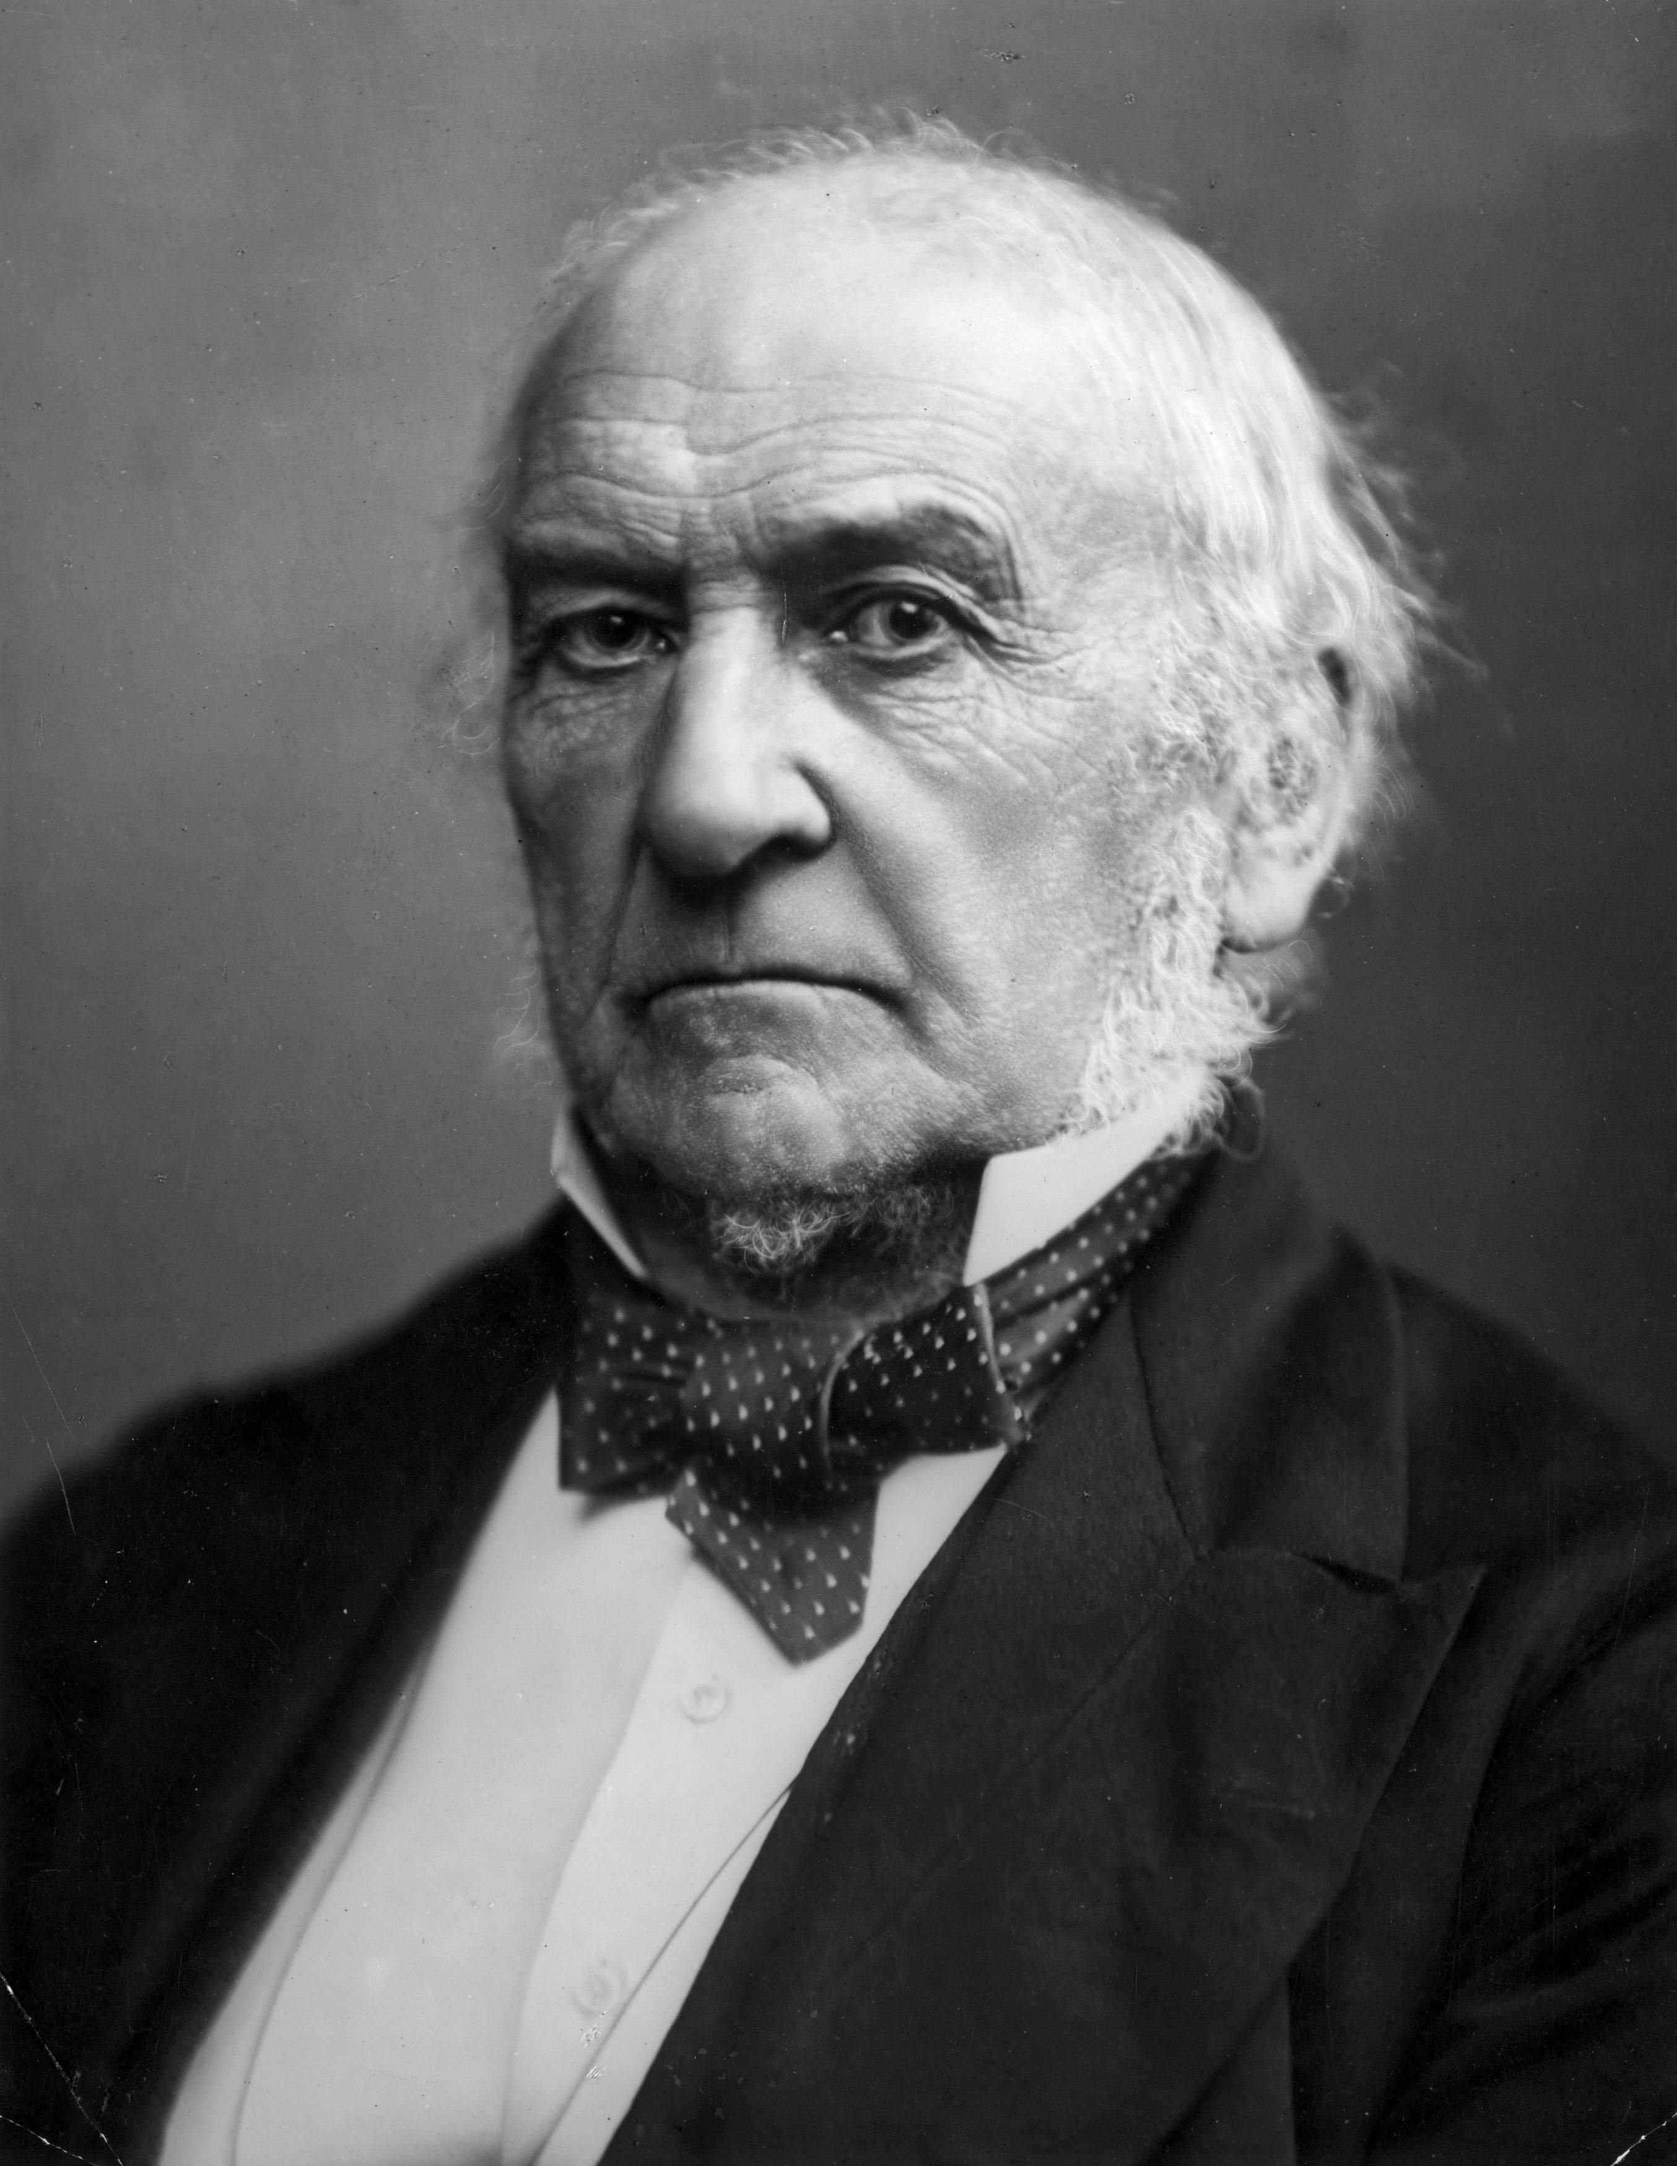

Slide 5
Expanded Democracy
After 1865 Britain saw expanded democracy under Disraeli and Gladstone
Disraeli:
Argued for aggressive foreign policy,
Expansion of British empire
Reluctantly supported democratic reforms
Was influenced by John Stuart Mill’s On Liberty
Influential work on necessity to increase democracy
Reform Bill of 1867: “leap in the dark”: Sponsored by Disraeli
Redistributed seats to provide more equitable representation in the House of Commons
Almost all men over 21 who resided in urban centers were granted suffrage
This almost doubled the number of men who could vote but it was not universal suffrage

Slide 6
William Gladstone: (most important liberal figure in 19th century England)
Supported Irish home rule
Fiscal policy
Free trade
Extension of democratic principles
Opposed imperialism
Was proponent of the Australian Ballot Act (1872): provide for secret ballot
Reform Act of 1884
Granted suffrage to adult males in counties on the same basis as in the boroughs
This added 2 million agricultural voters

Slide 7
Groups Seeking Extended Democracy
Groups included women's suffrage, anti-imperialists, socialists, and anti-nationalists
Fabian Society (1883):
Advanced a form of revised Marxism
Wanted political democracy and economic socialism
Independent Labor Party
This became a vocal third political party
Attracted trade unionists, socialists, those that did not see the Conservative or Liberal parties serving the needs of the people

Slide 8
Programs of the Liberal Party
Between 1905 and early 1920s the Liberal party advanced many aggressive social and economic programs
Parliament Act of 1911 (most significant reform under Liberal Party rule)
Eliminated powers of the House of Lords. Making the House of Commons the center of national power
Reduced the length of Parliament from 7 to 5 years
The party set the foundation for more social welfare programs in the decade before WWI
Right of unions to strike
Gov’t insurance for those injured on the job
Unemployment insurance and old age pensions
Compulsory school attendance
Taxes increased on the wealthy (meant to help fund the welfare state)

Slide 9
Women’s Suffrage Movement in England
By the 1890s, women’s rights activist realized that suffrage was the key to remedying other problems
Suffragettes
Came largely from the middle class
Benefited from education
Many middle class women did not have to work giving them time to become activists
Working-class women and socialists distrusted the middle class and worked toward their goals independently

Slide 10
Millicent Garrett Fawcett (1847-1929)
Leader of the National Union of Women’s Suffrage Societies (NUWSS)
Demanded that parliament grant female suffrage
Helped grow the suffrage movement
She was knighted in 1924
Emmeline Pankhurst (militant suffragette)
Infuriated that parliament would not grant females the vote
Founded (along with her daughter) the Women's Social and Political Union (WSPU) based on militant principals
Beginning in 1907 the WSPU undertook violent activates such as destroying railroads, works of art, store windows, and chaining themselves to gate sin front of Parliament
Organized parades and demonstrations
Many female militants were arrested
Many went hunger strikes in protest
Emily Davison committed suicide by throwing herself in front of a horse at the 1913 Epsom Derby

Slide 11
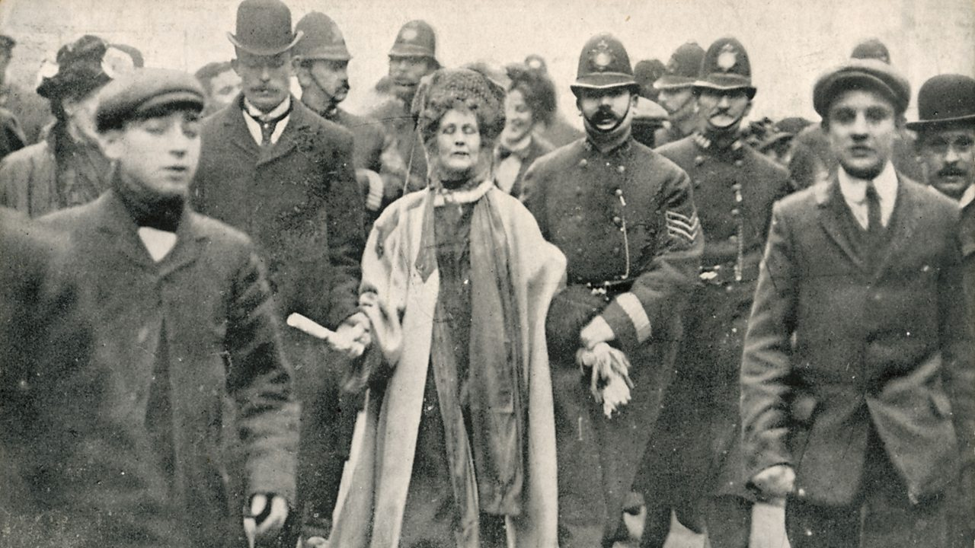
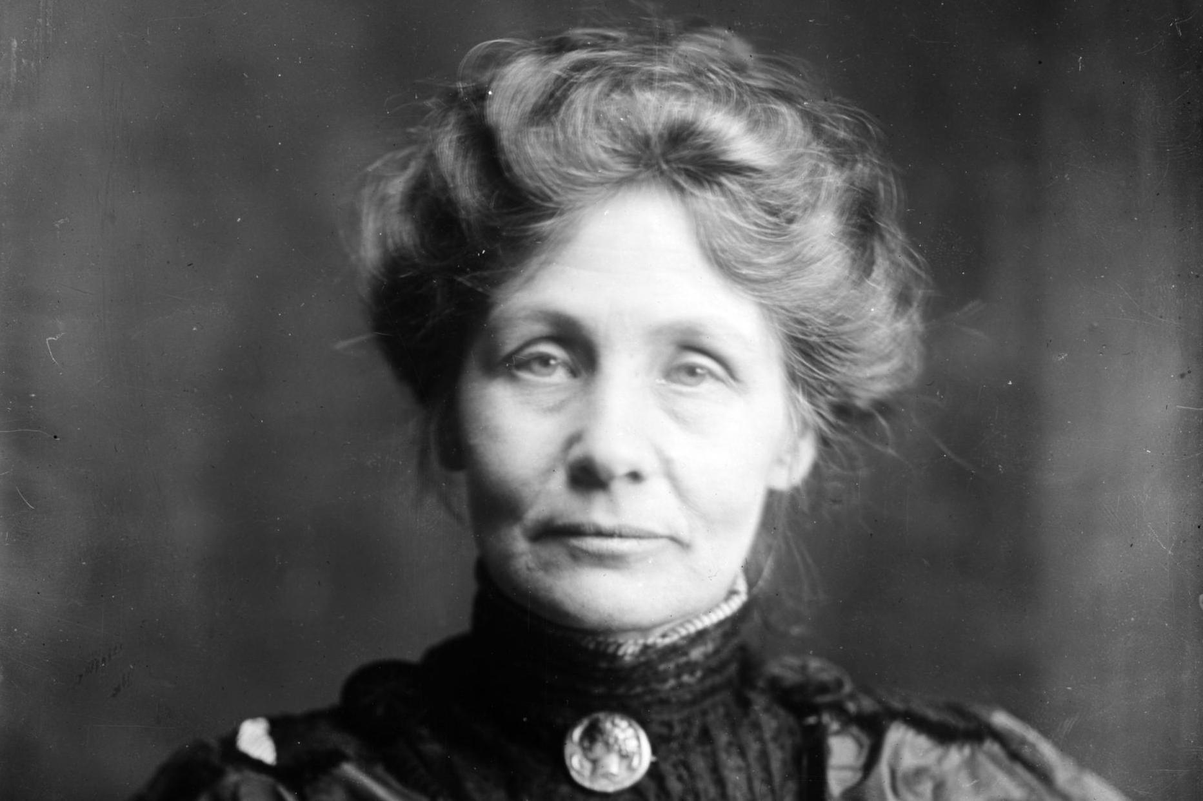

Slide 12
Representation Act of 1918
Due to contributions to the war effort during WWI Parliament granted all women over the age of 30 the right to vote
Reform Act of 1928
Women over the age of 21 gained the right to vote

Slide 13
The Irish Question
The Irish question was the most serious and recurring problem faced by Britain from 1890 to 1914
Gladstone (Liberal Party) had pushed unsuccessfully for Irish Home Rule
Ulster- Protestant counties in northern Ireland)
Opposed Irish Home Rule due to economic growth from the mid-1890s
The Ulsterites were supported by British public opinion
In 1914 Irish Home Rule was passed by house of Parliament but the Protestants did not accept it
Implementation was deferred until after WWI
Easter Rebellion (1916)- failed militant movement seeking independence from Britain
1922- Ireland officially gained independence; however, N Ireland remained part of the British Empire

