Slide 1
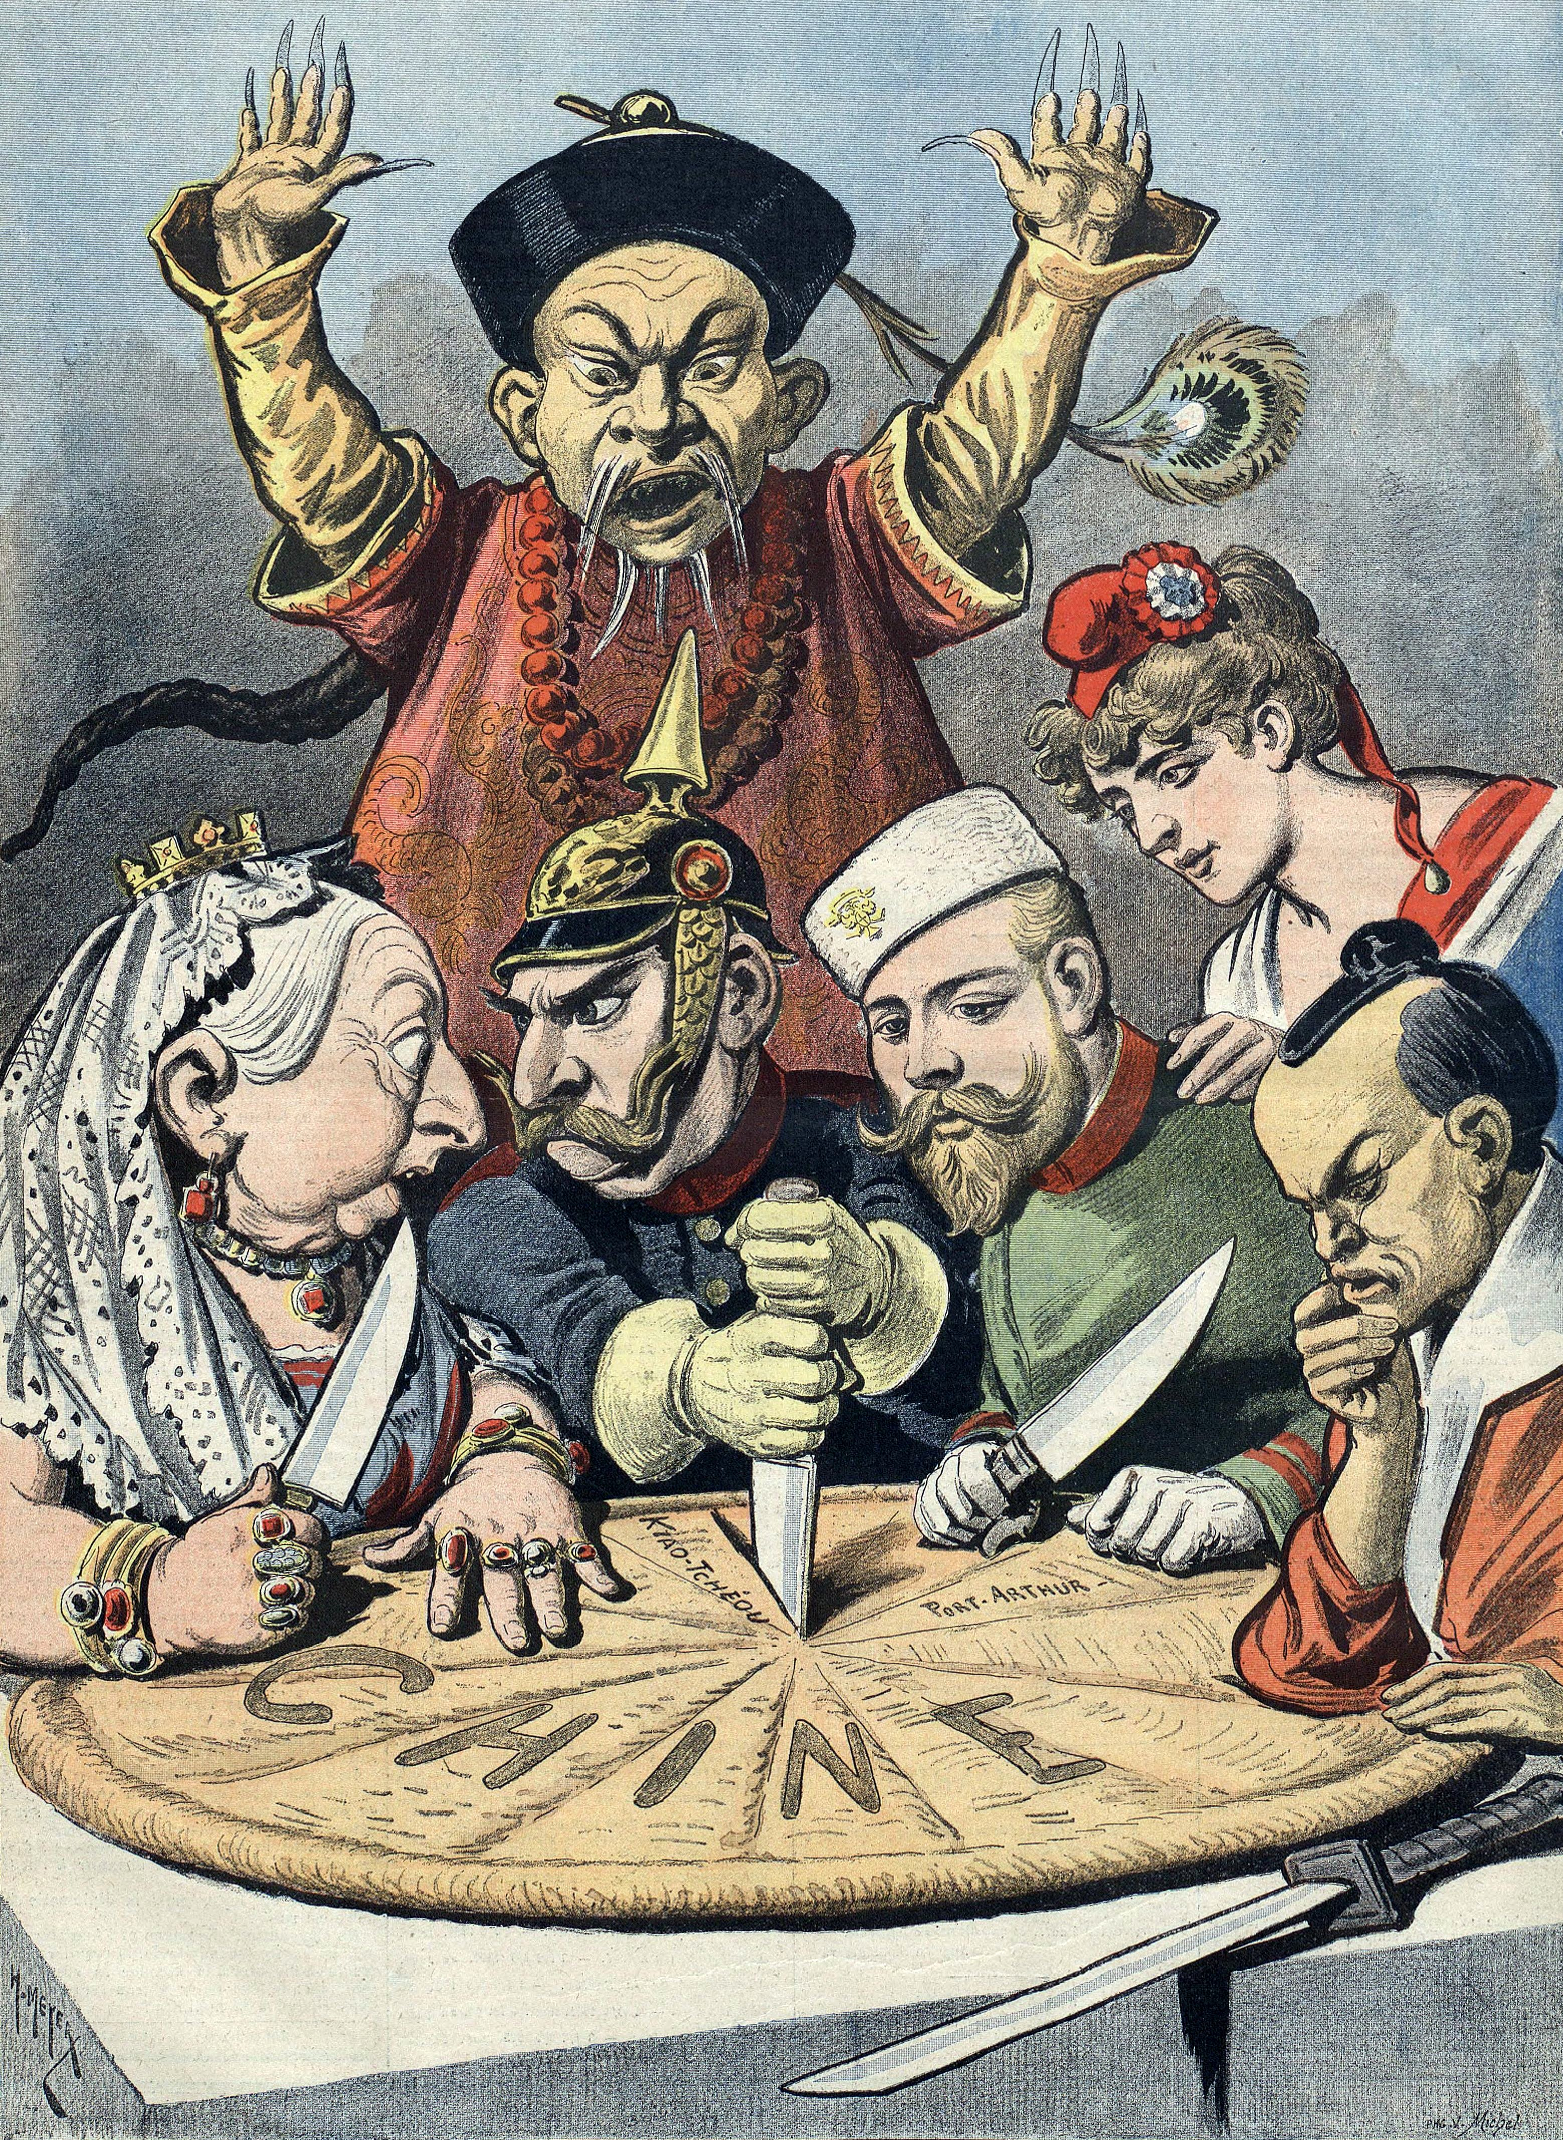
Age of Imperialism
Africa and Asia

Slide 2
Old Imperialism
Occurred between the 16th and 18th centuries
European powers did not usually acquire territory in Africa and Asia but rather built a series of trading stations
The New World was the exception
Spain established an enormous empire in Central and South America and lay claim to large portions of western North America.
Portugal established Brazil as a sugar colony and imported massive numbers of slaves from Africa
England colonized the east coast of North America
France established a colony in modern-day Canada as well as sugar colonies in the Caribbean

Slide 3
European Migration
Between 1815 & 1932 over 60 million people left Europe
Great Britain, Ireland, Italy and Germany saw the largest number of emigrants leave their homelands.
Migrants went primarily to European-inhabited areas: North & South America, Australia, New Zealand & Siberia
European migration provided further motivation for Western expansion
Most emigrants were poor and from rural areas, though seldom from the poorest classes (due to oppressive land policies)
Jewish emigrants who went to the U.S. in large numbers were the least likely to return to their homelands due to the persecution of Jews in eastern Europe.

Slide 4
New Imperialism
Began in 1880s in Africa; earlier in Asia
In 1800 Europeans controlled about 7% of the world’s territory; by 1914, they controlled 84%!
British Empire controlled about 25% of the world’s population by 1900 and 20% of the world’s territory:
The saying was “Empire upon which the sun never sets”
Europeans colonized Africa and Asia by:
using military force to take control of local governments
exploiting local economies for raw materials required by Europe’s growing industry
imposing Western values to benefit the “backwards” colonies.
Britain’s control of Egypt in the 1880s became the model for the “New Imperialism”

Slide 5
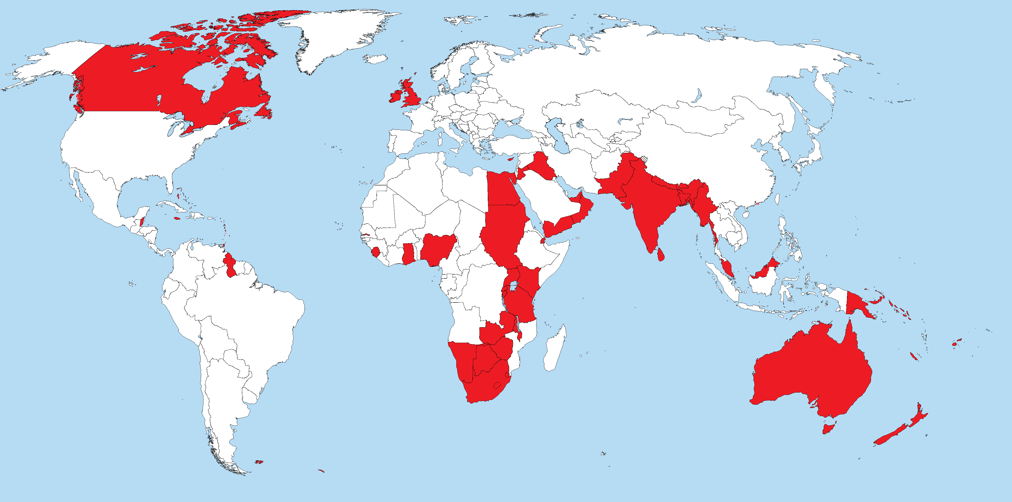

Slide 6
Major Causes for the Imperialist Impulse
A. Search for new markets and raw materials to fuel domestic industries
Examples of raw materials: ivory and rubber in the Congo, diamonds in South Africa, cocoa in Niger, tea in China and Ceylon (Sri Lanka), cotton from India, spices from Indonesia Missionary Work
B. Missionary activities proved far more successful in sub-Saharan Africa than in Asia and Islamic North Africa.
Dr. David Livingston: first white man to do humanitarian and religious work in south and central Africa
H. M. Stanley found Livingston (whom westerners thought to be dead) and his newspaper reports created European interest in Africa; Stanley sought aid from the king of Belgium to dominate the Congo region.
C. New military and naval bases to protect one’s interests against other European powers

Slide 7
D. Ideology: nationalism and Social Darwinism
“Survival of the fittest” ideology (Herbert Spencer) rationalized the conquest of weak countries by stronger more civilized ones
"White Man's Burden": racist and patronizing view that preached that the “superior” Westerners had an obligation to bring their culture to “uncivilized” peoples in other parts of the world.
This phrase was coined by Rudyard Kipling in his poem by the same name

Slide 9
Africa

Slide 10
Belgian Congo
1879, at the behest of Leopold II, British-American journalist H. M. Stanley established trading stations in the Congo and signed specious treaties with African chiefs that gave Leopold control of the Congo.
In 1884-85 the Berlin Conference recognized the region as the “Congo Free State” and as Leopold’s personal possession.
The Belgian rulers savagely treated the indigenous peoples in their quest for rubber and ivory
The Belgian Parliament, horrified by revelations of atrocities in the Congo, took the personal colony away from Leopold in 1908 and made it a Belgian colony
Leopold’s incursion into Congo basin raised the question of the political fate of black Africa (south of the Sahara); as did Britain's conquest of Egypt

Slide 12
British Egypt
Turkish general Muhammad Ali had made Egypt into a strong and virtually independent state by 1849
Egypt's inability to satisfy foreign investors led to control of its finances by France & Britain
1875, Britain bought a significant portion of shares for the Suez Canal and began managing it.
In 1883, Britain declared Egypt a protectorate, setting the stage for similar practices by other European powers.
Protection of the Suez Canal was a key motive in British occupation of Egypt and its bloody conquest of the Sudan.
Britain claimed the protectorate would only be temporary.
Technically, Egypt was still part of the Ottoman Empire but Britain actually controlled the country.
Egypt remained a protectorate of Great Britain from 1883 until 1956

Slide 13
The “Scramble for Africa”
In 1880, Europeans controlled 10% of Africa; by 1914, controlled all except Liberia & Ethiopia
Penetration into the African interior began in the late 1870s when Belgium took control of the Congo
Britain’s conquest of Egypt in the early 1880s became the model for the “New Imperialism”
The Berlin Conference in 1884-85 established the rules among European powers for carving up Africa
a. No imperial power could claim a territory in Africa unless it effectively controlled that territory
b. Slavery and the slave trade in Africa was terminated
The conference sought to prevent international conflicts between European nations over the issue of imperialism

Slide 15
The British Empire in Africa
Britain prided itself on being the most enlightened of the imperialist powers (though its rule can still be considered oppressive).
Sudan
After taking control of Egypt Britain pushed southward to the Sudan
Battle of Omdurman (1898): General Horatio H. Kitchener defeated Sudanese tribesman and killed 11,000 (with machine guns) while only 28 Britons died
Fashoda Incident (1898)
France & Britain nearly went to war over Sudan
France backed down (partly because it was in the midst of the Dreyfus Affair)

Slide 16
South Africa and the Boer War (1899-1902)
Cecil Rhodes had become Prime Minister of Cape Colony in South Africa
Principal sponsor of the “Cape-to-Cairo” dream where Britain would dominate the African continent.
Diamonds and gold were discovered in the Transvaal region and Rhodes wanted to extend his influence there but Boers controlled the region (the descendents of white Dutch settlers)
Boers initially successful in repelling British troops
Kruger Telegram (1902): Kaiser Wilhelm II dispatched a telegram to the Boers congratulating them on defeating British invaders without need of German assistance
Anger at Germany swept through Britain
Massive British force eventually defeated Boers and in 1910 the Transvaal, Orange Free State, Cape Colony, & Natal combined to form the Union of South Africa.
By 1890, Britain controlled Nigeria, Kenya, Uganda and Zanzibar
Germany recognized British control of these regions in return for British recognition of German control of an island naval station in the North Sea

Slide 17
French Empire in Africa
Algeria
Since 1830, the French had controlled Algeria in North Africa.
The attack on French shipping by Barbary pirates was used as a pretext for conquest.
Algeria remained under French control until the early 1960s.
Tunisia
1881, France justified its annexation of Tunisia due to frequent raids into Algeria by Tunisian rebels.
Tunisia became a French protectorate
Britain abandoned its claims to Tunisia at the Berlin Conference in 1884-85.

Slide 18
French control of the northern Congo basin was also recognized at the Berlin Conference
Somaliland (modern-day Somalia) gave France territory on the east African coast.
Madagascar, an island off the coast of east Africa, seized by France in 1896.
France controlled French West Africa (including the Ivory Coast and the Sahara)
Britain recognized these claims in return for French recognition of British control of Egypt and the Sudan.
By 1914, France controlled most of Morocco

Slide 19
German Africa
Since Germany wasn’t unified until 1871, it was late to the imperialist game compared to Britain and France.
Prior to 1884, Bismarck had not been very interested in colonialism as he was more concerned about dangers posed by Russia to his east and France to his west
The Berlin Conference was organized by Bismarck to provide for a more orderly conquest of Africa.
This guaranteed that Germany would now be a major player in Africa.
Germany thus set about establishing a number of small protectorates in Africa.
By WWI, Germany controlled territory in Africa five times larger than Germany itself.
1884, Germany took control of Cameroon and Togoland in West Africa.
1885, Germany formally claimed Tanganyika which was renamed German East Africa.
This was easily done since German businessmen had already dominated the region.
Southwest Africa also came under German control.
German control was particularly brutal as a local rebellion resulted in Germans killing over 50,000 men, women and children.

Slide 20
Italian and Portuguese Africa
Italy was the last of the European powers to participate in the scramble for Africa.
Eritrea on the Red Sea coast became Italy’s first colony in Africa in the 1880s.
In 1896, Italian forces were defeated trying to take Ethiopia.
Italy became the first European country to suffer a defeat by Africans.
6,000 Italian troops killed; thousands taken prisoner
Mussolini sought to rectify this humiliating defeat by conquering Ethiopia in 1935.
Libya was taken from the Turks in 1912.
Portugal controlled Angola in southwest Africa and forced the people there to accept what amounted to slavery

Slide 21
Asia

Slide 23
China
Opium Wars with Britain
The increasing British trade of opium in China in the mid-19th century took a large toll on the Chinese people.
The Chinese gov’t demanded that Britain stop selling opium in China
In the First Opium War (1839-1841) Britain occupied several coastal cities and forced China to surrender.
Treaty of Nanking, 1842
Gave Hong Kong to Britain (until 1997)
Four “treaty ports” were opened to British trade including Canton and Shanghai.
British residents in China (and European visitors) were granted extraterritoriality and were thus immune from Chinese law.
Second Opium War (1856-1860)
China was forced to open six more ports to British and French trade indefinitely.
China was forced to accept trade and investment on unfavorable terms for the foreseeable future.

Slide 25
Taiping Rebellion of 1850
Primarily caused by differing Chinese factions: rebels opposed the ruling Manchus
As many as 20 million people perished.
The Manchus defeated the rebellion after 14 years with the help of the British military.
Spheres of Influence
By the late-nineteenth century, much of eastern China had become subject to domination by Britain, France, Russia, Japan and Germany.
Japan gained Taiwan as a result of the Sino-Japanese War (1894-95).
This conflict revealed China’s weaknesses and resulted in further control by imperialist powers.
Britain gained a trade monopoly on the Yangtze River.
France gained a lease on Canton Bay and a “sphere of influence” in trade in several southern provinces.
Russia controlled northern Manchuria seeking to build a railroad through the region.
Germany gained a 99-year lease on the port of Qingdao and concessions to build two railroad lines in the Shandong Province.

Slide 27
The U.S. in 1899 demanded an “Open Door” to trade in China resulting in an agreement that the imperialist powers in China would not interfere in any treaty port or the interests of another power.
Boxer Rebellion, 1900
Led by a Chinese secret society of nationalists, the Society of the Righteous and Harmonious Fists, a rebellion in northern China killed European officials and sought to force out Western and Japanese influence.
A multi-national army including Great Britain, France, Japan, the U.S., Germany, and Russia crushed the uprising and foreign domination of China continued until the birth of the Chinese republic in 1911.
In 1911, the Qing dynasty was overthrown and replaced by a republic led by nationalist Dr. Sun Yat-sen.

Slide 28
India
Since 1763 The British East India Company (BEIC) had controlled India
Sepoy Mutiny, 1857-58
Insurrection of Hindu and Muslim soldiers in the British Army spread in northern and central India before it was crushed, primarily by loyal native troops from southern India.
Sepoys had resented British taking direct control of Indian states.
The short term cause was the British use of animal fat to grease rifle cartridges which was sacrilege to both Muslim and Hindu faiths.
Result: After 1858, India was ruled by British Parliament in London and administered by a tiny, all-white civil service in India.
The BEIC no longer controlled India.
Britain created of a unified and powerful Indian state.
Often referred to as one of the following; Direct Rule, Crown Rule, or the British Raj

Slide 29
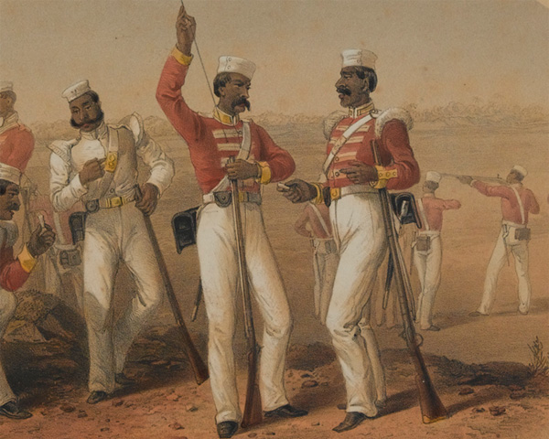

Slide 30
The Indian National Congress was formed in 1885.
Purpose: Britain trained Indians to run India along British lines.
Educated Indians, predominantly Hindu, increasingly demanded more equality and self-gov't.
Due to the INC’s leadership in the independence movement led by Mohandas K. Gandhi and Jawaharlal Nehru, India gained its independence in 1947 (just after WWII)
Other British colonies in Asia
Burma (1820s)
Malay Peninsula (Malaysia)
North Borneo (Indonesia)

Slide 32
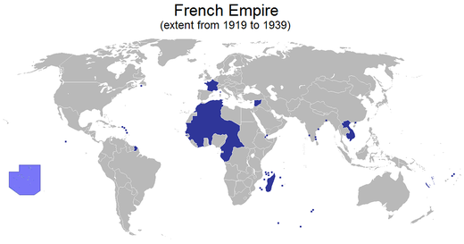
French Indochina
Indochina (modern-day Vietnam, Cambodia, Laos)
It became a protectorate in the 1880s and 1890s.
In the South Seas, France took Tahiti and New Caledonia.

Slide 33
German and Spanish Possessions
Germany:
controlled the Marshall Islands and Samoa in the South Pacific
Spanish-American War (1898):
The U.S. defeated Spain and took the Philippines, Guam, and Hawaii.

Slide 34
Opponents of New Imperialism
Karl Marx- Das Kapital (1867)
He claimed that the bourgeoisie needed constantly expanding markets to increase profits; this would inevitably lead to conquest.
J. A. Hobson
most prominent of the anti-imperialism theorists
He stated that imperialist powers needed colonies in order to provide new markets for domestic European goods.
He claimed that businessmen and bankers unduly influenced government’s imperialist policies.

Slide 35
