Slide 1
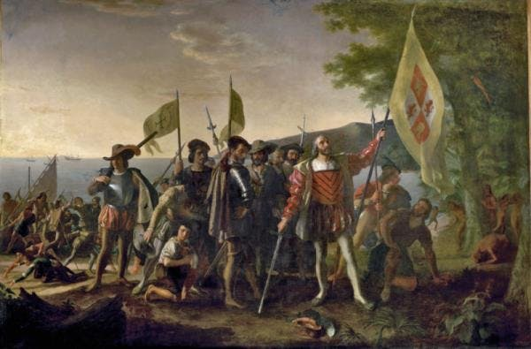
Age of Exploration and Conquest

Slide 2
Causes for Exploration
God, glory, and gold” were the primary motives.
Christian crusaders in 11th and 14th centuries created European interest in Asia and the Middle East.
Rise of nation states (New Monarchs) resulted in competition for empire and trade
Portugal and Spain sought to break the Italian monopoly on trade with Asia
Impact of the Renaissance: search for knowledge
Revival of Platonic studies, especially mathematics
Awareness of living “at the dawn of a new age”
Invention of the printed book resulted in the spread of accurate texts and maps

Slide 3
The commercial revolution resulted in capitalist investments in overseas exploration.
The religious desire to convert pagan peoples in the New World served as an important impulse.

Slide 4
Maps
Advances in cartography (map making) improved navigation
Martin Behaim: terrestrial globe, 1492
Waldseemullee’s word map (1507)
Mercator (1569)
Portolani: navigational maps based on compass directions and estimated distances for ports and coastal areas
Portugal and Spain saw them as state secrets.

Slide 5
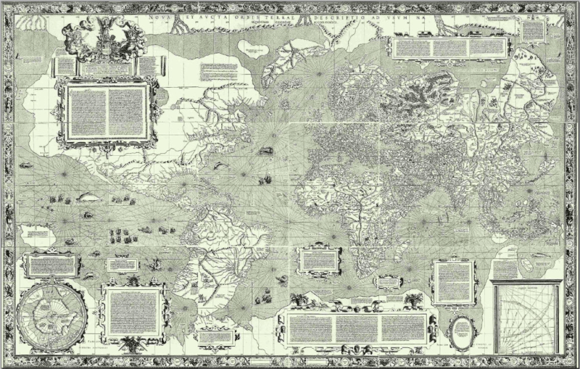
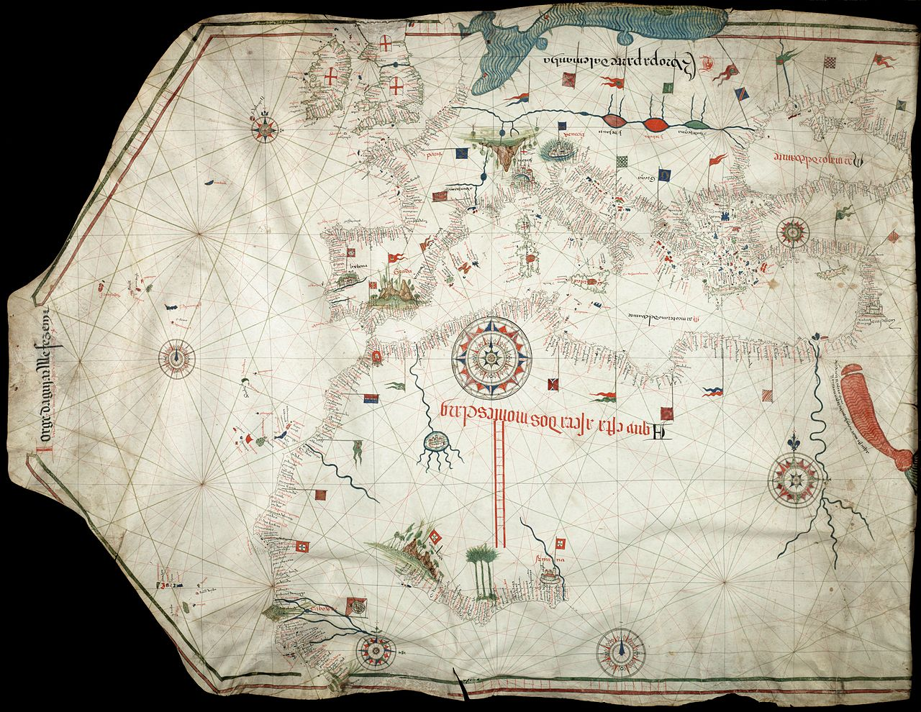
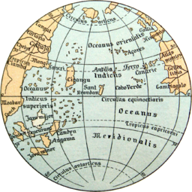
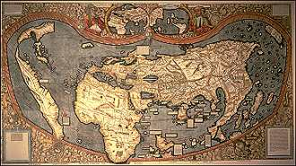

Slide 6
Technological Advances
Advances in astronomy helped in charting locations at sea
Instruments
Magnetic compass (ca. 1300)
Geometric quadrant (ca. 1460)
Mariner’s astrolabe (ca. 1480)
Ships
Portuguese caravel (ca. 1450)
Lateen sail and rope riggings
Stern-post rudder (axial rudder)
Guns, gunpowder, cannons, and horses

Slide 7
Portugal
Portugal established a commercial network along the African coast, in South and East Asia, and in South America.
Motives for exploration
Economic: sought an all-water route to Asia to tap the spice trade
The Ottoman Empire blocked land routes to Asia.
Religious: sought to find the mythical Prester John (a Christian king somewhere in the East) for an alliance against the Muslims
Prince Henry the Navigator (1394-1460)
Financed numerous expeditions along the West African coast
Ushered in a new era of European exploration

Slide 8
Portuguese Explorers
Bartholomew Dias (1450-1500): he rounded the southern tip of Africa in 1488
Vasco da Gama (1469-1525):
he completed an all-water expedition to India in 1498
brought back Indian goods creating a huge demand for these products in Europe.
This was a huge blow to the Italian monopoly of trade with Asia and helped precipitate the economic and political decline of the Italian city-states.
Amerigo Vespucci (1454-1512)
He explored Brazil.
He was perhaps the first European to realize that he had discovered a new continent in the New World.
“America” was named after him when Waldseemüller honored Vespucci’s false claim that he was the first to sight the new continent

Slide 9
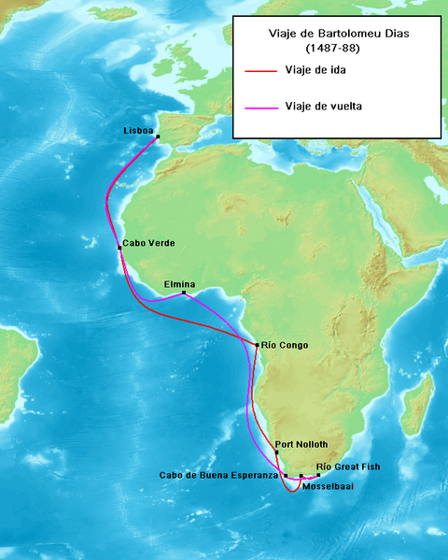
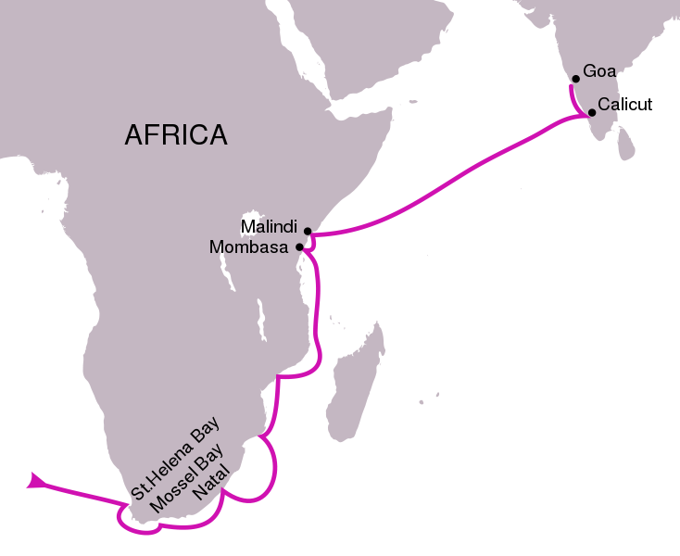

Slide 10
Brazil
Portugal’s major colony in the New World
Administrative structure was similar to that of Spain in the New World (viceroyalties)
In the 17th century, large numbers of slaves from Africa were imported for production of coffee and cotton and most importantly, sugar (18th century).
A significant racial mixture between whites, American Indians and blacks resulted.

Slide 11
Spain
Christopher Columbus (1451-1506): wanted to compete with Portuguese expansion
Ferdinand and Isabella financed Columbus’ voyage.
1492, Columbus reached the Bahamas, believing he had reached the “Indies” somewhere west of India.
His four expeditions charted most of the major islands in the Caribbean as well as Honduras in Central America.
The monumental significance of Columbus’ expeditions was that it ushered in an era of European exploration and domination of the New World.

Slide 12
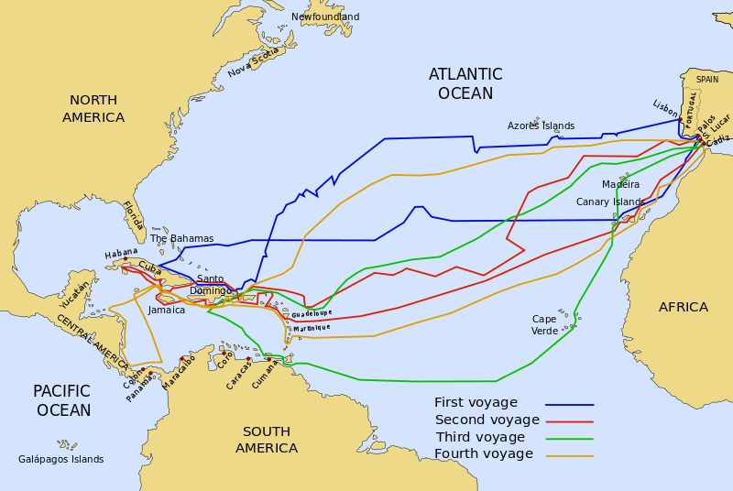

Slide 13
Bartholomew (Bartalome) de Las Casas (1474-1566)
Priest and former conquistador whose father had accompanied Columbus on his 2nd voyage
A Brief Account of the Destruction of the Indies (1542)
Publicly criticized the ruthlessness with which Columbus and his successors treated the American Indians.
His writings helped spread the “black legend” in Protestant countries
Spain was accused of using Christianity ostensibly for killing countless natives.
In reality, Protestant countries, like England, were just as guilty of decimating American Indian populations.

Slide 14
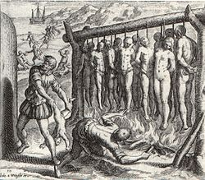

Slide 15
Treaty of Tordesillas (1494)
Spain sought to secure Columbus’ discoveries in the New World.
Provisions:
The New World was divided between Spain and Portugal (at the behest of Pope Leo V).
A north-south line was drawn down the middle of the Atlantic Ocean: Spain’s territory was west of the line; Portugal’s was east
Portugal was granted exclusive rights to the African slave trade.
Portugal retained Brazil and its claims to Africa while Spain received the rest of the Americas.

Slide 16
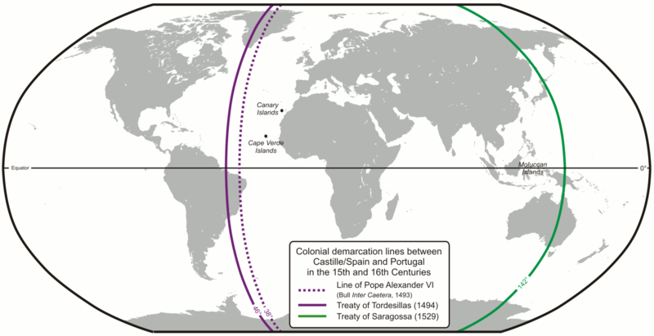

Slide 17
Spanish Conquest
Spanish conquistadores: began creating Spain’s New World empire by conquering American Indians
Hernando Cortès (1495-1547): conquered the Aztecs in Mesoamerica in 1521
Francisco Pizarro: conquered the Inca in Peru in 1532

Slide 18
Golden Age of Spain
The empire was divided into four vice-royalties, each led by a viceroy.
It was mercantilist in philosophy from the early-16th century onward.
Colonies existed for the benefit of the mother country.
The mining of gold and silver was most important
the Crown got 1/5 of all precious metals); this accounted for 25% of the crown’s total income.
In 1545, the opening of the world’s richest silver mines at Potosí in Peru ushered in the “golden age.”
Spain shipped manufactured goods to America

Slide 20
Encomienda System
Motive: the Spanish government sought to reduce the savage exploitation of American Indians in the Spanish empire.
In reality, the laws against exploitation were poorly enforced.
System: American Indians worked for an owner for certain number of days per week but retained other parcels of land to work for themselves.
Spain’s ability to forcibly utilize American Indian labor was a major reason why the Spanish Empire imported few slaves from Africa.

Slide 21
Social Groups in Spanish Colonies
Creoles:
Spaniards who were born in the New World to Spanish parents
Eventually, they came to dominate politics in the empire and later, independence movements.
Mestizos
Spaniards married American Indian women creating children of mixed white and Native American descent.
Relatively few Spanish women came to the New World during the 16th and 17th centuries.

Slide 22
“Old Imperialism”- Africa and Asia
The establishment of posts and forts on coastal regions but not penetration inland
Posed a sharp contrast to Spanish imperialism in the New World
Posed a sharp contrast to the late-19th and early 20th-century pattern of “New Imperialism”
Portugal had set up forts along the African coast by 1495
Da Gama had created trading posts in Goa and Calcutta (India)
Alphonso d’Albuquerque had established the imperial patterns that would allow Portugal to dominate the Indian Ocean Region in 16th and 17th centuries.
Jesuit missionaries had traveled to east Asia and converted many to Catholicism

Slide 23
Other European Claims
Dutch Republic (Netherlands)
The Dutch East India Company was founded in 1602 and became the major force behind Dutch imperialism.
Expelled the Portuguese from Ceylon (Sri Lanka) and other Spice Islands (Indonesia).
By 1650, began challenging Spain in the New World and controlled much of the American and African trade
France
Quebec, France’s first settlement in the New World, was not founded until 1608.
France eventually lay claim to over one-half of North America before being expelled in 1763.

Slide 25
England
The first permanent settlement in North America was not founded until 1607 in Jamestown (Virginia).
Tens of thousands of Englishmen came to the eastern coast of North America in the 17th and 18th centuries
Far more English came to the New World than the French, Spanish and Portuguese combined;
By 1775 2.5 million Europeans lived in the original thirteen American colonies

