Slide 1
Age of Absolutism
1600-1750
Notes:
Are your classroom colors different than what you see in this template? That’s OK! Click on Design -> Variants (the down arrow) -> Pick the color scheme that works for you!
Feel free to change any “You will…” and “I will…” statements to ensure they align with your classroom procedures and rules!

Slide 2
Introduction
With the growth of overseas empires in the 1400’s and 1500’s European monarchs found themselves the heads of wealth states
Monarchs began to consolidate their power
European monarchs sought to take control away from traditional noble families and institutions.
The age of absolutism began with the ascension of James I to the English throne in 1601
The height of the age of absolutism occurred in 1700s in France and Russia

Slide 3
Characteristics of Absolute Rulers
Absolute rulers were often kings or queens (emperors/empresses)
Gain their position through hereditary or marriage
They have complete political control
The rulers make the law and execute the law
Absolute rulers are in essence the “state”
Absolute Monarchs can outlaw
Religion
Speech
Assembly
Political parties
They maintain and enforce their rule through the use of a military

Slide 4
Divine Right
The idea that a monarch is anointed by God
This means that God has granted the individual the right to rule
This lessens the need for the Pope as a figure that “makes” kings
This had begun during the Protestant Reformation
The concept of divine right of kings becomes one of the most important ways absolute monarchs legitimized their rule

Slide 5
Challenges to Old Orders
The rise of absolute monarchs in western and eastern Europe challenged old orders
The rise of these absolute rulers will eventually lead to the fragmentation of the Holy Roman Empire
The balance of power in Europe changed with the decline of Spain and the Ottoman Empire as major players in European political and economic affairs
The policies of absolute monarchs will eventually give rise to the Enlightenment and the political revolutions of the late 18th and early 19th centuries.

Slide 6
Absolute Monarchs

Slide 7
France
Louis XIV (1643-1715)
He personified the idea that the sovereignty of the state resides in the ruler.
“L’ état, c’est moi” (“I am the state”)
He became known as the “Sun King” since he was at the center of French power (just as the sun is the center of our solar system).
Strong believer in “divine right” of kings
France became the undisputed major power in Europe during his reign.
Under Louis XIV, the Palace at Versailles became the grandest and most impressive palace in all of Europe.
The awe-inspiring scale of the palace reinforced his image as the most powerful absolute ruler in Europe.
Versailles Palace became, in effect, a pleasure prison for the French nobility. a. Louis gained absolute control over the nobility
He also fought several expensive wars across Europe

Slide 9
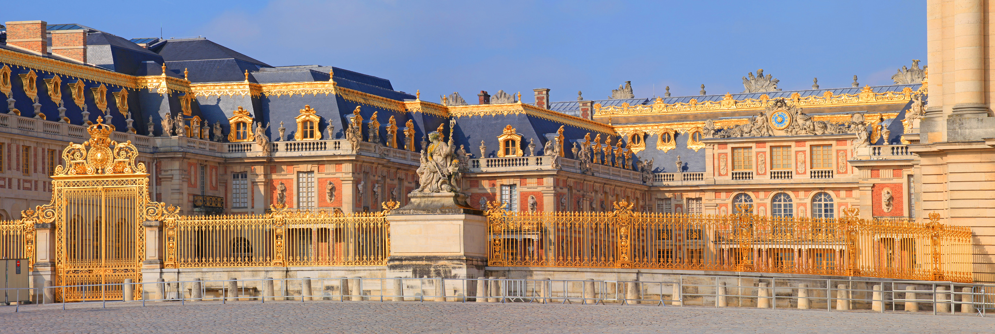
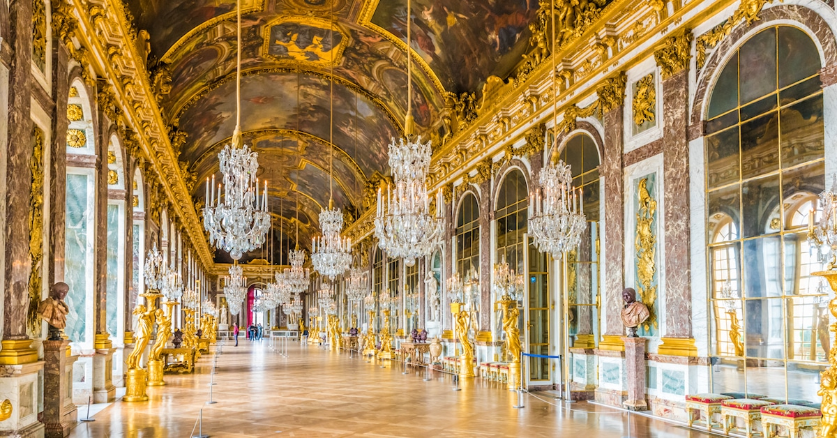

Slide 10
Russia
Under the early tsars (czars) Russia had lagged behind western Europe in terms of technological and economic development
Peter the Great (1682-1725)
Came to the throne at a young age
Did not take direct rule until the age of 22
He main concern early on was making Russia a formidable military power
Began a series of initiatives to westernize Russia
This includes changing dress, religion, architecture, military power, and moving the capital

Slide 12
Other Absolute Rulers
Hapsburg Dynasty
Located primarily in what is today Austria
They had traditionally been elected as the Holy Roman Emperors
Between 1619 and 1740 the Hapsburg rulers consolidated their power
Prussia
The House of Hohenzollern (ruled in Brandenburg which was a principality of the Holy Roman Empire)
By the 1600s the rulers of Brandenburg were less involved in the affairs of the HRE
Through marriage the Hohenzollerns began to take territory in western Germany
Between 1600 and 1800 the Hohenzollern rulers would consolidate power culminating in the reign of Frederick II (Frederick the Great)
The Prussian state will be leader in the movement for German unification in the mid and late 1800’s

Slide 13
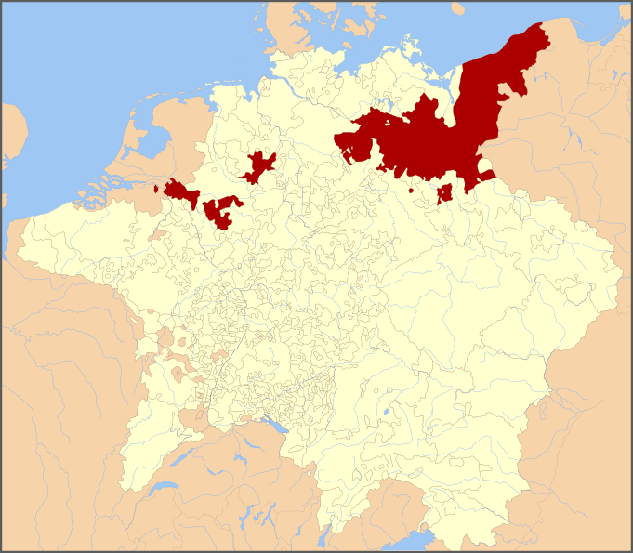
Hohenzollern territory added through marriage.
Brandenburg (Prussia) principality during the Holy Roman Empire. Ruled by the Hohenzollern Family

Slide 14
England
The Tudor dynasty came to an end in 1603 with the death of Elizabeth I.
She dies without an heir and the thrown passed to her cousins son, James I (James VI o Scotland)
This establishes the Stuart line of English monarchs
James I (1603-1625) tries to institute absolute policies
He dissolves parliament twice
Charles I (1625-1649) (son of James I) believed in divine right of kings
He often disagreed with parliament
His relationship with parliament led to the English Civil Wars (1642-1651)
Absolutism largely fails in England. The Glorious Revolution (1688) and the English Bill of Rights (1689) set England on the path toward constitutionalism

Slide 15
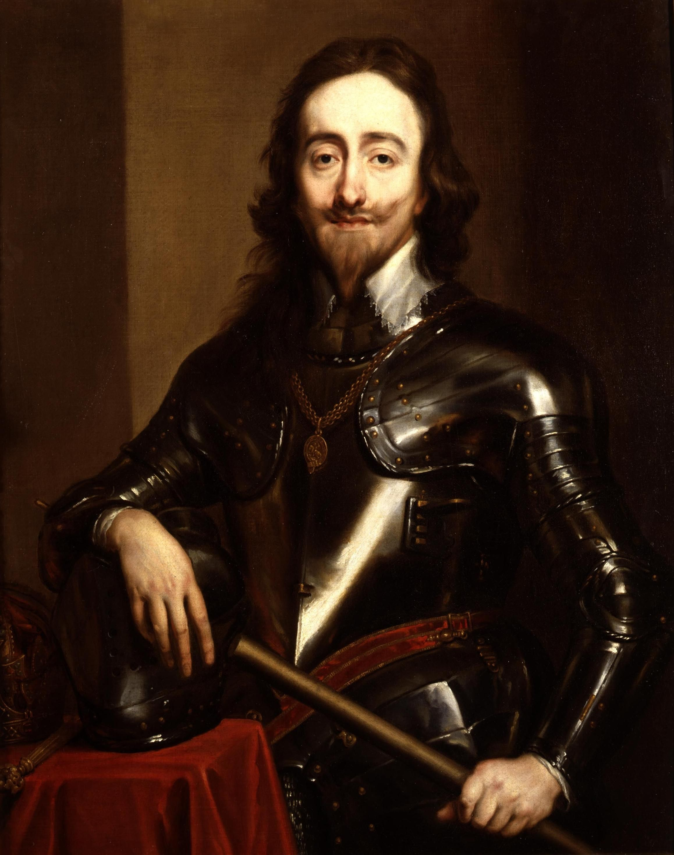
James I
Charles

