Slide 1
African Civilizations of the Middle Ages

Slide 2
African Societies
Characteristics of Stateless Societies
Lacking concentrated political power & authority
Power exercised by rulers or a council of families
No taxes
Some secret societies
Many thrived
The spread of Islam through much of the northern third of Africa resulted in more trade & commerce
Military power and dynastic alliances based on cultural unity
Stateless Societies:
Organized around kinship

Slide 3
Animistic religion was commonly practiced throughout much of Africa
Economics:
Based on Agriculture
Trade
Specialization
Kinship groups sometimes controlled trade

Slide 4
The Arrival of Islam to N. Africa
As part of the Roman & Greek Empires Christianity was main religion
Muhammad’s followers swept across N. Africa spreading Islam
Arab & Berber armies
Spread of Islam into Europe was stopped by Charles Martel & the Franks at the Battle of Tours
Islam appealed to African kings the most

Slide 5
Christian Kingdoms
Two Christian Kingdoms: Axum and Ethiopia
King Lalibela- King of Ethiopia
Built Christian state
Built 12 stone churches

Slide 6
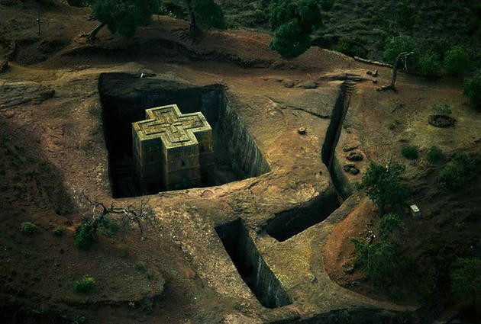
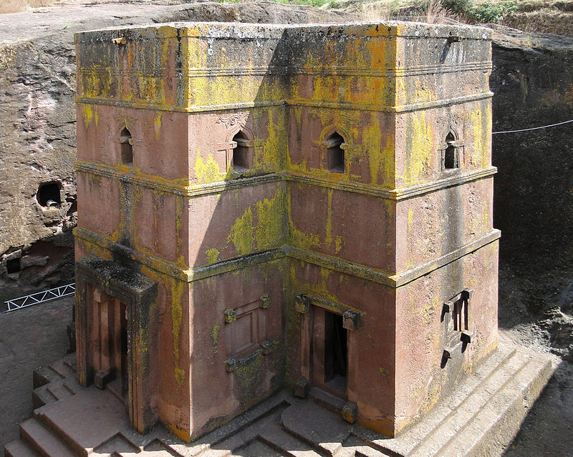
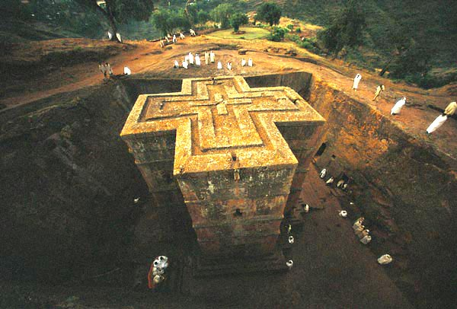
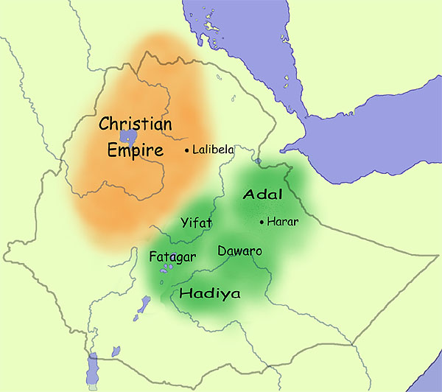
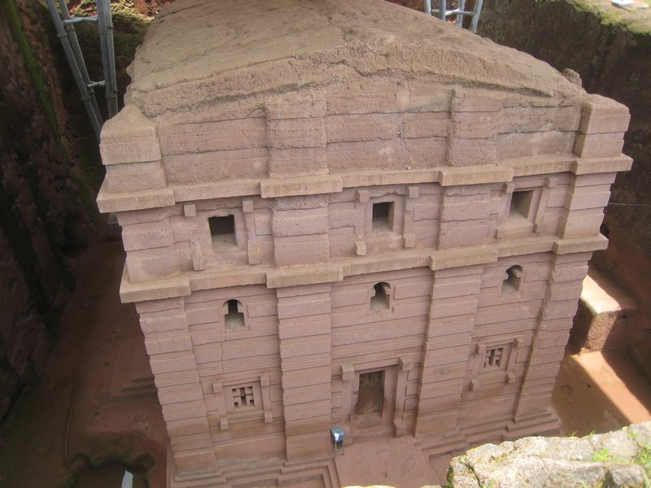

Slide 7
Kingdoms the Grasslands
Islam spread via travelers & merchants
Ghana was powerful
Taxed salt & gold
Islam was considered a “royal cult”
Islam reinforced indigenous ideas of kinship

Slide 8
Mali was the second of the grassland kingdoms.
Juula – Malinke merchants
Gold
Sundiata- takes the title mansa (ruler)
Mansa Musa (greatest leader in Mali)
Makes a pilgrimage to Mecca
Ibn Battuta- A Muslim traveler that recorded journals of his travels.

Slide 9
Jenne & Timbuktu two important trading cities
Thrived with expansion on Mali, Songhay
Songhay was the last grassland kingdom
Sunni Ali (1464-1492): 1st king
Expanded territory

Slide 10
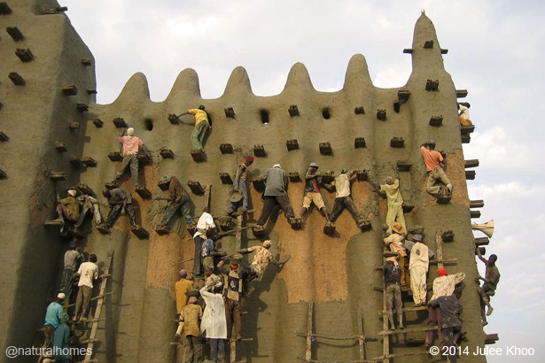
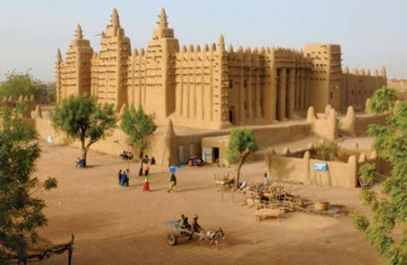
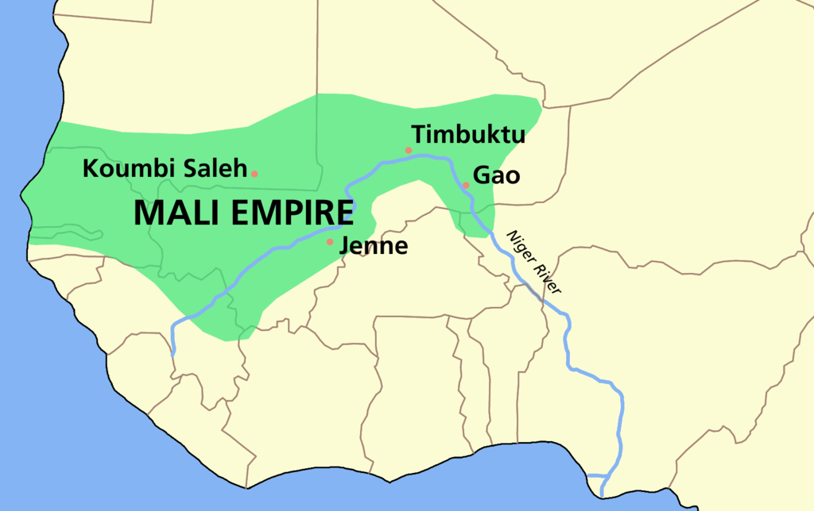
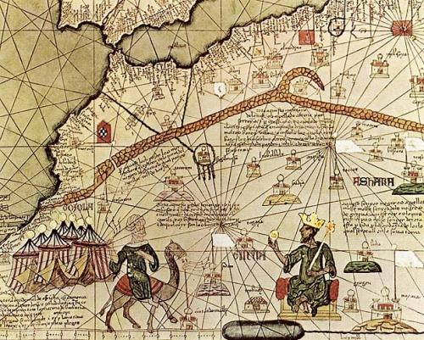

Slide 11
Political and Social life in Sudanic States
Common religion and law (Sharia) provided solidarity
Slavery and slave trade between black Africa and the rest of the Islamic world impacted women and children
In theory, Muslims viewed slavery as a process of conversion for pagans

